Slide 1
THE ASTROSMART PROJECT
AN EXPERIMENT OF SCIENTIFIC TOURISM
INAF – OAPa
Istituto Nazionale di Astrofisica
Osservatorio Astronomico di Palermo «Giuseppe S. Vaiana»
The Hitchhiker’s Guide to the Galaxy
San Donato in Poggio, 11-13 July 2018
Giulia Amodeo INAF - OAPa

Slide 2
Since March 2018 the INAF - Astronomical Observatory of Palermo has implemented a project, financed by the Sicilian Region, European Social Fund 2014 – 2020
TO
strengthen employability in the research and development system and the birth of research spin-offs in Sicily
The Hitchhiker’s Guide to the Galaxy
San Donato in Poggio, 11-13 July 2018
Giulia Amodeo INAF - OAPa

Slide 3
What is the context where this initiative fits in?
WHY NOW?
The Hitchhiker’s Guide to the Galaxy
San Donato in Poggio, 11-13 July 2018
Giulia Amodeo INAF - OAPa

Slide 4
2015
Palazzo dei Normanni – UNESCO World Heritage Site
Focus on Museo
della Specola
re-opening within 2018
2018 Palermo: Italian Capital of Culture
More opportunities to promote alternative cultural activities
The Hitchhiker’s Guide to the Galaxy
San Donato in Poggio, 11-13 July 2018
Giulia Amodeo INAF - OAPa

Slide 5
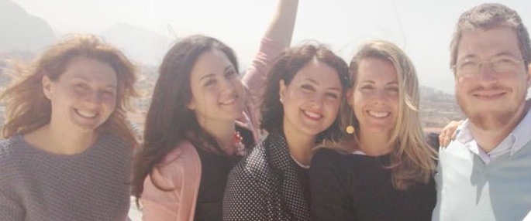
THE PROJECT “ASTROSMART”
The five scholarship holders currently engaged in this experience for 18 months
have different educational backgrounds and skills
Interdisciplinary projects and results
The Hitchhiker’s Guide to the Galaxy
San Donato in Poggio, 11-13 July 2018
Giulia Amodeo INAF - OAPa

Slide 6
THE EDUCATIONAL PATH
Learning on the job
Taught class
management
communication
experimentation of innovative fruition methodologies of cultural heritage
organization of promotional events
communication and relations with the territory
marketing of scientific cultural heritage
business planning
market analysis
marketing administration
finance, intellectual protection and certification
access to public and private funds
coordination and management of European projects
The Hitchhiker’s Guide to the Galaxy
San Donato in Poggio, 11-13 July 2018
Giulia Amodeo INAF - OAPa

Slide 7
Achieved projects
The Hitchhiker’s Guide to the Galaxy
San Donato in Poggio, 11-13 July 2018
Giulia Amodeo INAF - OAPa

Slide 8
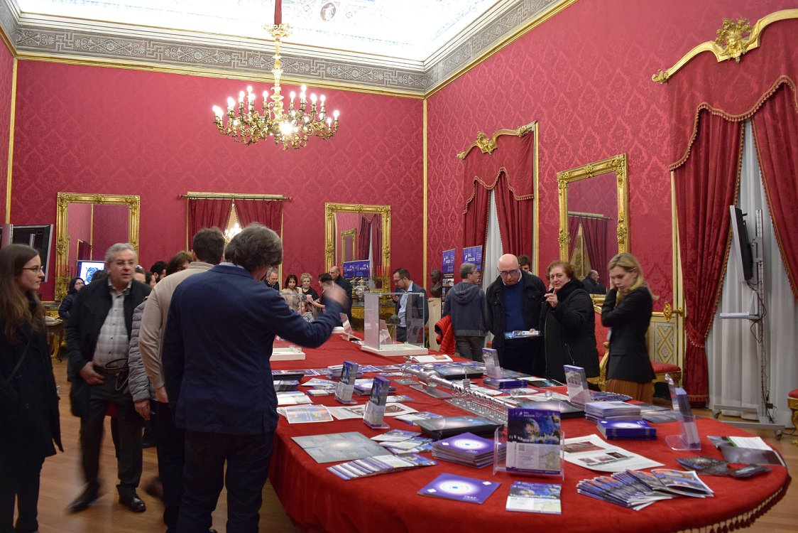
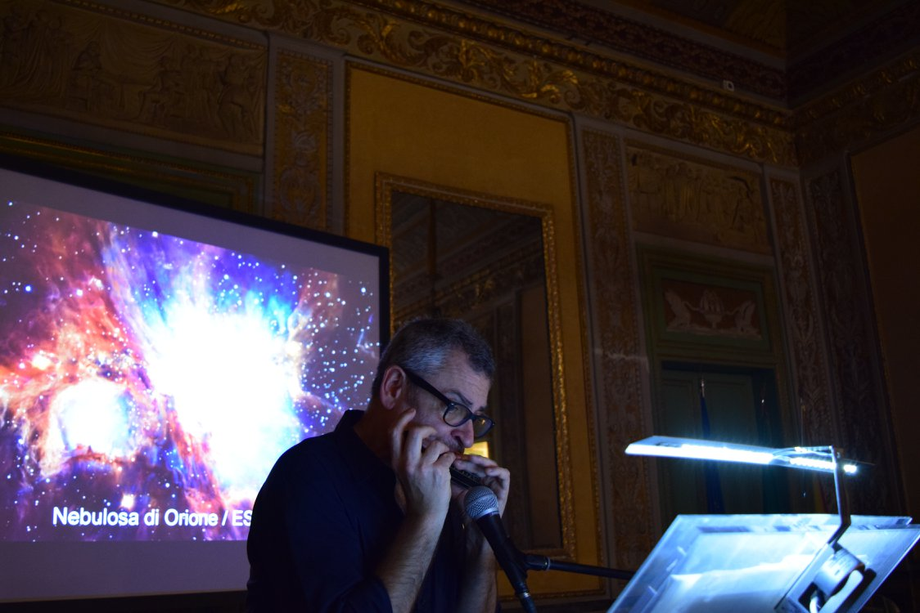
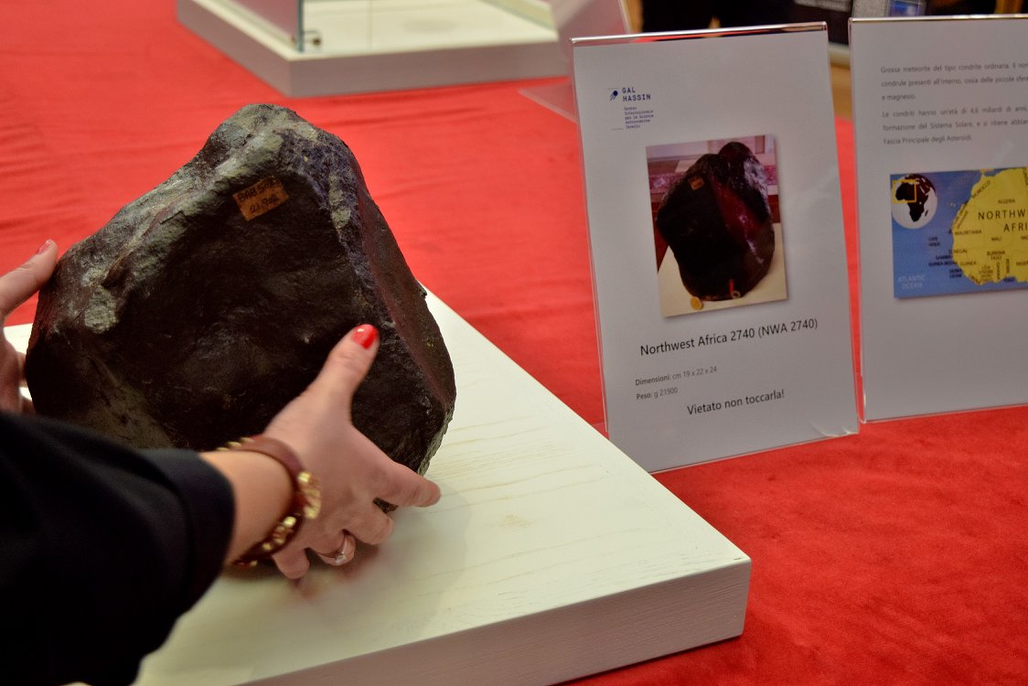
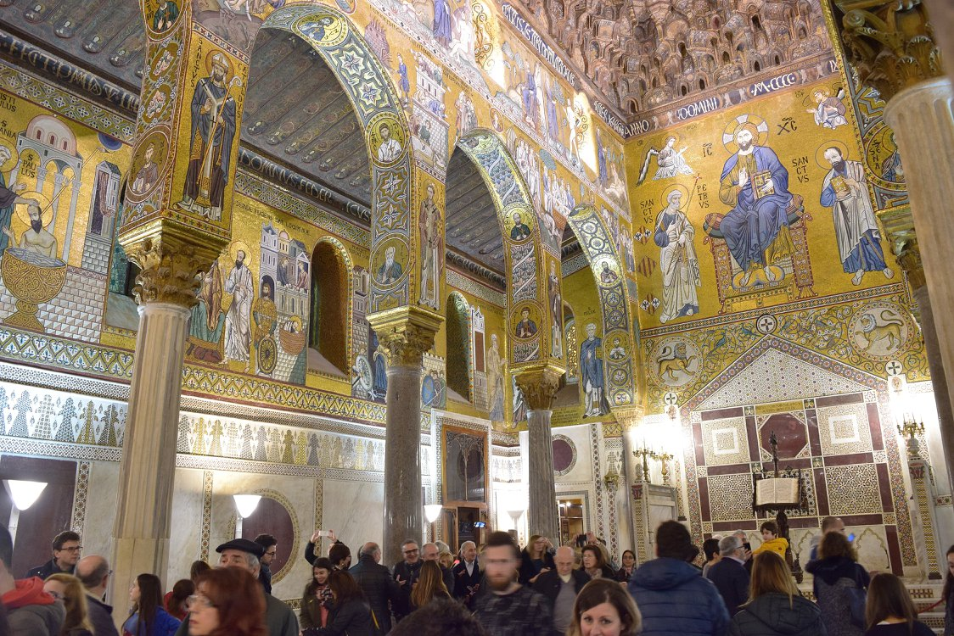
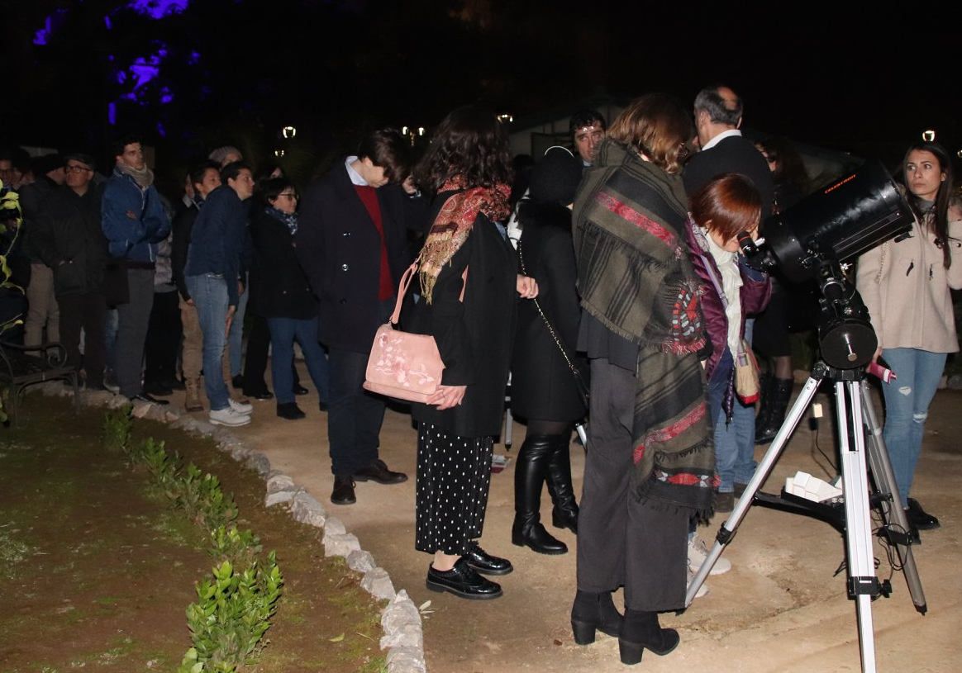
NOTTE BIANCA DELL’UNESCO
20.000 citizens and tourists visited
for free the Palazzo dei Normanni
The Hitchhiker’s Guide to the Galaxy
San Donato in Poggio, 11-13 July 2018
Giulia Amodeo INAF - OAPa

Slide 9
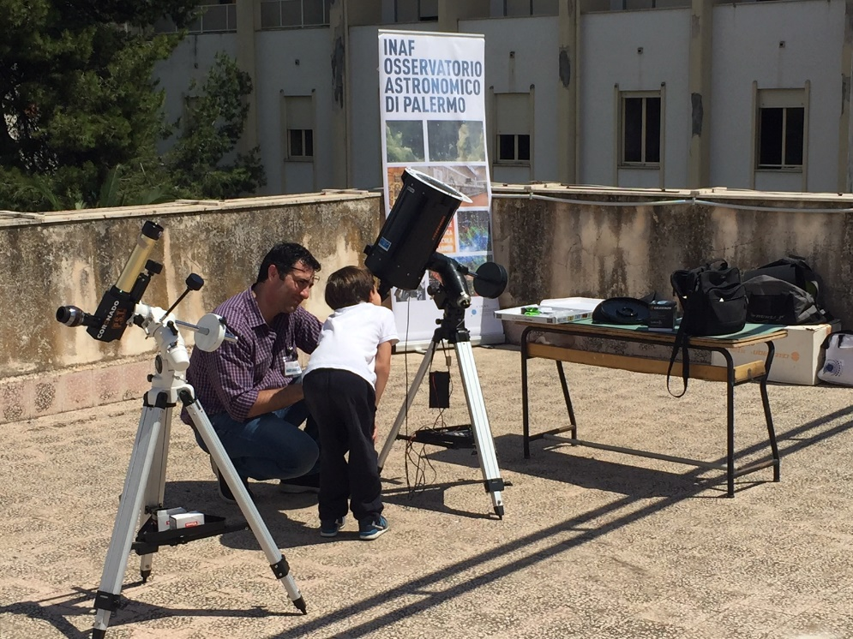
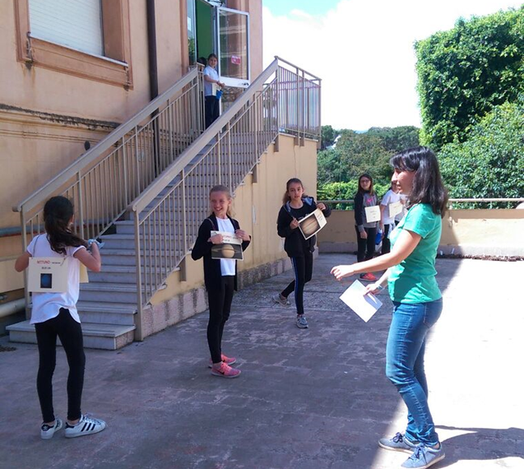
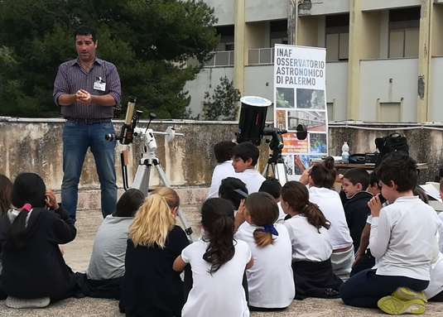
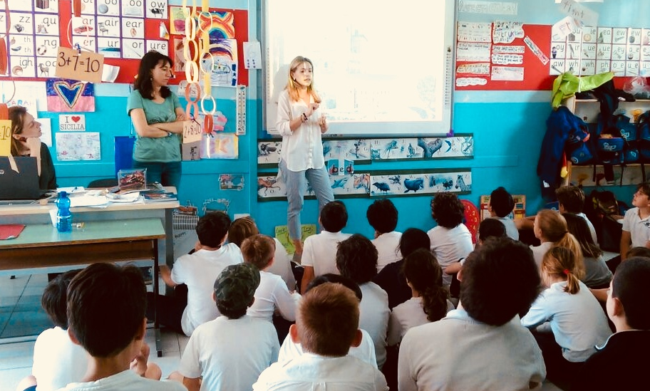
INTERNATIONAL SCHOOL PALERMO
100 students from Primary to High School for one full day, enjoyed astrophysics subject through conference, educational workshops and solar observations
The Hitchhiker’s Guide to the Galaxy
San Donato in Poggio, 11-13 July 2018
Giulia Amodeo INAF - OAPa

Slide 10
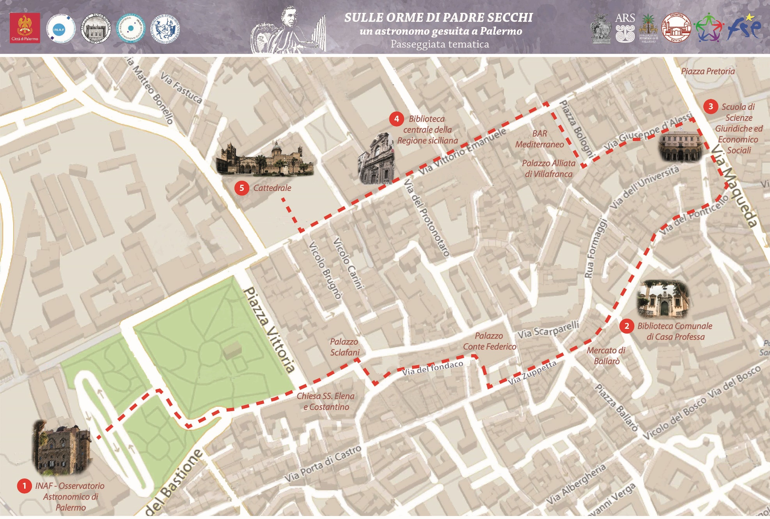
HISTORY WALK
In the footstep of Father Secchi:
A Jesuit astronomer in Palermo
The Hitchhiker’s Guide to the Galaxy
San Donato in Poggio, 11-13 July 2018
Giulia Amodeo INAF - OAPa

Slide 11
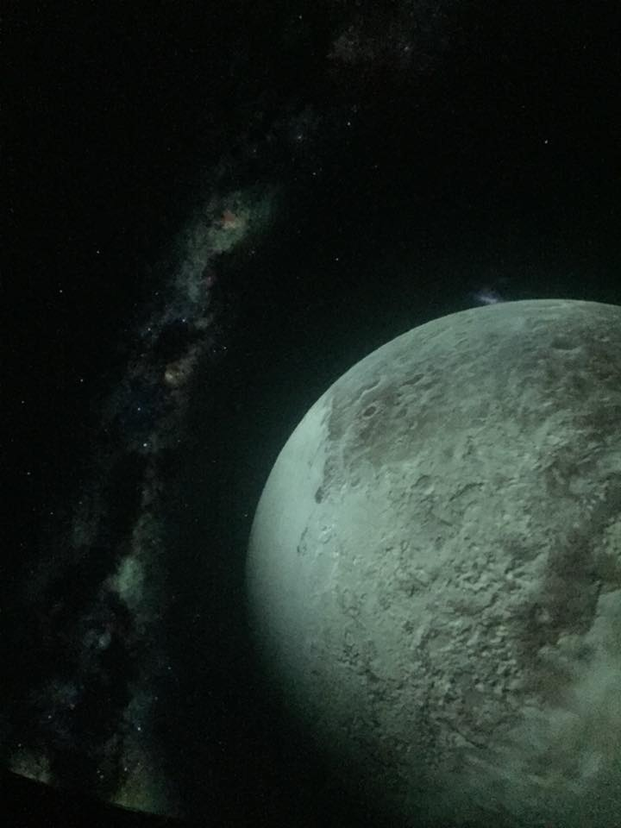
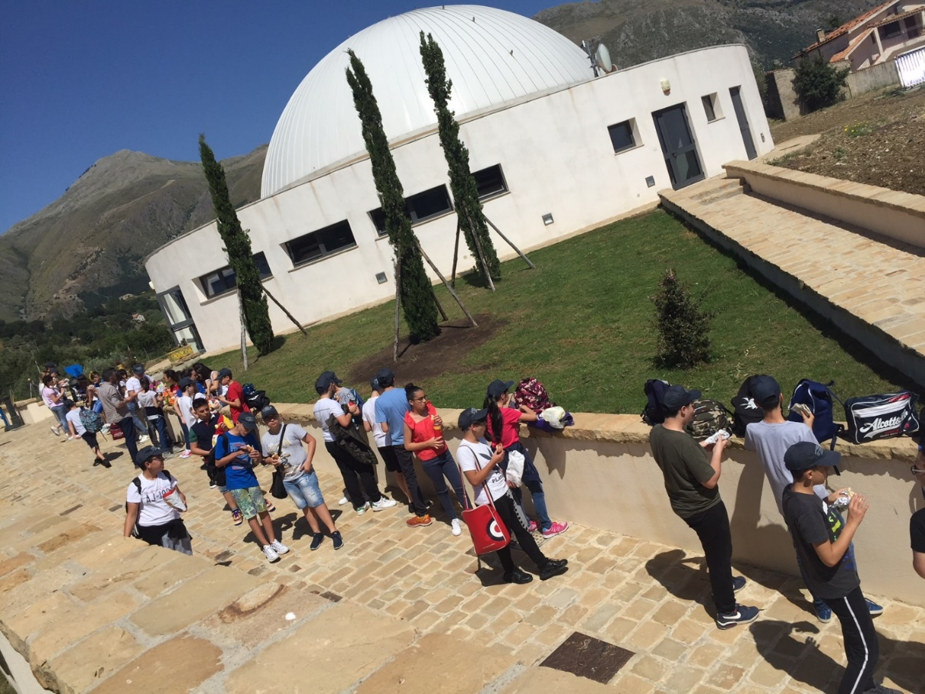
INTERNATIONAL CENTRE FOR ASTRONOMICAL SCIENCES – GAL HASSIN, ISNELLO (PA)
Internship
The Hitchhiker’s Guide to the Galaxy
San Donato in Poggio, 11-13 July 2018
Giulia Amodeo INAF - OAPa

Slide 12
ONGOING projects
The Hitchhiker’s Guide to the Galaxy
San Donato in Poggio, 11-13 July 2018
Giulia Amodeo INAF - OAPa

Slide 13
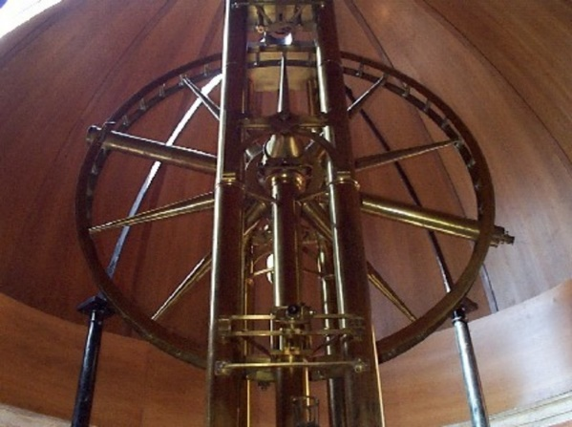
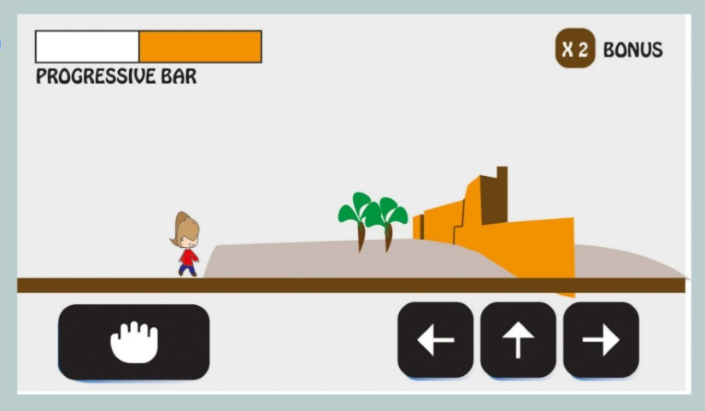
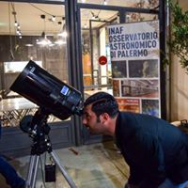
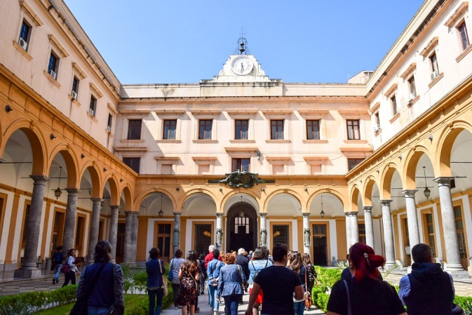
Game design about Museo della Specola
App design about Padre Angelo Secchi walking tour
Writing and publishing a Palermo guide with some astronomical tours
Breaking through the walls in cultural heritage enjoyment
The Hitchhiker’s Guide to the Galaxy
San Donato in Poggio, 11-13 July 2018
Giulia Amodeo INAF - OAPa

Slide 14
PROVINCE and regional ITINERARIES
The Hitchhiker’s Guide to the Galaxy
San Donato in Poggio, July, 11st – 13rd 2018
Giulia Amodeo INAF - OAPa

Slide 15
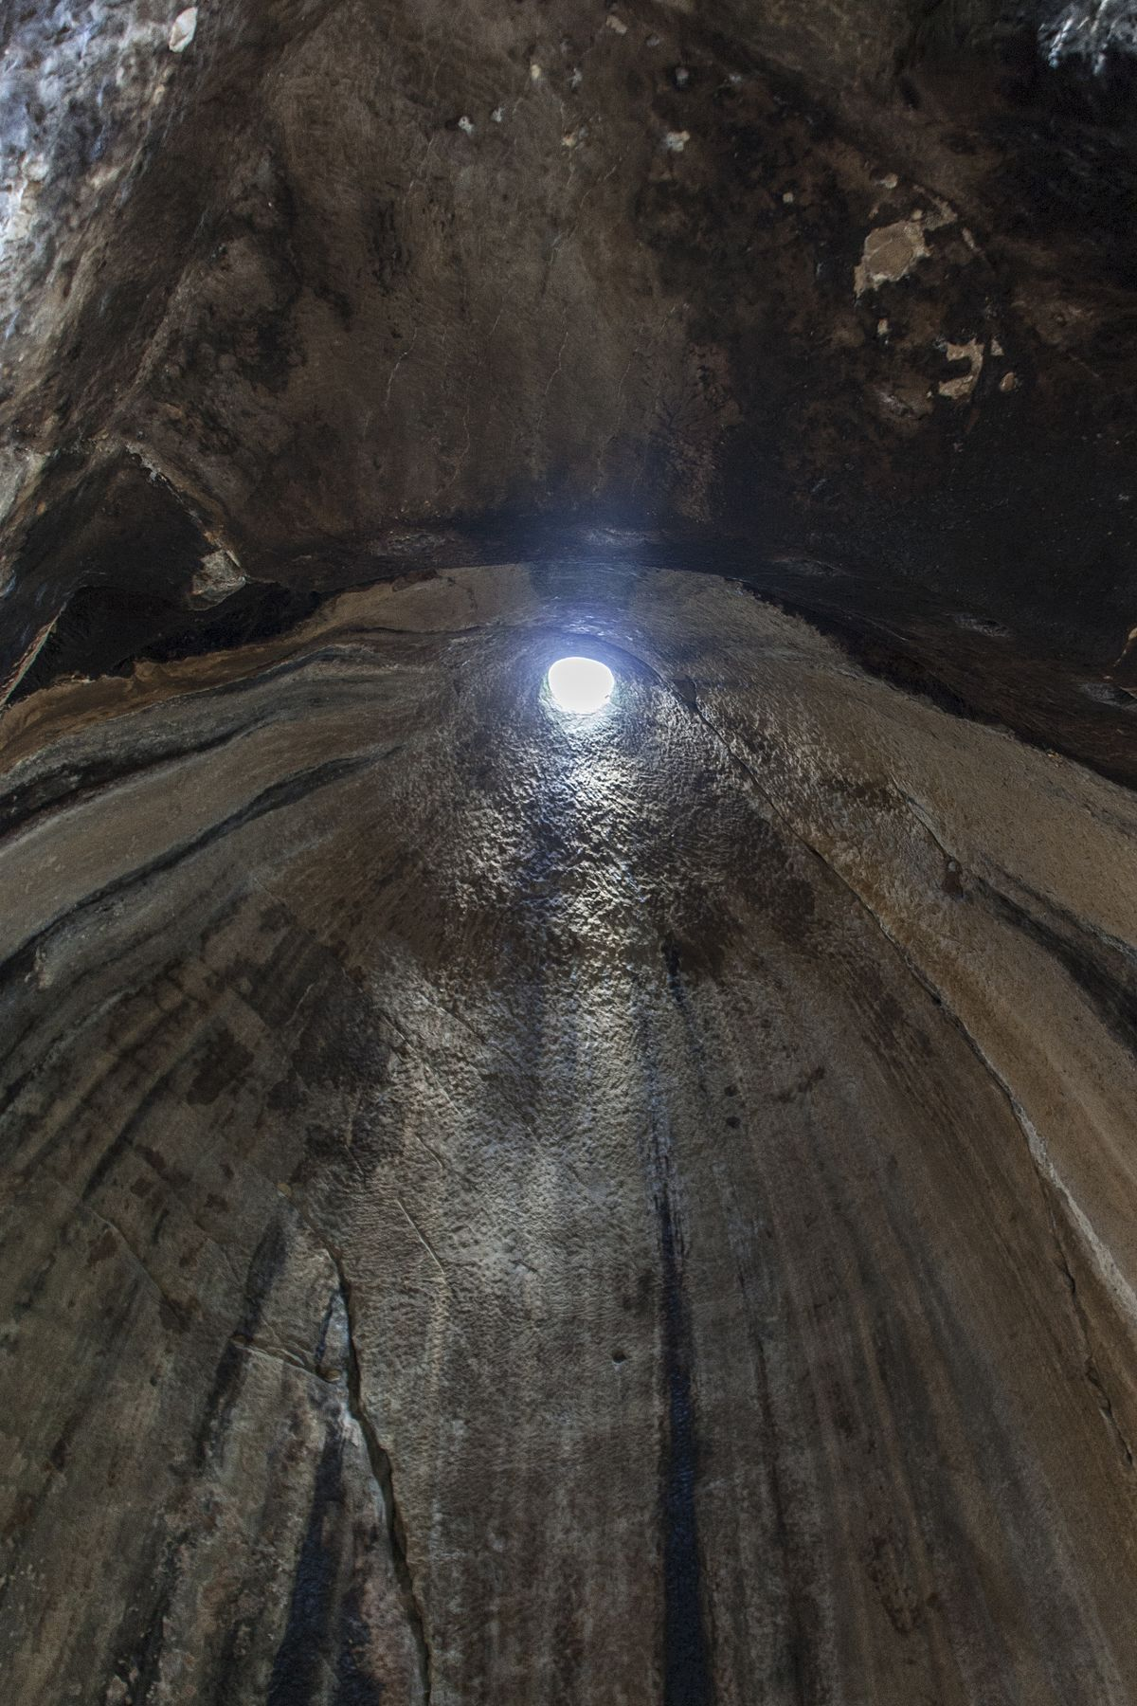
Gurfa caves, Alia (PA)

Slide 16
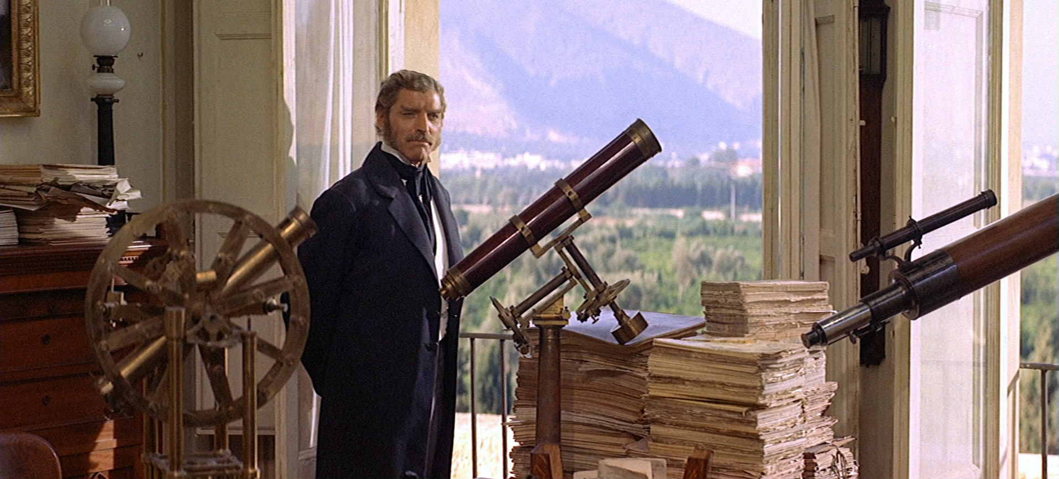
GATTOPARDO, Luchino Visconti

Slide 17
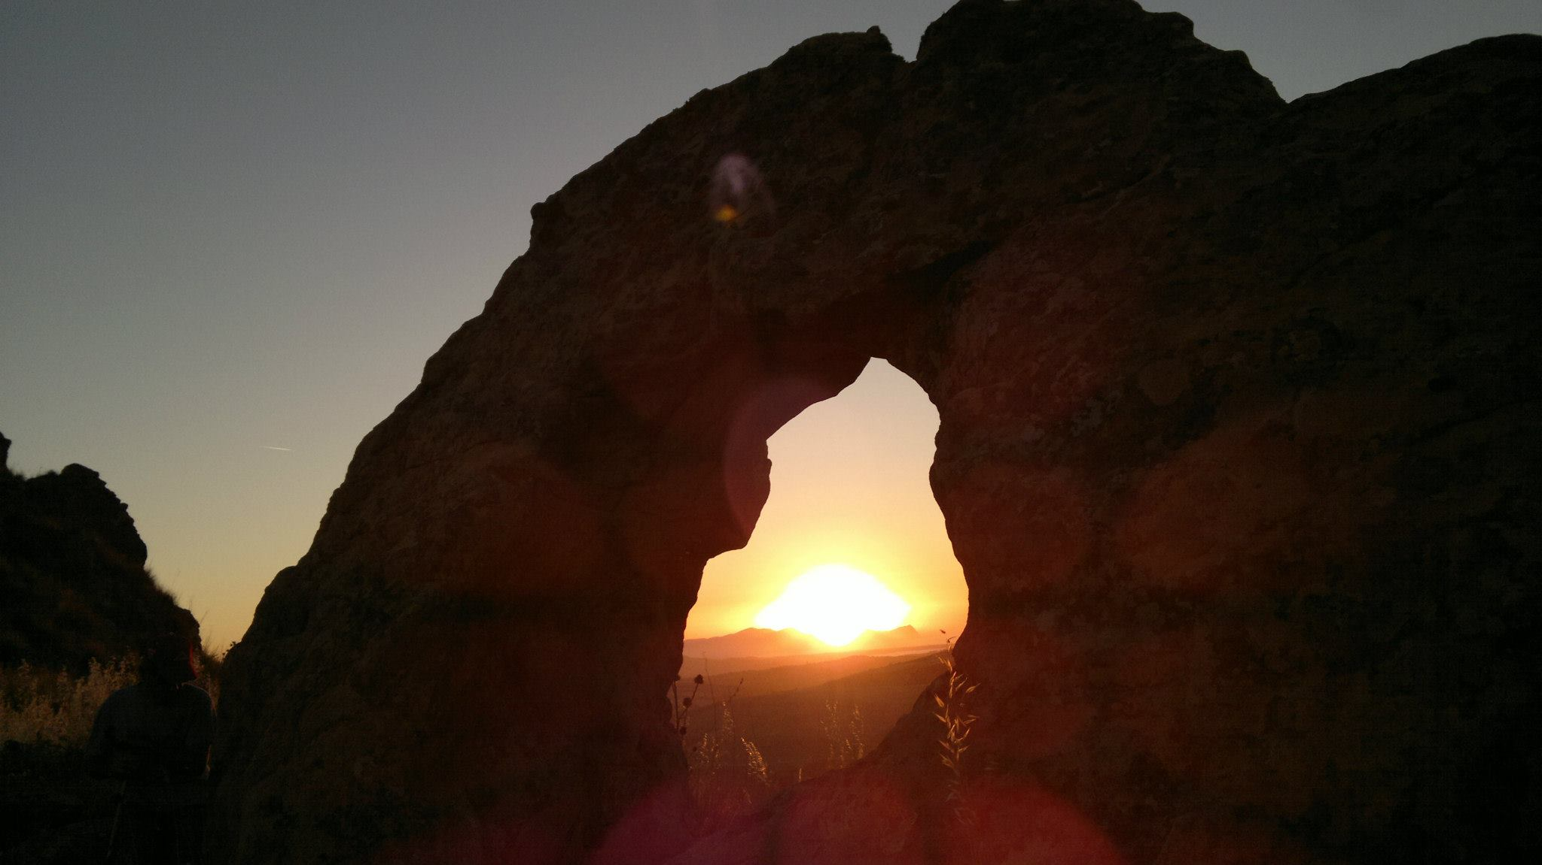
«I Campanari», Monte Iato (PA)

Slide 18
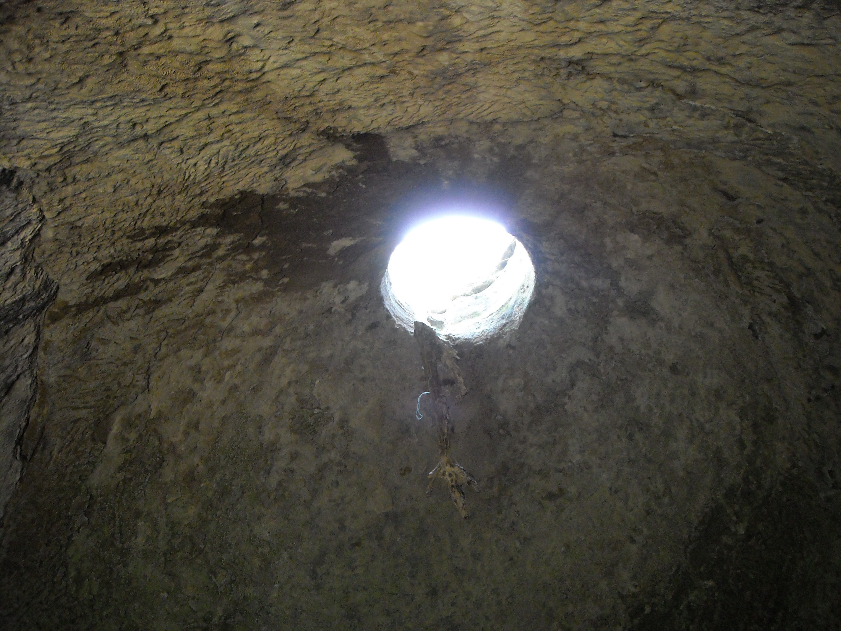
Tholoi, Monte Raitano (PA)

Slide 19
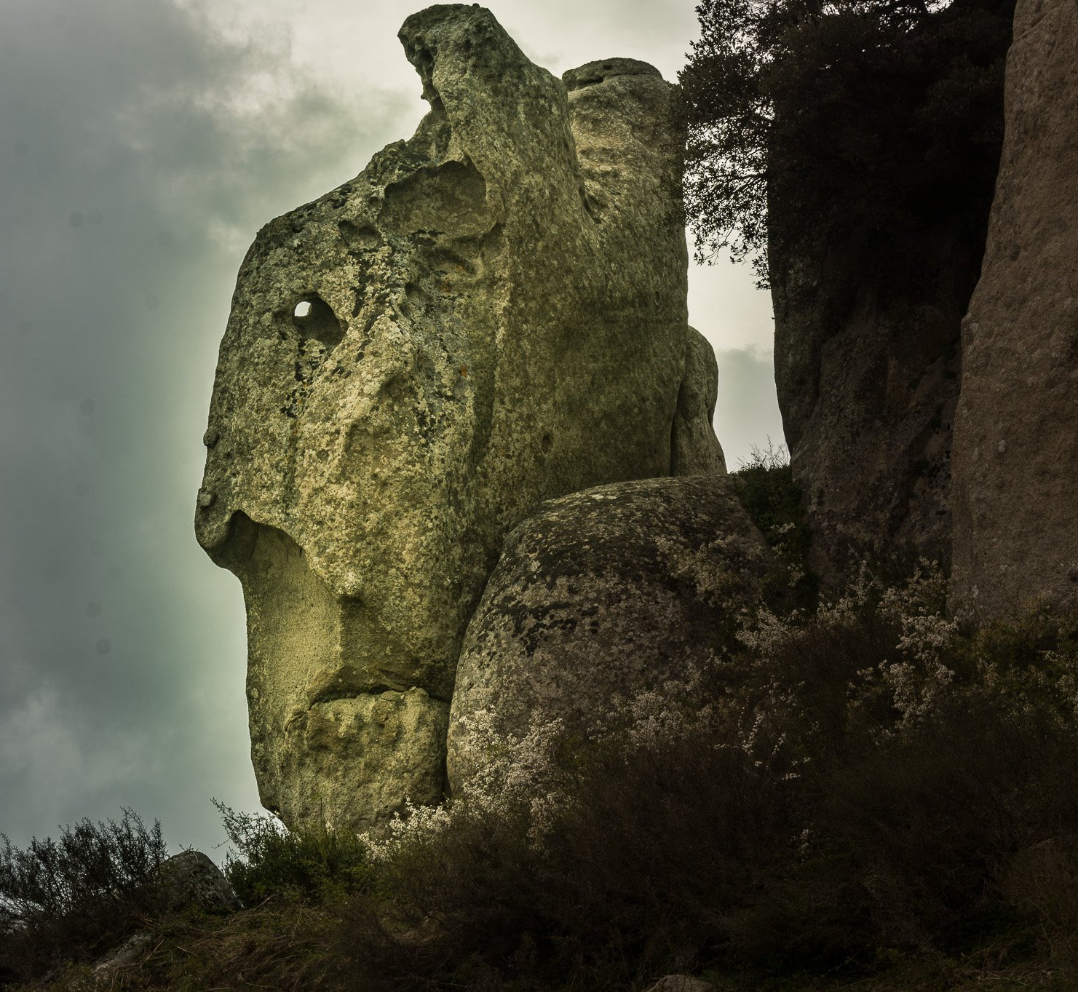
Argimusco tableland:
the Priest (ME)

Slide 20
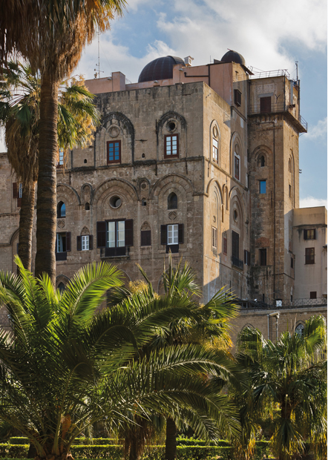
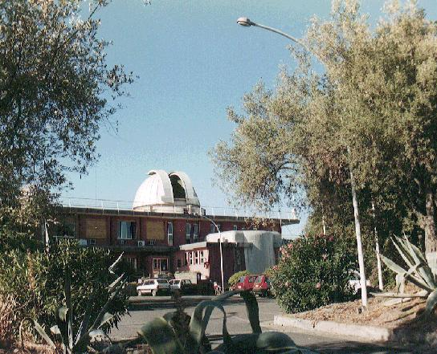
Astronomical Observatory, Palermo
Astronomical Observatory, Catania

Slide 21
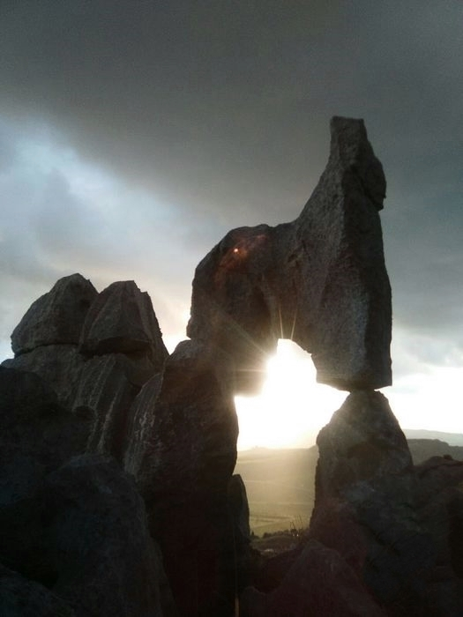
The stone-calendar, Castellammare del Golfo (TP)

Slide 22
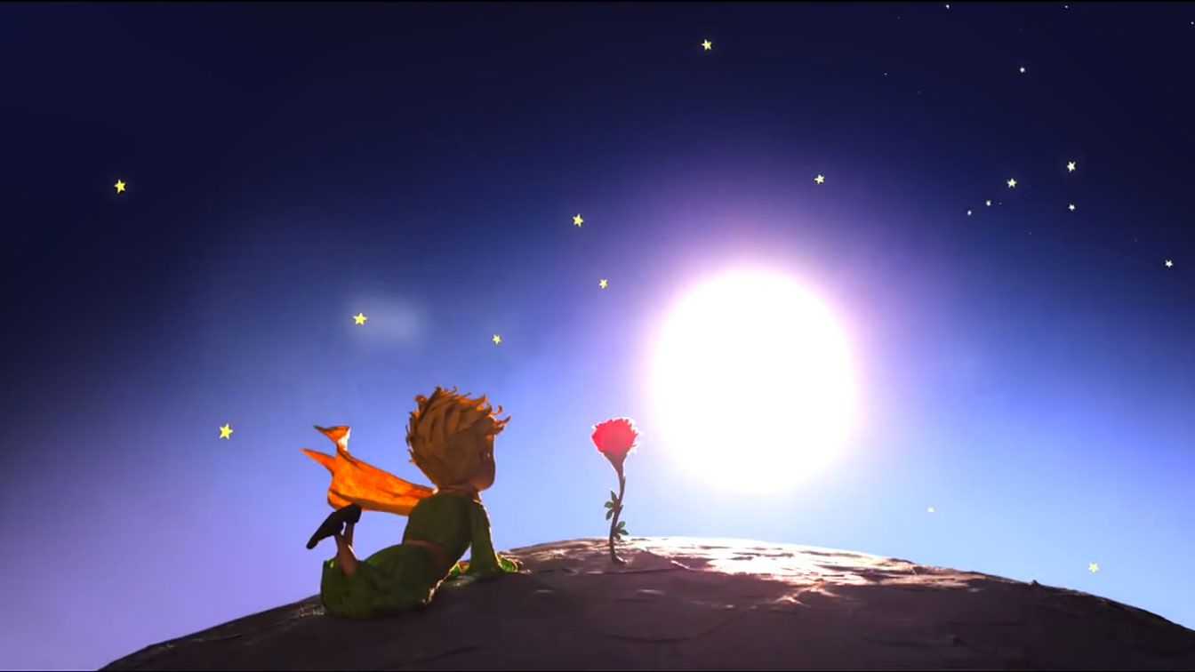
OUR FUTURE AFTER ASTROSMART….
The Hitchhiker’s Guide to the Galaxy
San Donato in Poggio, 11-13 July 2018
Giulia Amodeo INAF - OAPa

Slide 23
Building up a sustainable and inclusive
tourist offer that integrates historical heritage
with natural landscapes through astronomical itinerary
The Hitchhiker’s Guide to the Galaxy
San Donato in Poggio, 11-13 July 2018
Giulia Amodeo INAF - OAPa

Slide 24
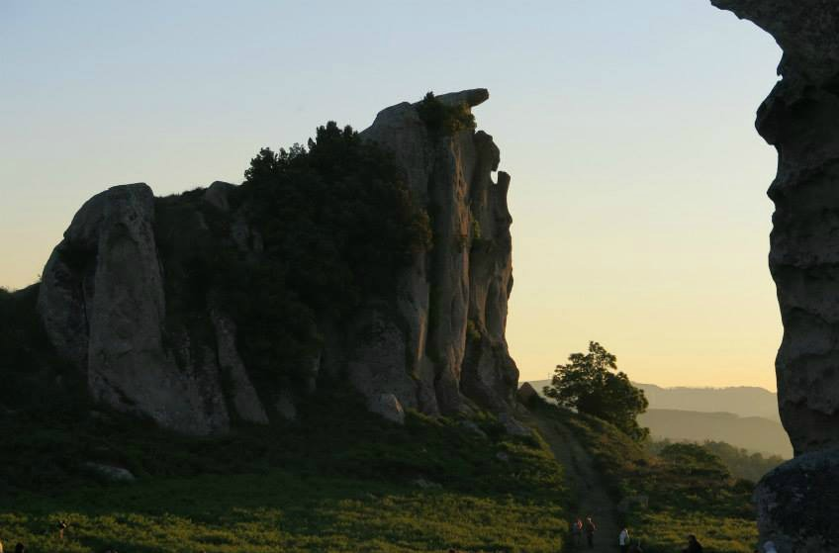
ThANK YOU FOR YOUR KIND ATTENTION
e-mail: gamodeo@astropa.inaf.it
The Hitchhiker’s Guide to the Galaxy
San Donato in Poggio, 11-13July 2018
Giulia Amodeo INAF - OAPa

