Slide 1
Discovering and Exploiting the Italian Cultural Astronomical Heritage: the contribution of the Società Italiana di Archeoastronomia (SIA)
Giangiacomo Gandolfi
SIA – SEAC – Planetario di Roma

Slide 2
Astrotourism stands on two main legs:
Dark Sky Areas and Observatory Sites
Heritage Sites of Astronomy and Archeoastronomy
I would like to focus on the second component in the italian scenario, introducing the fundamental role of SIA, the only academic society concentrating professionally both on the study of Archeoastronomy and History of Astronomy and on the preservation and promotion of their heritage.

Slide 3
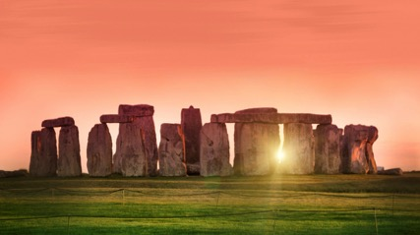
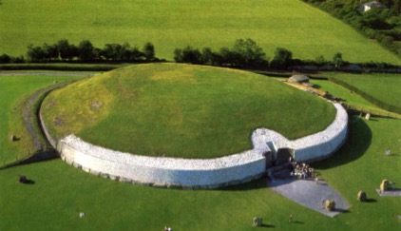
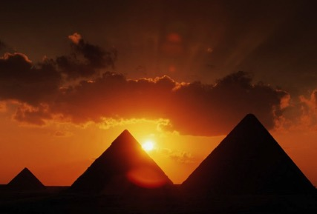
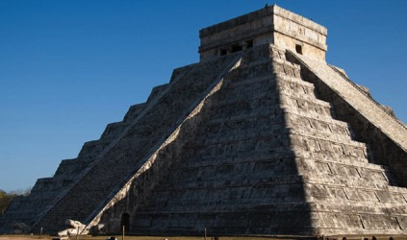
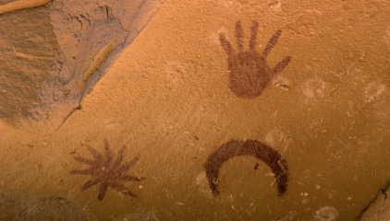
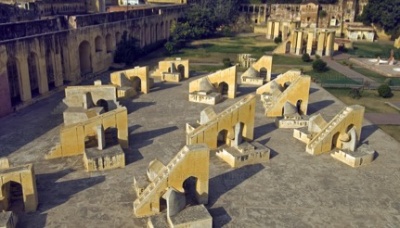

Slide 4
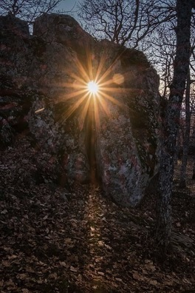
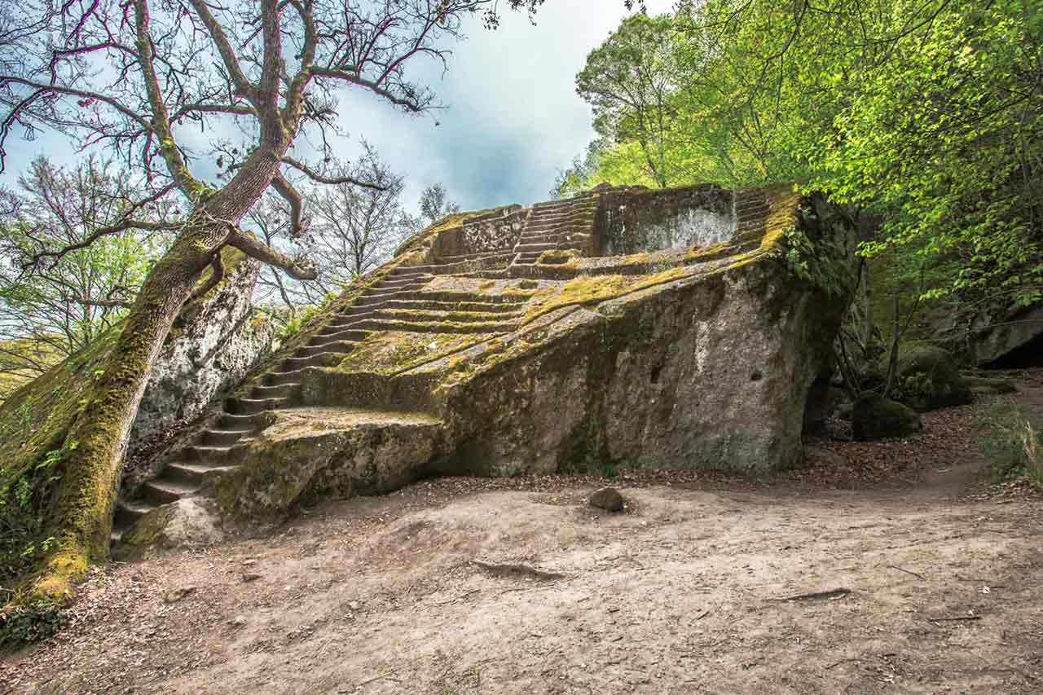
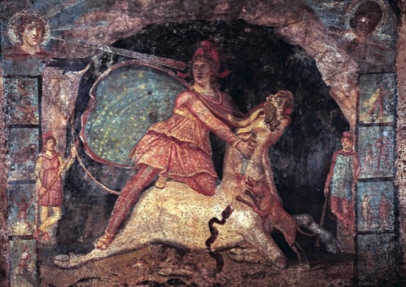
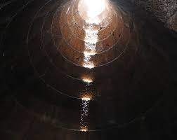

Slide 5
Such an heritage – which is both tangible and intangible, moveable and immoveable - is not limited in any way to the monuments of archaeoastronomy or to old observatory and instruments, but is a more general cultural heritage and its study is defined by the term “Cultural Astronomy” or “Astronomy in Culture”.
The International Society for Archaeoastronomy and Astronomy in Culture

Slide 6
According to these societies, Cultural Astronomy consists in:
Archaeoastronomy
History of of Astronomy
Historical Astronomy
Ethnoastronomy
But a similar taxonomy doesn’t take into account a lot of themes and disciplines, like History of Astrology, Astronomy in Literature and Theatre and so on.
A more inclusive definition for CA may be:
the interdisciplinary study of the material and immaterial relationship between Man and the Universe.

Slide 7
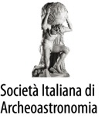
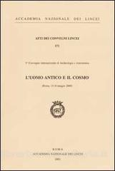
SIA was born in 2000 from a group of astronomers and archeologists, many of them members of the Accademia dei Lincei, in the aftermath of a congress about Ancient Astronomy.
Vittorio Castellani
Giuliano Romano
Edoardo Proverbio
Gustavo Traversari
Francesco Bertola

Slide 8
Organization
2015-2017
President: E. Antonello VicePresidents: G. Rosada, M. Incerti Council Members: E. Proverbio, H. DeSantis, N. Lanciano, M. Mazzoni, P. Moscati, V.F. Polcaro Secretary: M.P. Biffi Treasury: S. Motta Electoral Committee: F. Castaldi, A. Gaspani, M.P. Biffi

Slide 9
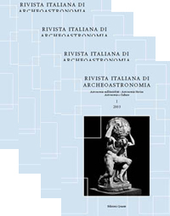
SIA is a meeting point for scholars from Humanities and Scientific Departments, stimulating interdisciplinary research and giving continuity to an intercultural approach through annual congresses, publications, collaborations, training and refresher courses.
Since 2005: annual proceedings of SIA congresses
2002-2005

Slide 10
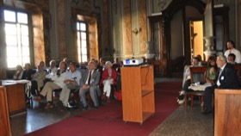
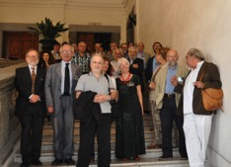
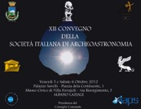
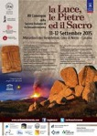
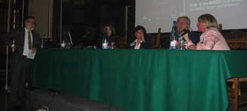
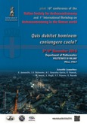
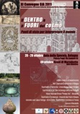
The key moments for SIA are the annual congresses (sometimes associated to thematic international workshops)

Slide 11
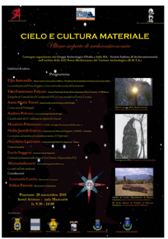
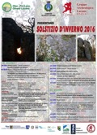
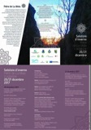
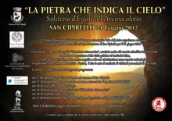
Participation to the XIII BMTA in Paestum (2010)
Longstanding collaboration with GAI for the protection and cultural promotion of astronomical heritage sites
+

Slide 12
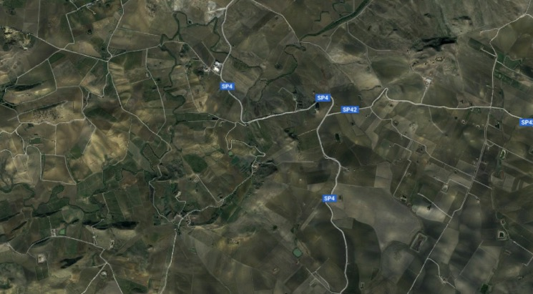
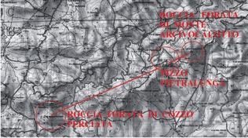
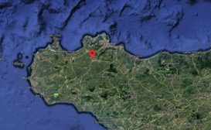
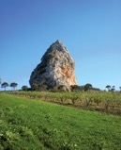
The “Campanari” in the Valley of Belice (Sicily)
Monte Arcivocalotto
Pizzo Pietralunga
Cozzo Perciata

Slide 13
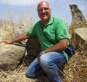
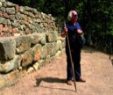
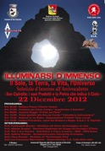
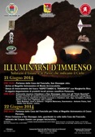
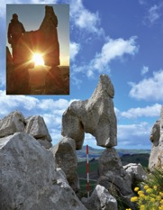
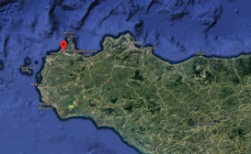
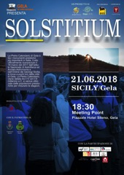
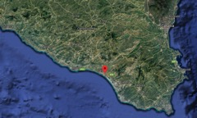
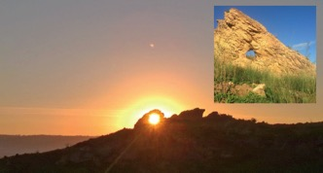
These perforated megaliths are giant calendrical stones from the Bronze Age, oriented towards the solstices.
A. Scuderi
V.F. Polcaro
Custonaci, Trapani
Cozzo Olivo, Gela

Slide 14
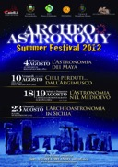
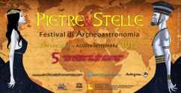
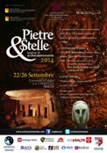
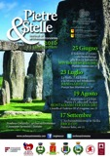
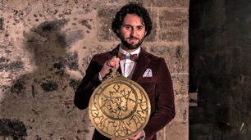
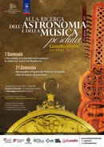
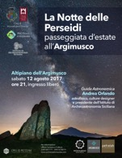
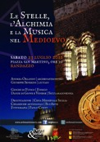
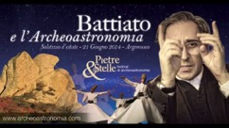
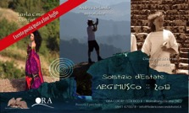
OTHER ARCHEOASTRONOMY IN Sicily
A. Orlando – Istituto di Archeoastronomia Siciliana

Slide 15
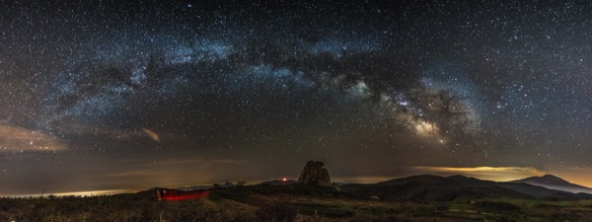
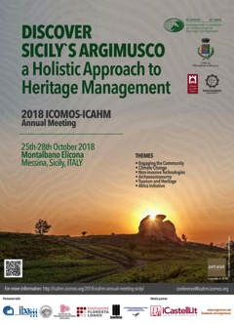
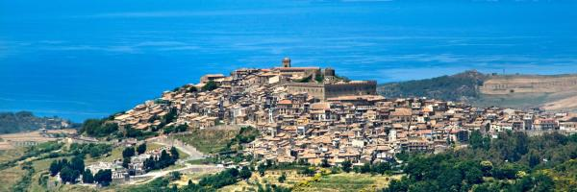
Argimusco Plateau
Montalbano Elicona

Slide 16
Created in 2003 within the framework of the Global Strategy for the World Heritage List, as a pilot activity for the identification of the sites connected with astronomy, the Thematic Initiative on Astronomy and World Heritage, aims to establish a link between Science and Culture towards recognition of the monuments and sites connected with astronomical observations dispersed throughout all the geographical regions, not only scientific but also the testimonies of traditional community knowledge.
The first international experts meeting was held in Venice, Italy (17-19 March 2004)

Slide 17
In the Working Group on Astronomy and World Heritage two italian members are SIA associates: Giulio Magli (Politecnico Milano) and Manuela Incerti (Università di Ferrara)
In 2012 at the IAU General Assembly in Beijing the Portal to the Heritage of Astronomy is finally launched.

Slide 18
THE ASTRONOMICAL HERITAGE FINDER

Slide 19
THE ASTRONOMICAL HERITAGE FINDER

Slide 20
BATTISTERO, Parma, Italy

Slide 21
BATTISTERO DI PARMA
PANTHEON
Rome, Italy

Slide 22
ACROPOLI Alatri, Italy

Slide 23
But this is just the tip of an unexplored iceberg:
there is an incredible wealth of astronomical heritage sites in Italy, often connected to the cultural and artistical treasures…
They only wait for an adequate promotion and an intelligent and sustainable exploitation of their touristic potential!

Slide 24
Medieval HIerophanies in Italian Churches
San Leonardo – Siponto (FG)
San Nicola - Bari
San Miniato - Firenze

Slide 25
Astral Representations in Italy: Middle Ages and Renaissance
Work in progress: about 250 zodiacal or planetary depictions

Slide 26
ASTROLOGICAL VAULTS
Appartamenti Borgia - Vaticano
Castello di Roccabianca - Parma
Palazzo Te - Mantova
Duomo - Montagnana
Palazzo Ducale - Mantova
Palazzo Chiericati - Vicenza
Palazzo Farnese - Caprarola

Slide 27
Palazzo Schifanoia - Ferrara
Palazzo della Ragione - Padova

Slide 28
The Sala Di Galatea in Villa Farnesina (RM): an astrologically oriented vault

Slide 29
4 July 1442
The Planetaria of the Sagrestia Vecchia and Cappella Pazzi (FI)
( )
6 July 1439

Slide 30
…and I still didn’t mention History of Astronomy Heritage that in Italy is simply outstanding…

Slide 31
In conclusion, SIA should be an important point of reference for italian astrotourism related to local cultural heritage sites!
In general a correct approach for astrotourism activities should involve the international organizations dedicated to Astronomy in Culture!

