Slide 1
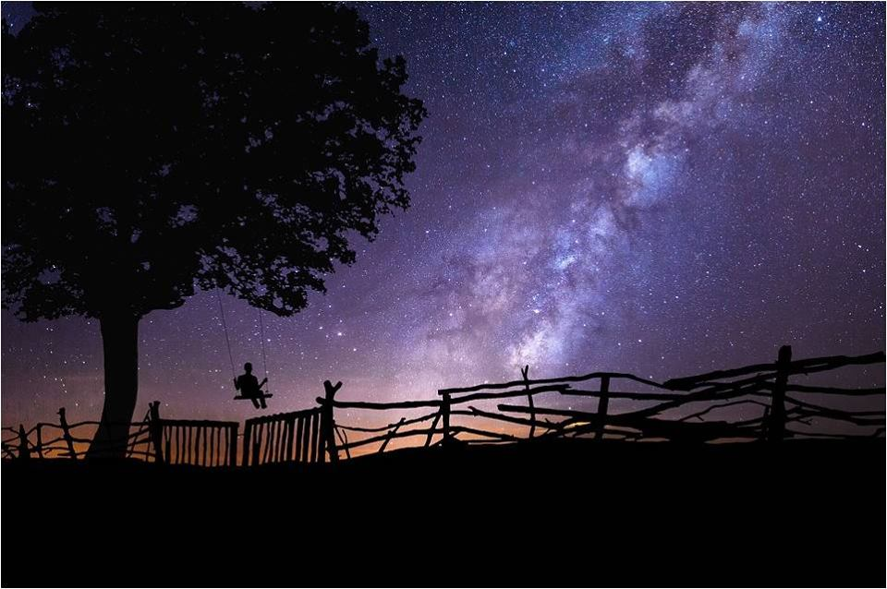
TOURISTS OF THE SKY: FROM THE PLANETARIUM TO THE REAL WORLD
Engaging the Public in a Personal Awareness of the Universe
Stefano Giovanardi
(Planetarium and Astronomical Museum of Rome)
Chianti Topics 2018

Slide 2
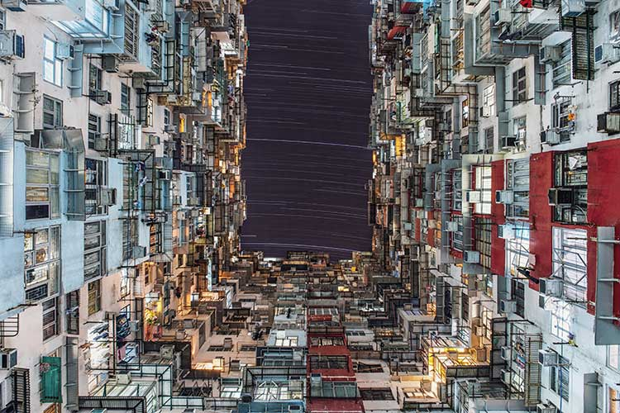
For the majority of mankind, stars are lost in light pollution.

Slide 3
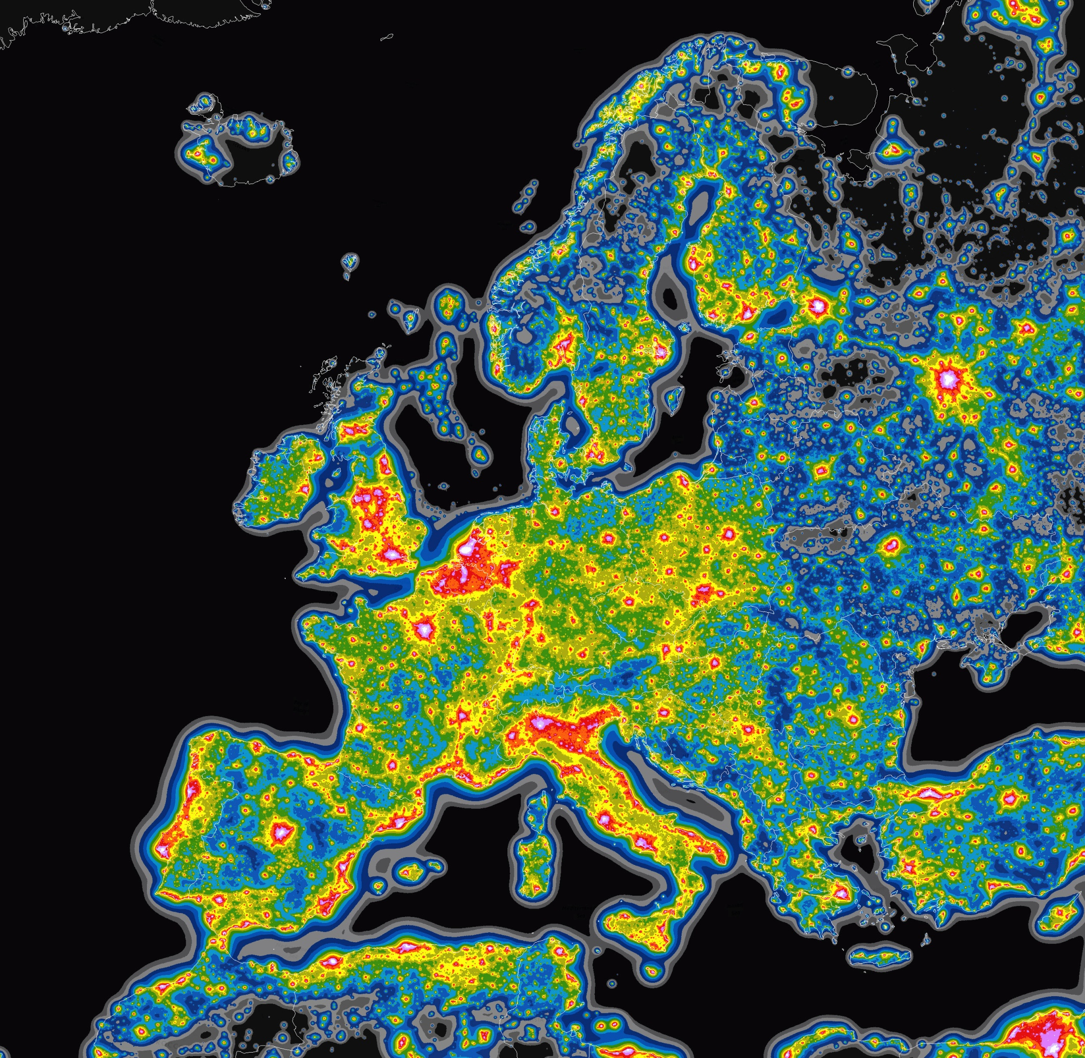

Slide 4
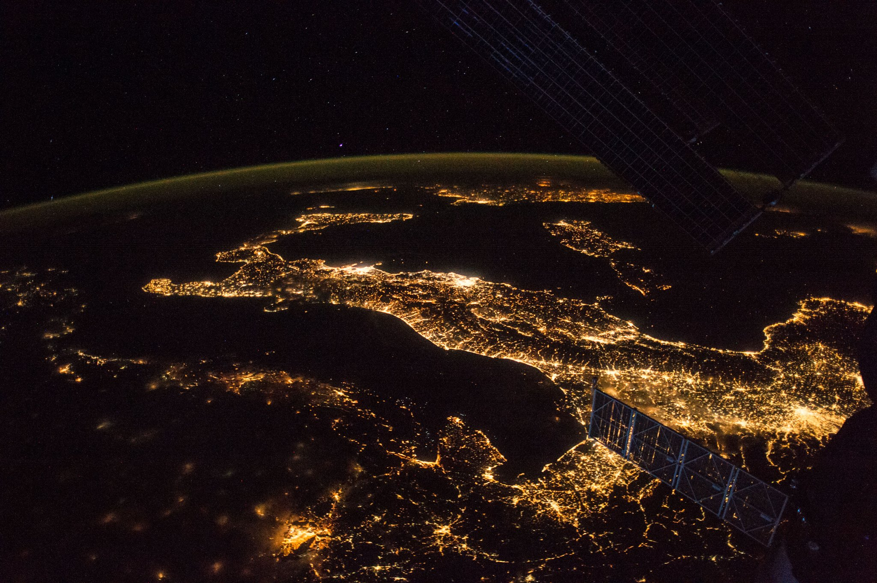
A NATIONAL MONUMENT TO LIGHT POLLUTION
80% of Italians cannot see the Milky Way (Falchi et al. 2016).

Slide 5
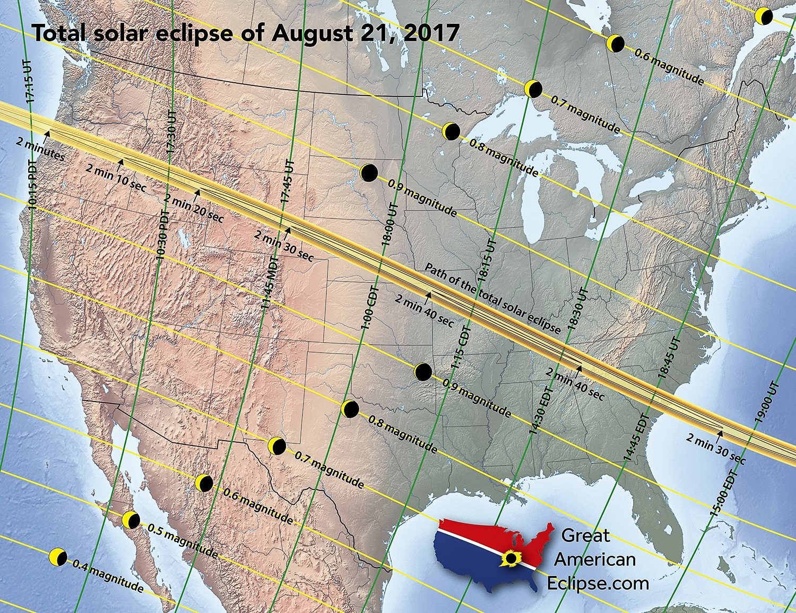
215 million American adults watched the eclipse (88% of the adult population). More than the Super Bowl.
154 million saw it directly
About 20 million travelled somewhere to have a better view.

Slide 6
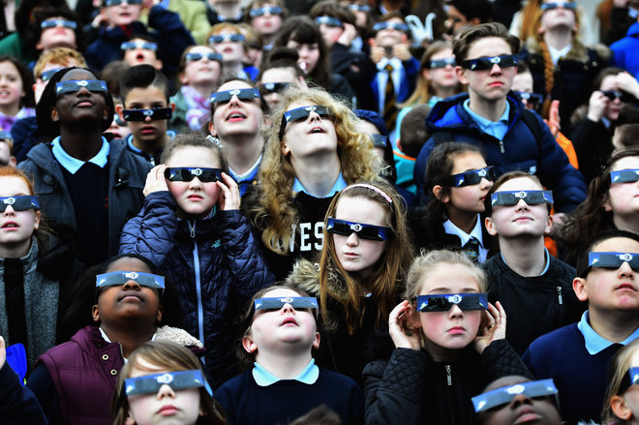
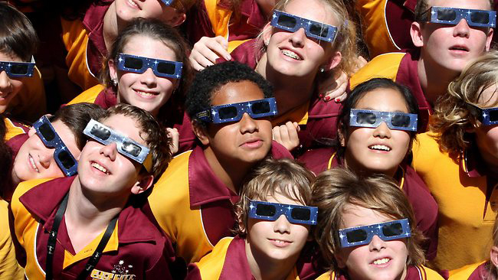
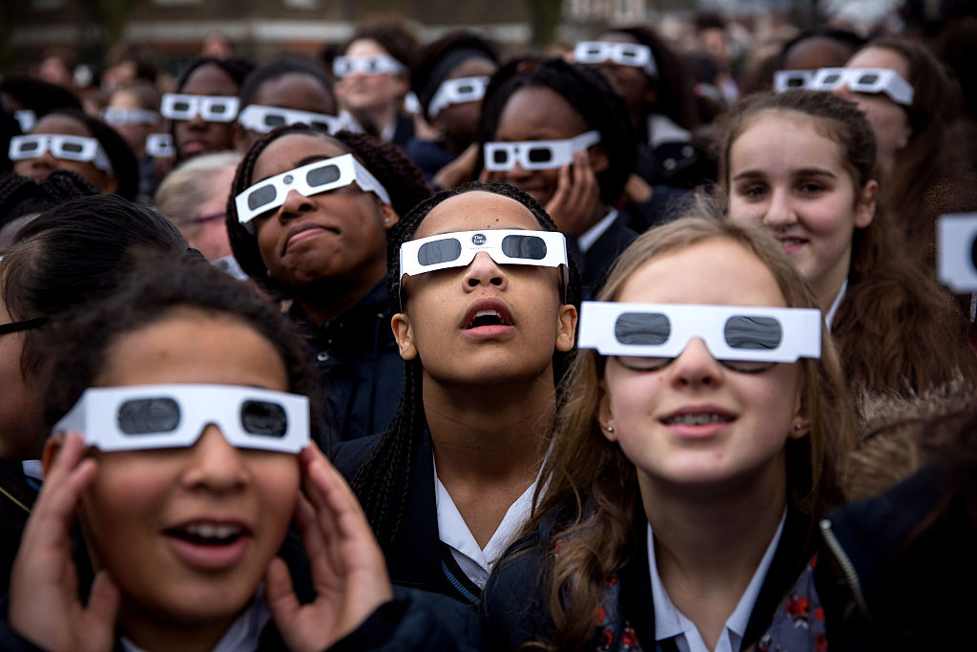
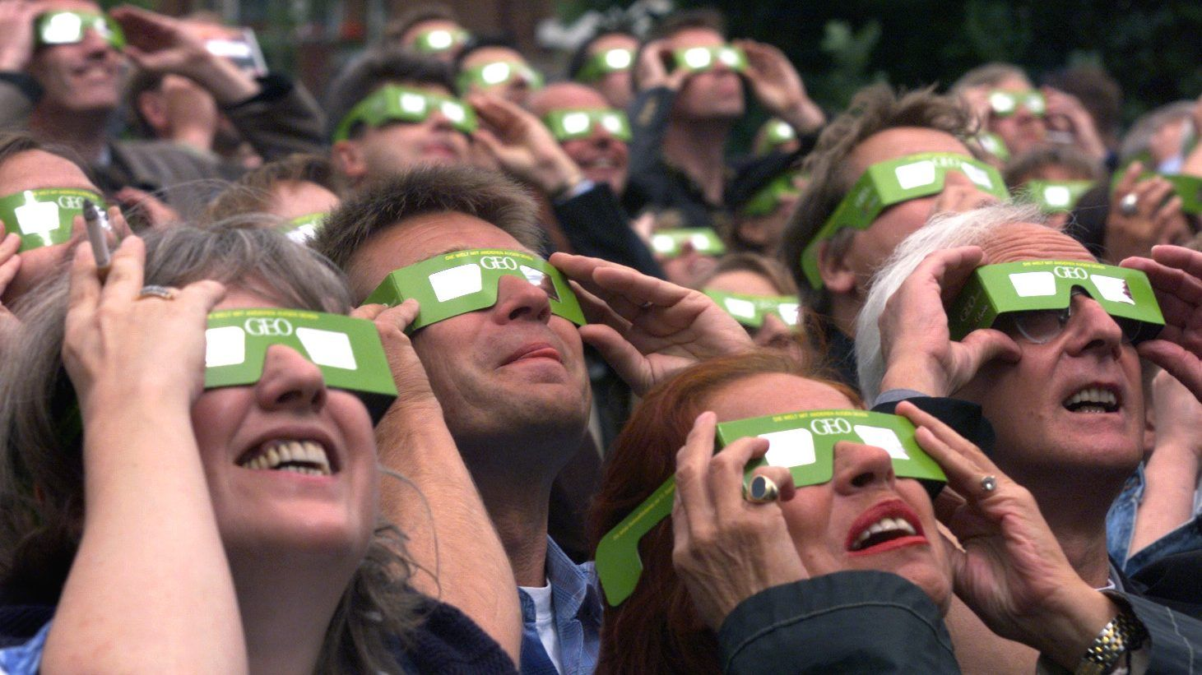

Slide 7
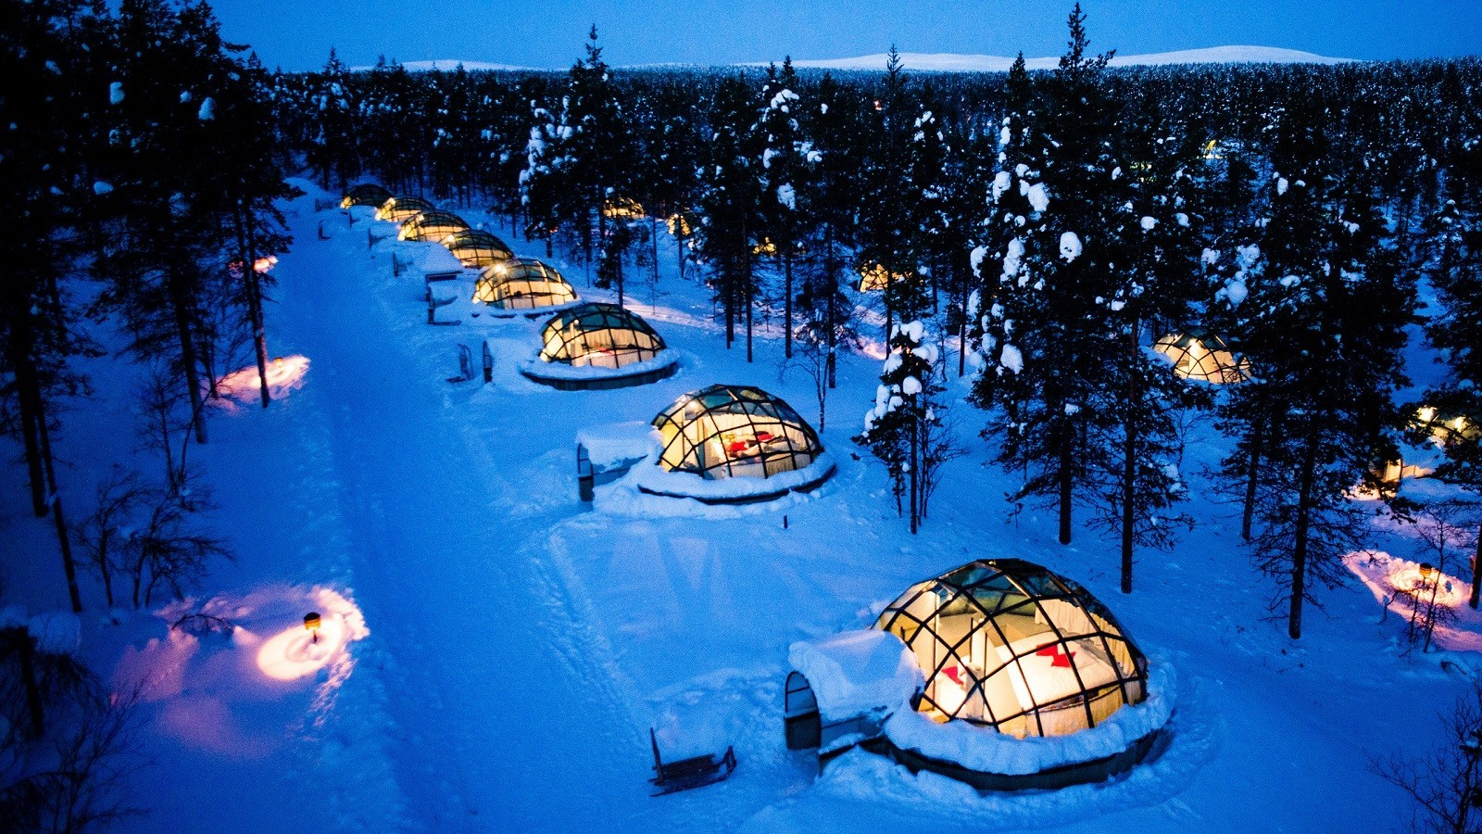
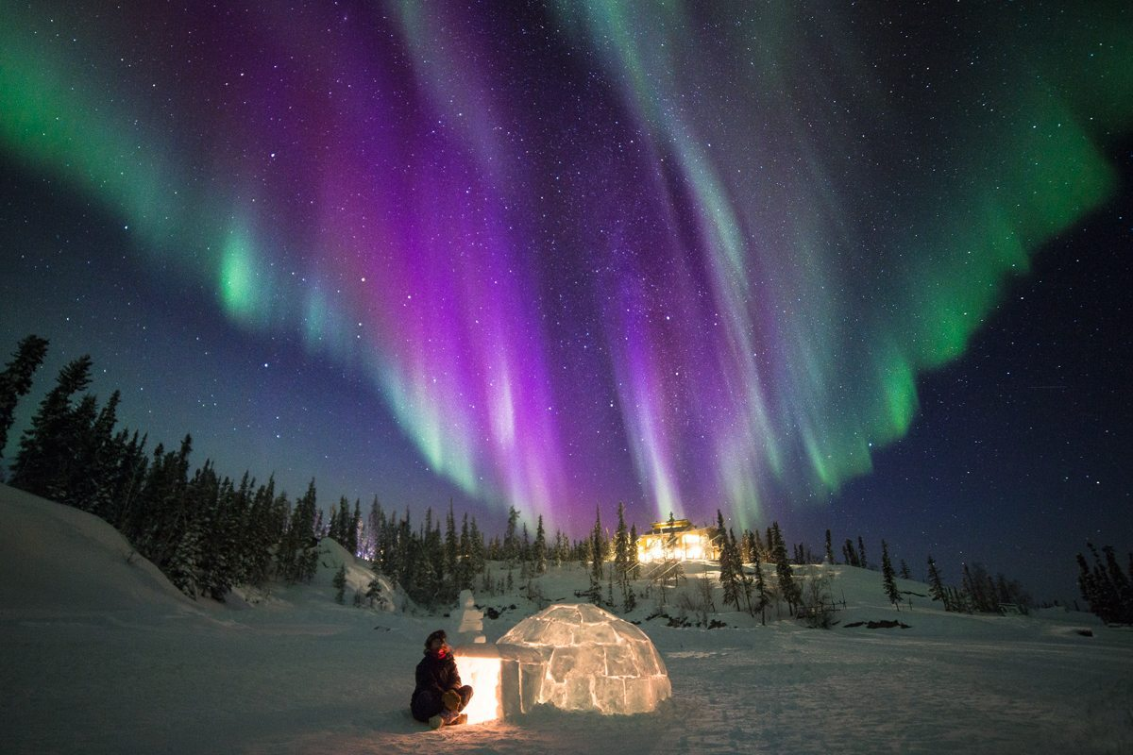

Slide 8
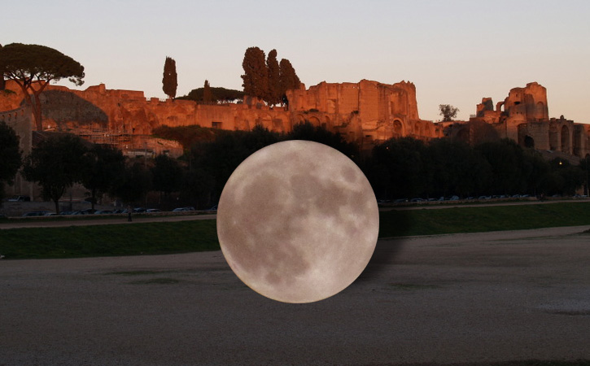
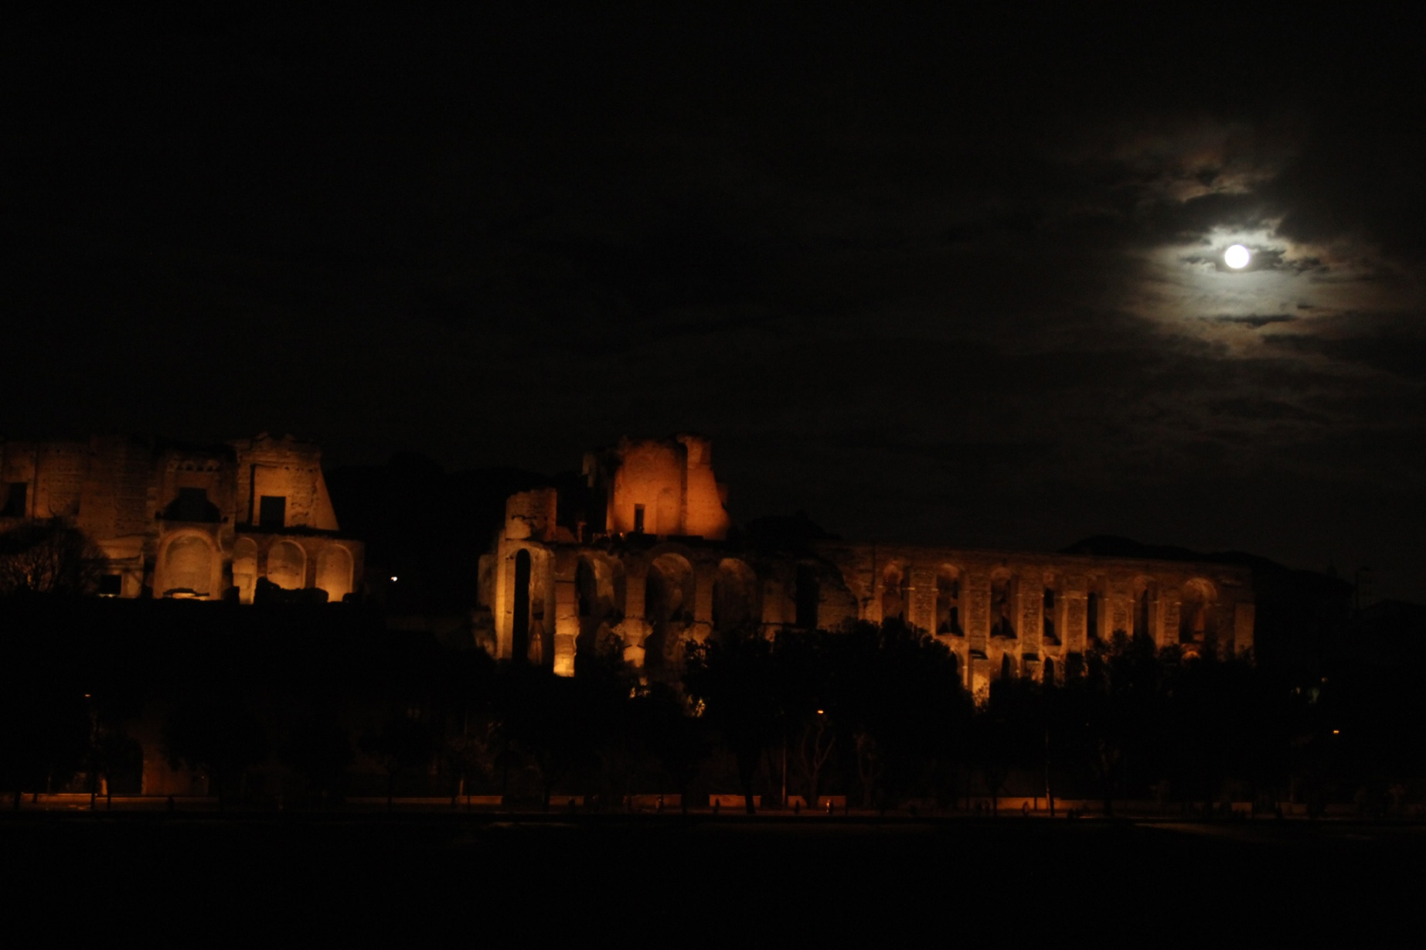
SUPERMOON AT CIRCUS MAXIMUS!
The popularity of astronomical events on social networks indicates how huge is the share of public eager to be engaged directly in their observation, becoming the target of astrotouristic activities.
Urban Starwalk in Rome, 1/1/2018

Slide 9
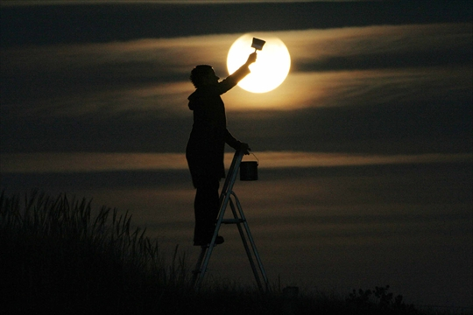
Establish a direct relationship with the sky, that goes beyond the pure scientific level and is mainly rooted in sensitivity and emotion.

Slide 10
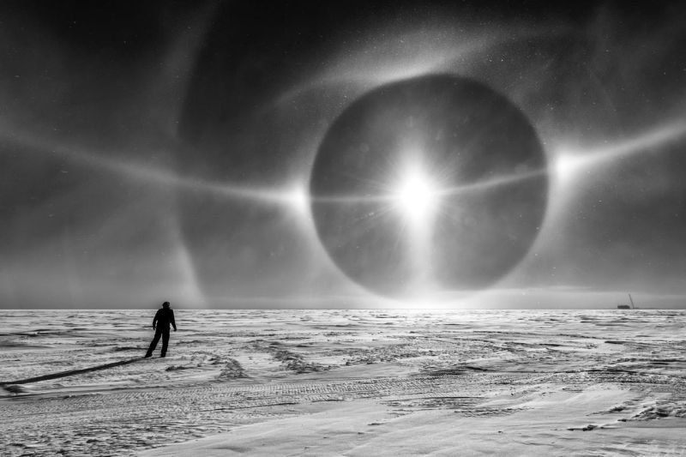
A SELFIE WITH THE UNIVERSE
Experience the enchantment (Max Weber)

Slide 11
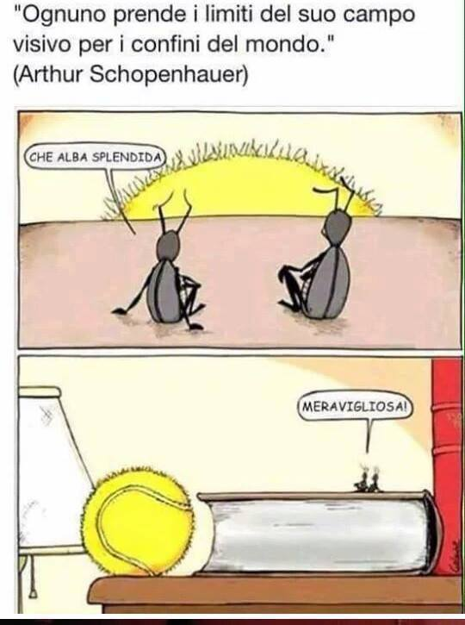
“Everyone takes the limits of his own vision for the limits of the world.”
(A. Schopenhauer)
Hence, the goal of all tourism (including astrotourism) is bringing “all you can fit” inside one’s field of view (including stars)!

Slide 12
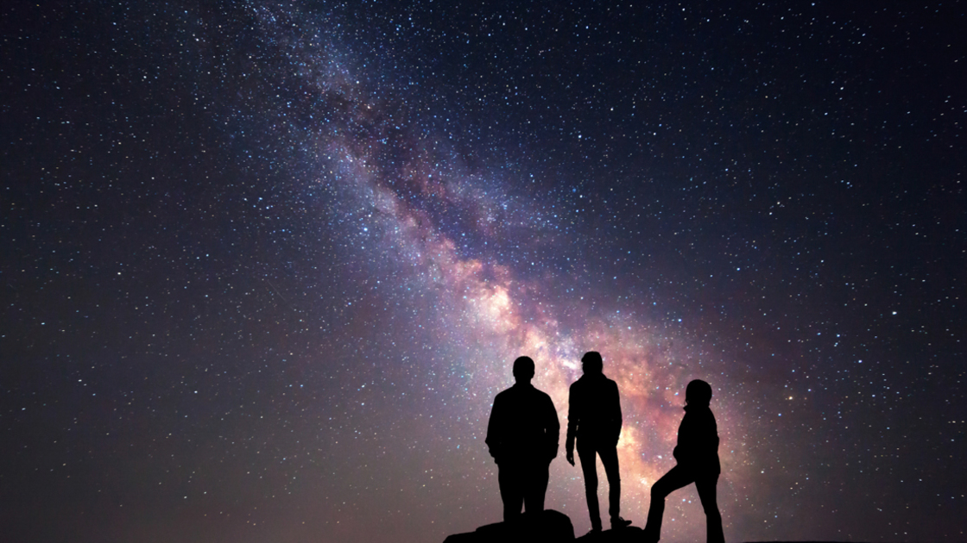
MEANING BY FRAMING
Astronomical events – just like all events (social, political, personal) – become meaningful to people when they are allowed to frame them within their individual experience.
Everybody wants to say:
“I was there!”

Slide 13
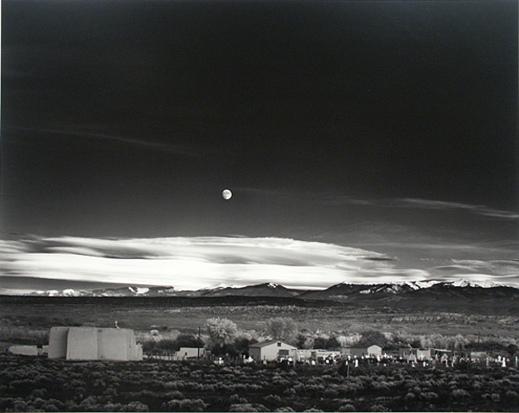
THE PERFECT FRAMING
“While the draughtsman starts with the middle of the sheet, the photographer starts with the frame. The photograph’s edge defines content.”
J. Szarkowski, “The Photographer’s Eye”
“Contemplation”: in Latin “cum templum”, the space of the sky selected for divination. It denotes a point of view, the position for wonder.

Slide 14
THE PERFECT FRAMING
“While the draughtsman starts with the middle of the sheet, the photographer starts with the frame. The photograph’s edge defines content.”
J. Szarkowski, “The Photographer’s Eye”
At the intersection between astronomical and personal storytelling, it’s the context that makes news out of information, and turns news into knowledge.

Slide 15
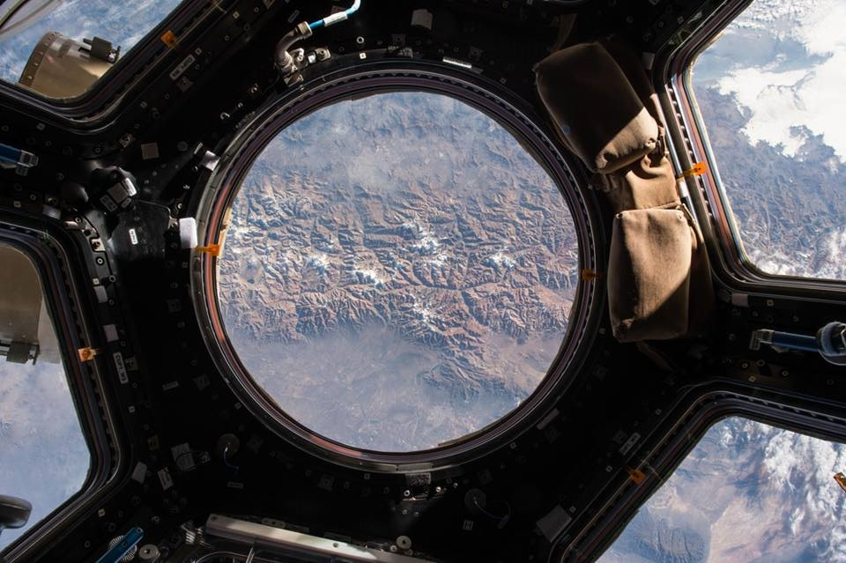
THE MOST IMPORTANT WINDOW OF THE WORLD

Slide 16
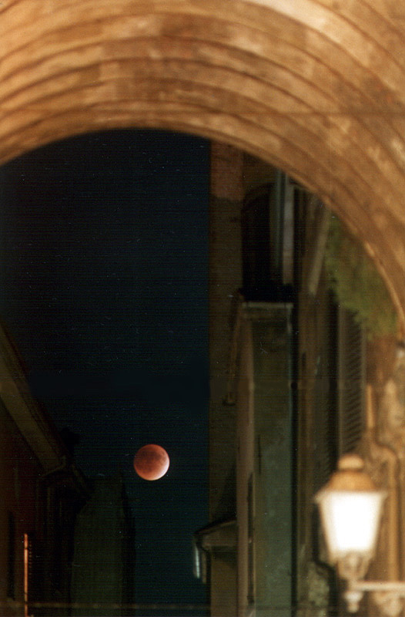
THE PHOTOGRAPHER’S EYE
In astronomy everything is far away, to infinity, especially as perceived by the public. The sky lacks depth.
Adjusting the focus is necessary, as an action to put the sky in perspective with respect to people’s lives and experiences.
Best if done in a personal way: travelling through the author’s words and eyes. Just like in a planetarium!

Slide 17
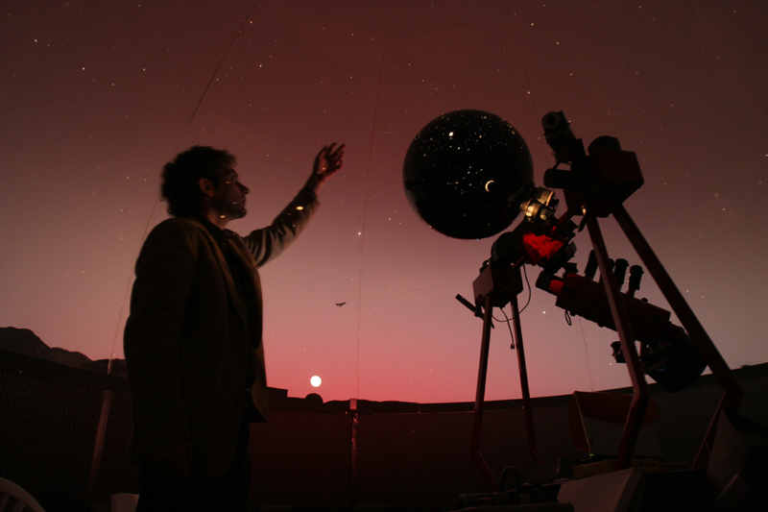
ASTROTOURISM IN A PLANETARIUM
In the planetarium, the narrator is a tour guide to the sky and to the universe beyond the dome.
The audience travels through space and time while remaining seated, just following the narration, the music and the visuals.
A planetarium show is an astrotouristic experience.

Slide 18
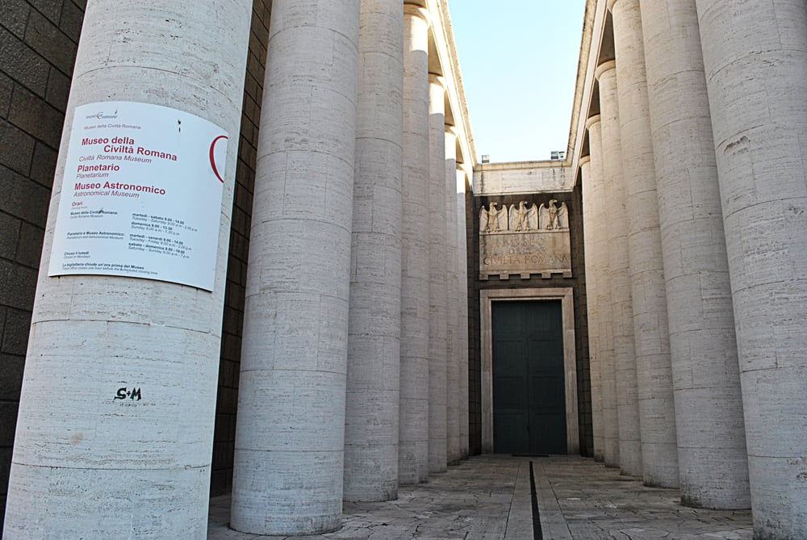
PLANETARIUM AND ASTRONOMICAL MUSUM OF ROME
Almost 1 million visitors in 10 years (2004-2014).
For 3 years in the top ten most visited science museums in Italy (source: Dossier Musei TCI)
Rich menu of astronomical shows: 65 different titles, all original productions.

Slide 19
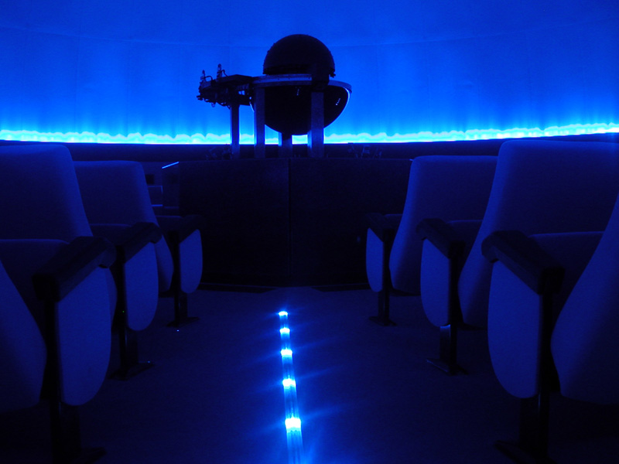
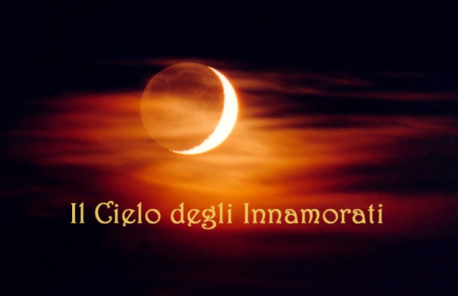
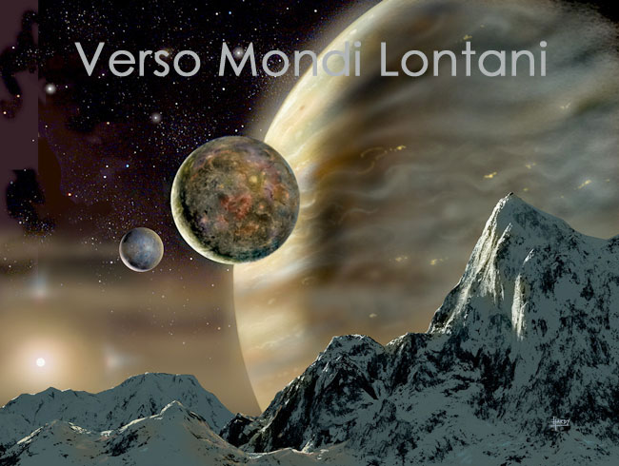
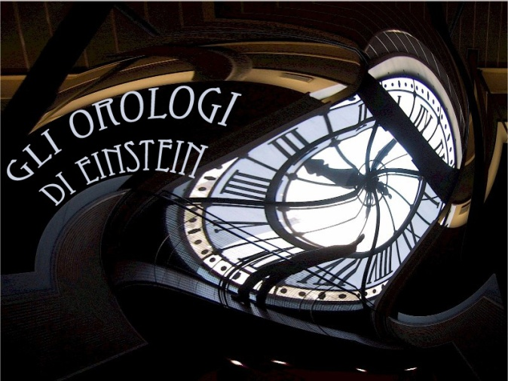
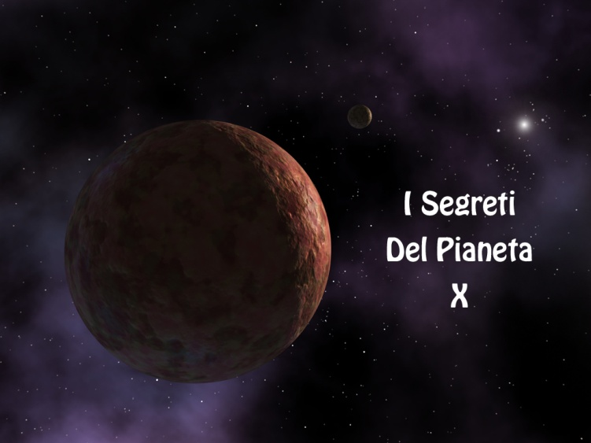
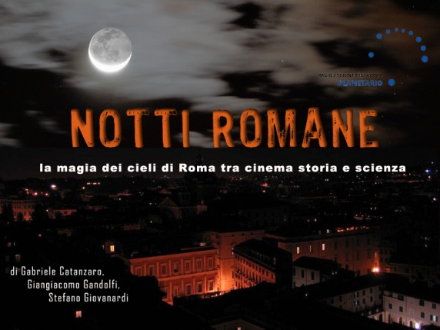
THE PLANETARIUM OF ROME
Opened: 2004, closed: 2014
Network “Musei in Comune” (www.museiincomuneroma.it)
14 m dome with 98 seats
Optical Projector RSA Cosmos SN98, 4500 stars + 3 digital projectors + 12 all-sky slide projectors

Slide 20
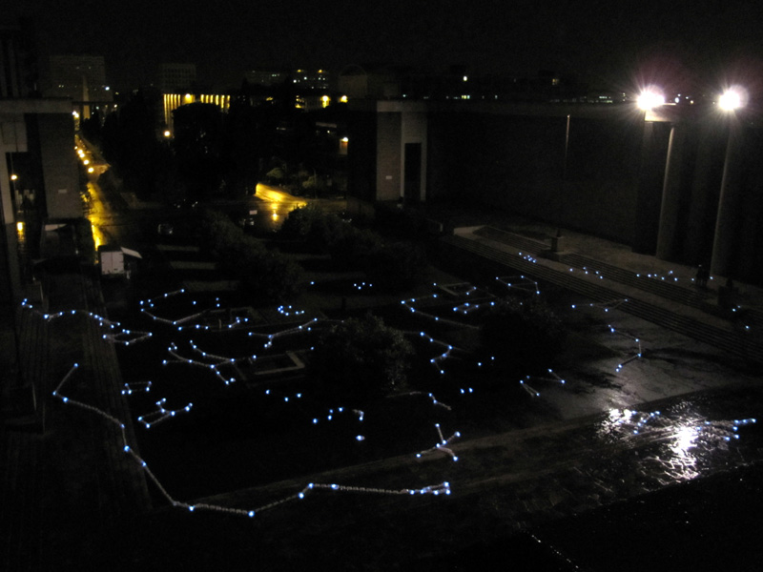
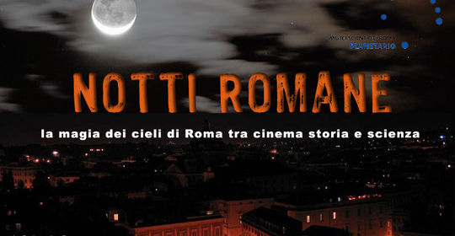
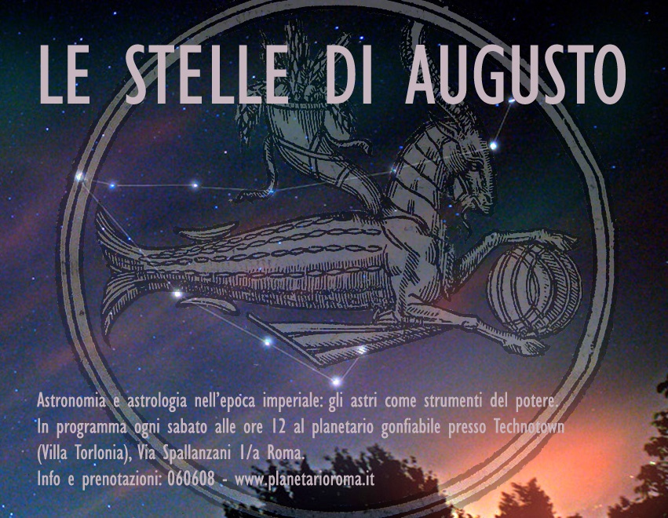
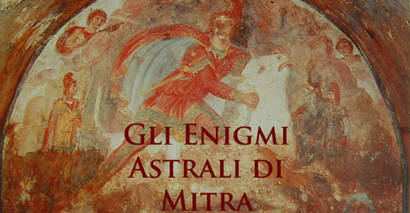
Connecting Rome to the sky…

Slide 21
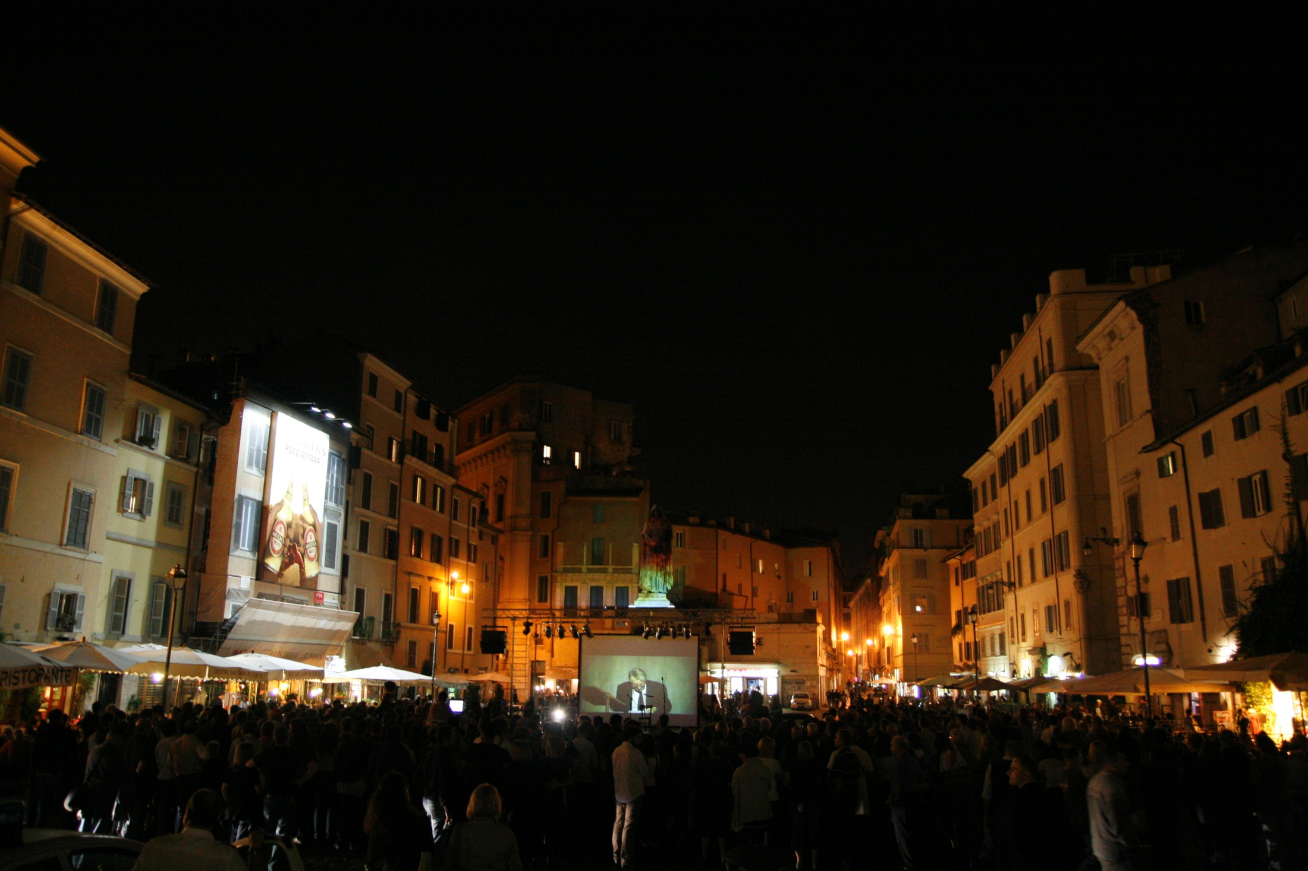
INFINITE SUNS, COUNTLESS WORLDS (2009)
Observation of the transit of an extrasolar planet (TrES-3b) under the statue of Giordano Bruno.

Slide 22
Inverting trends: the Urban Star Party

Slide 23
A circuit of 8 itinerant stargazing sessions in the parks and squares of Rome, guided by the Planetarium astronomers, with the contribution of amateurs and private citizens. Turnout: approximately 7000 people.

Slide 24
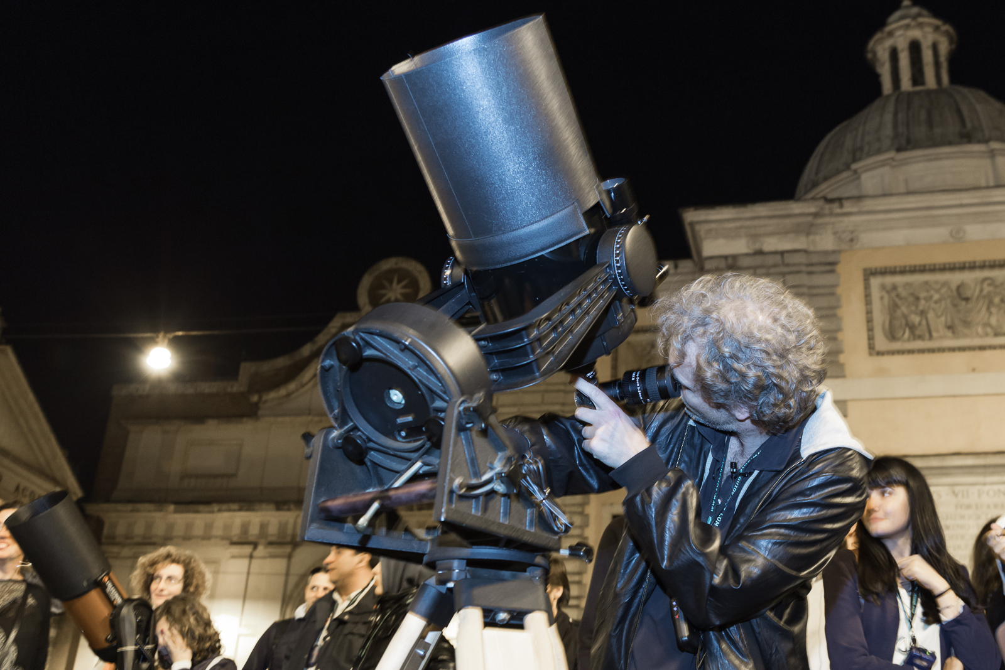
ASTRONOMICAL PROMENADES IN ROME
Passeggiate Astronomiche a Roma
In partnership with Cultural Association “Danae”, 2010-2018

Slide 25
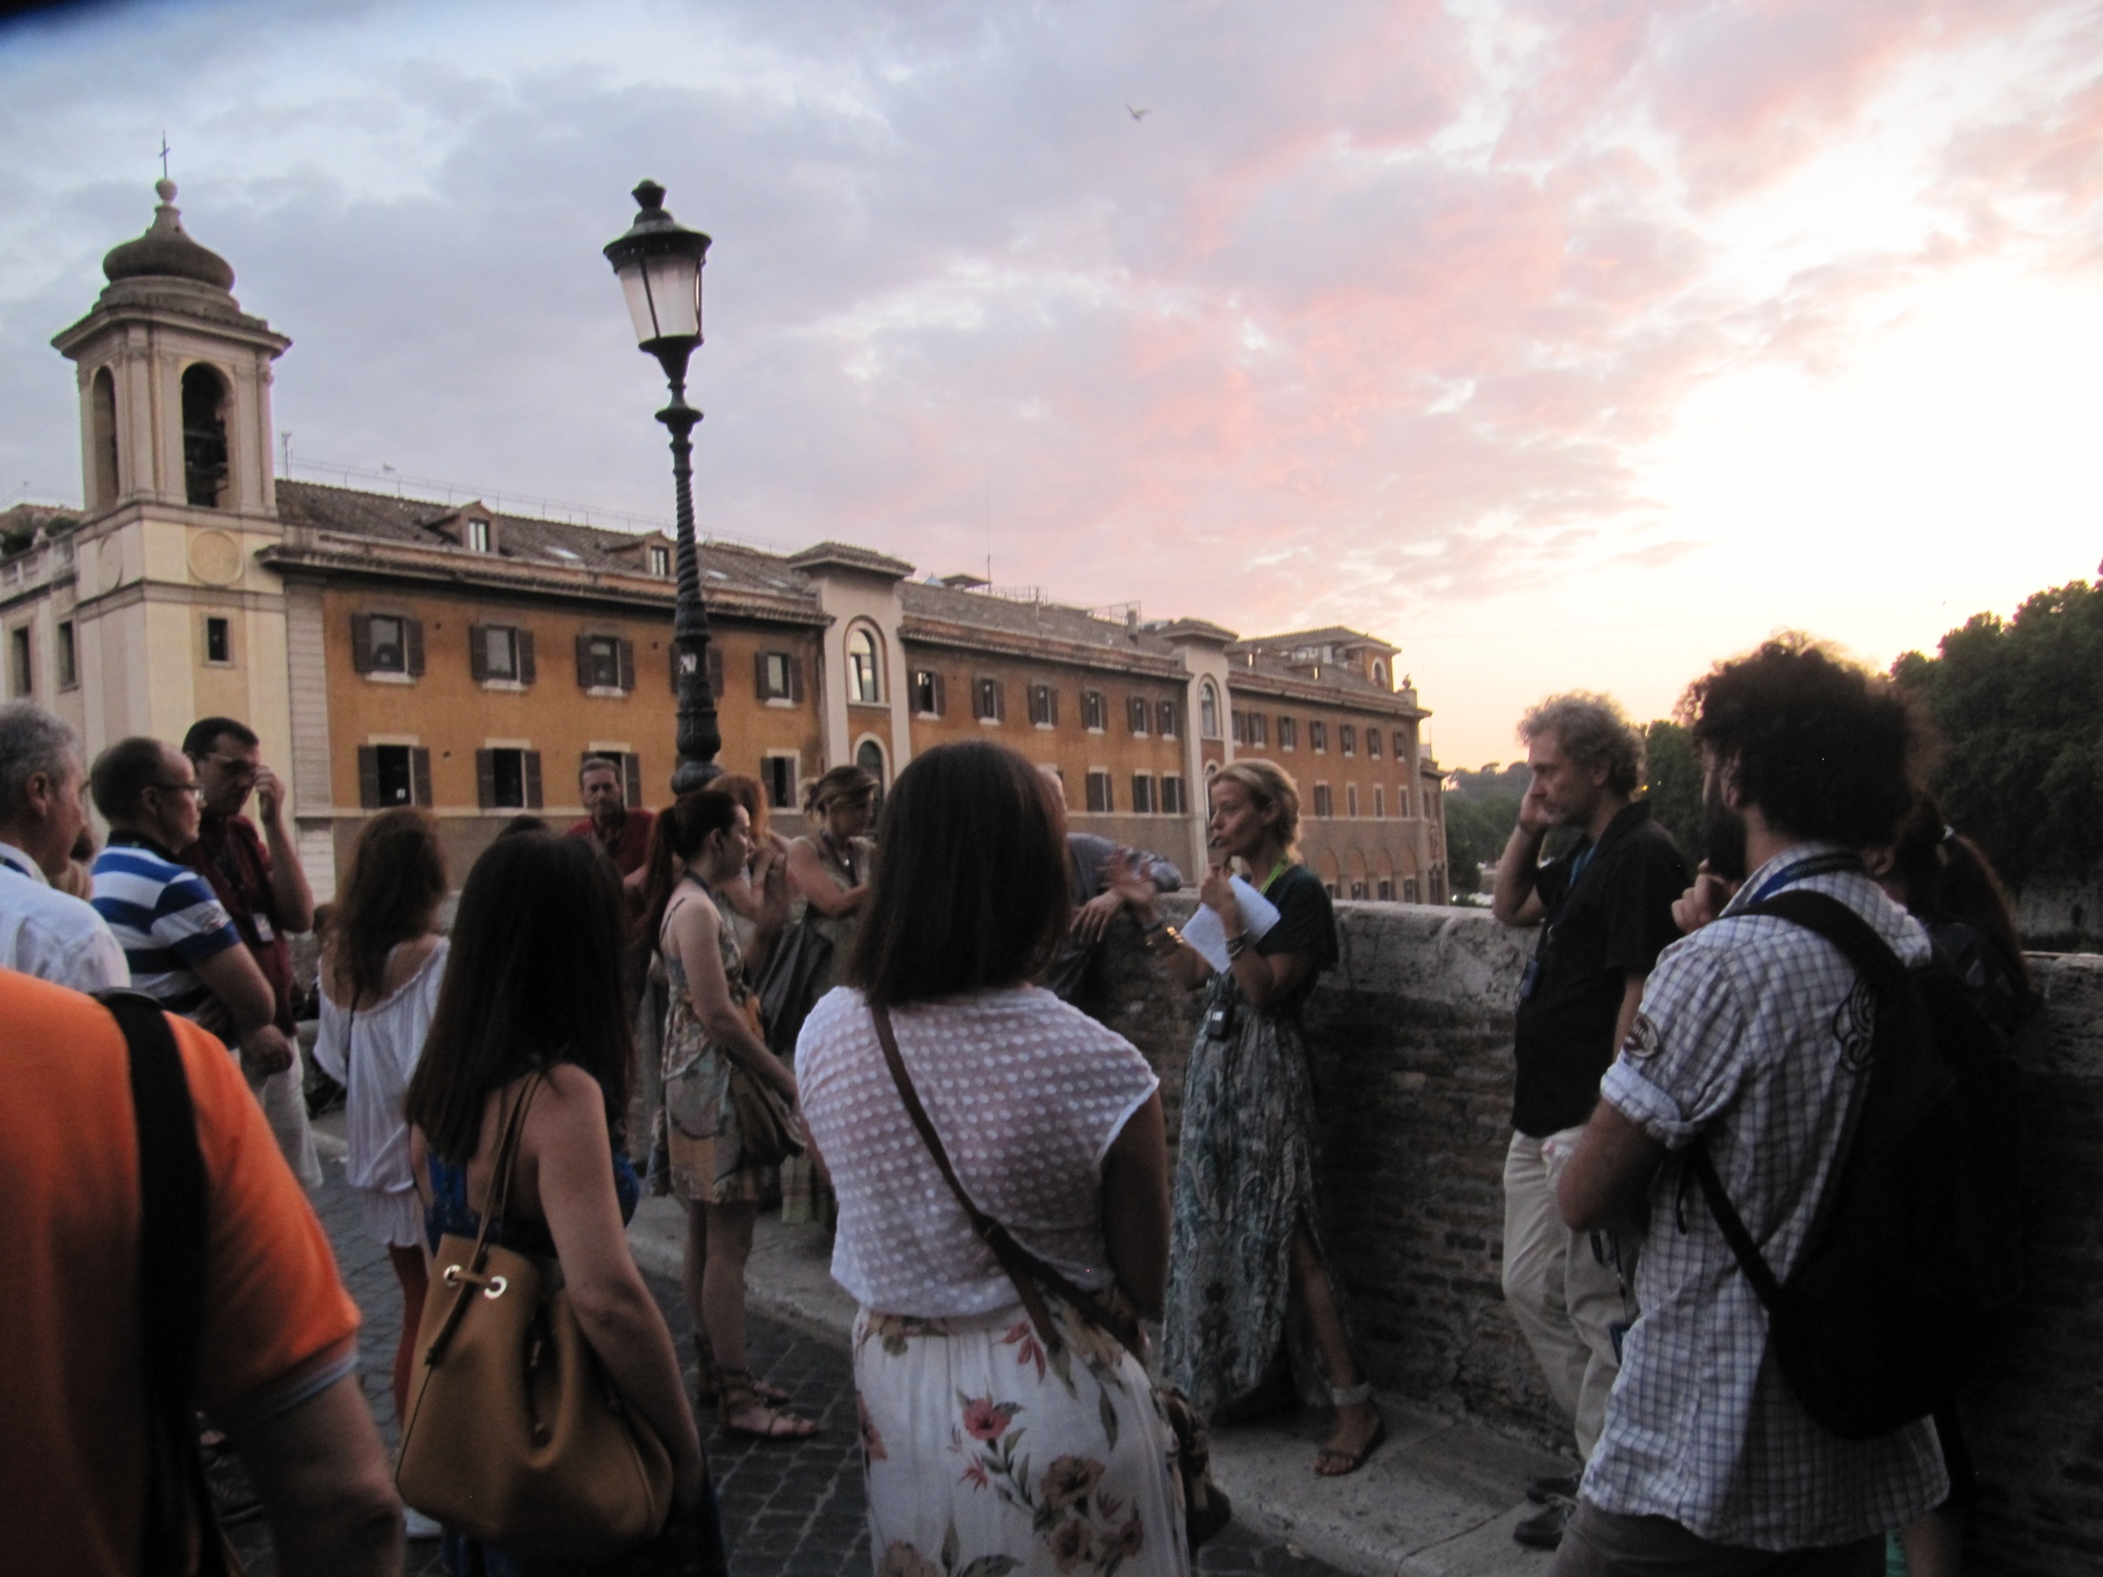
CASTING CULTURAL BRIDGES TO THE SKY
Over 30 different itineraries connecting the history of Rome with the sky.
First half: guided tour by Tiziana Litteri (art historian) to sites of artistic, historical and astronomical relevance.
Second half: telescopic observations from a spot shaded from nearby lights.
Groups of 20 up to 60 people.

Slide 26
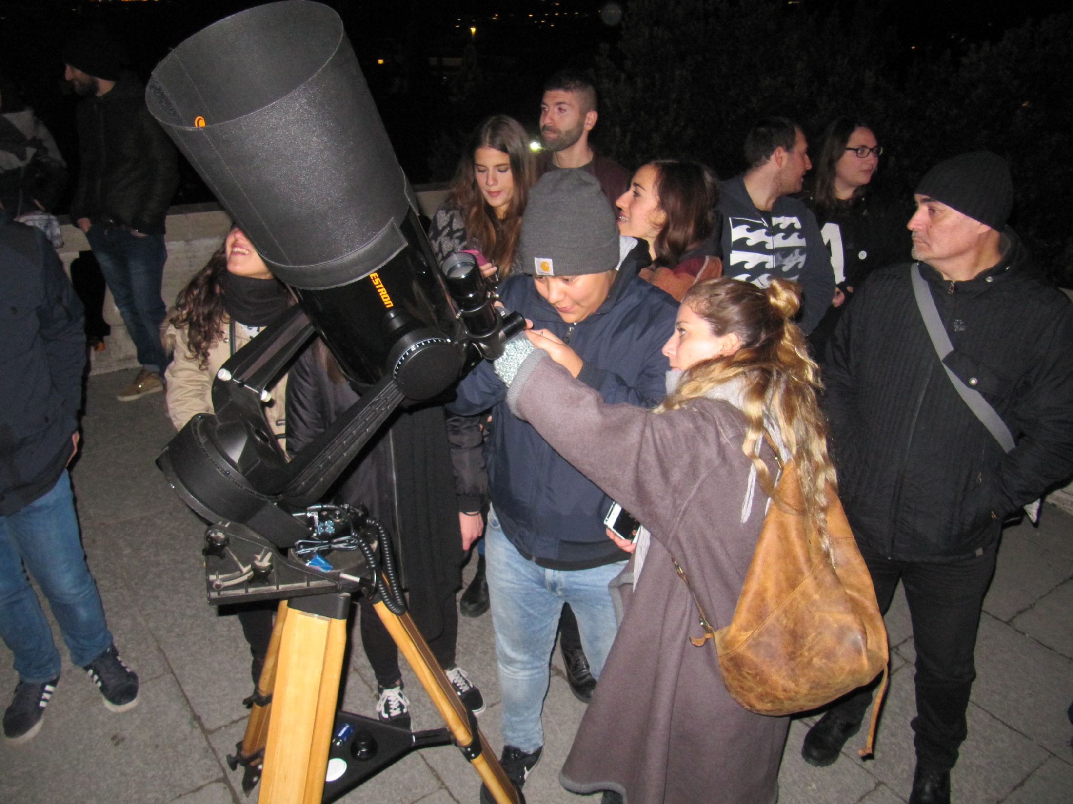
Play with the expectations of the public as to what they will see through the telescope.
Italian Touring Club, 2012-2013

Slide 27
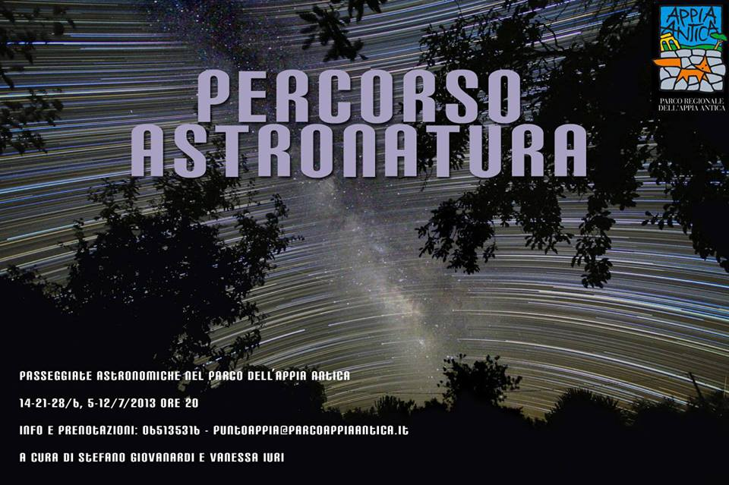
Ancient Appian Road Park, 2013

Slide 28
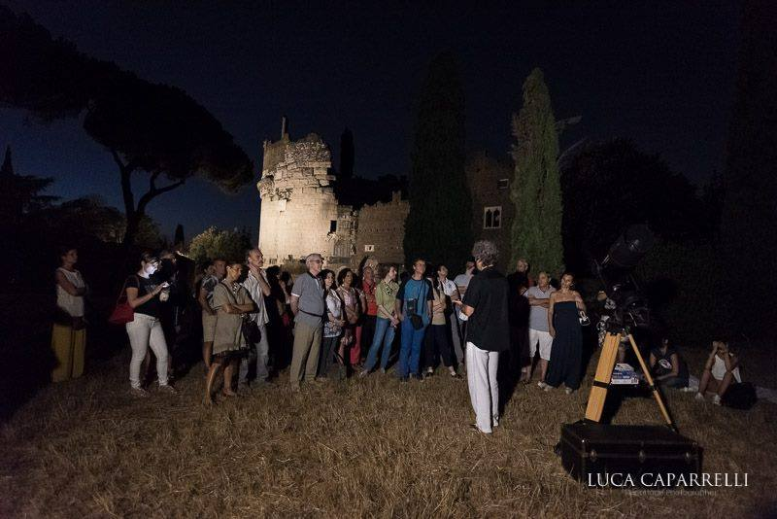
Cultural Association “Ars in Urbe”, 2016

Slide 29
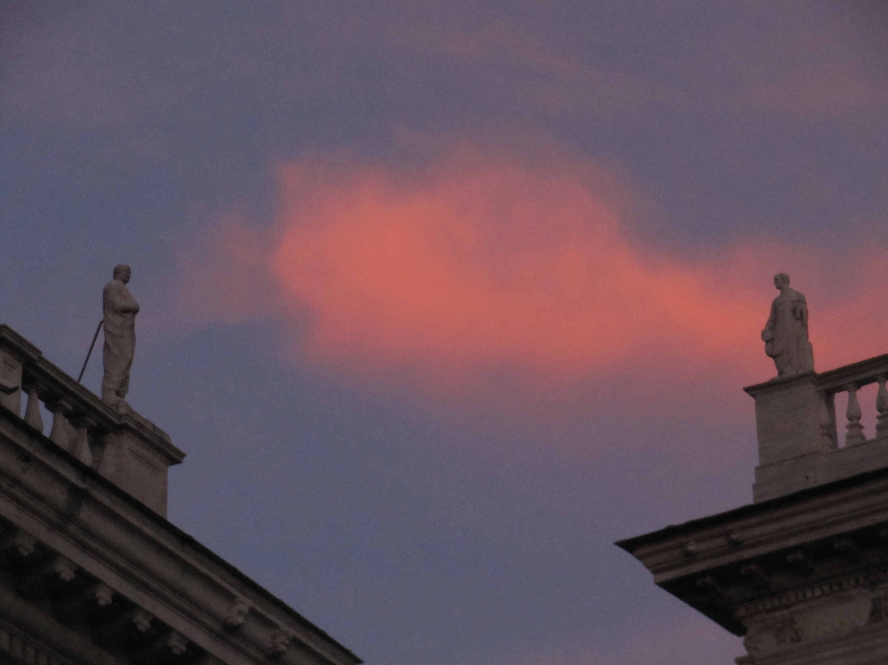
The history of Rome, from its foundation up to the present time, is full of references to the sky and the stars. They offer new keys to visit the city – both for tourists and Roman citizens.
They represent a cultural treasure that may qualify Rome and its territory among the most interesting destinations worldwide for astrotourism (despite the poor quality of the night sky!).

Slide 30
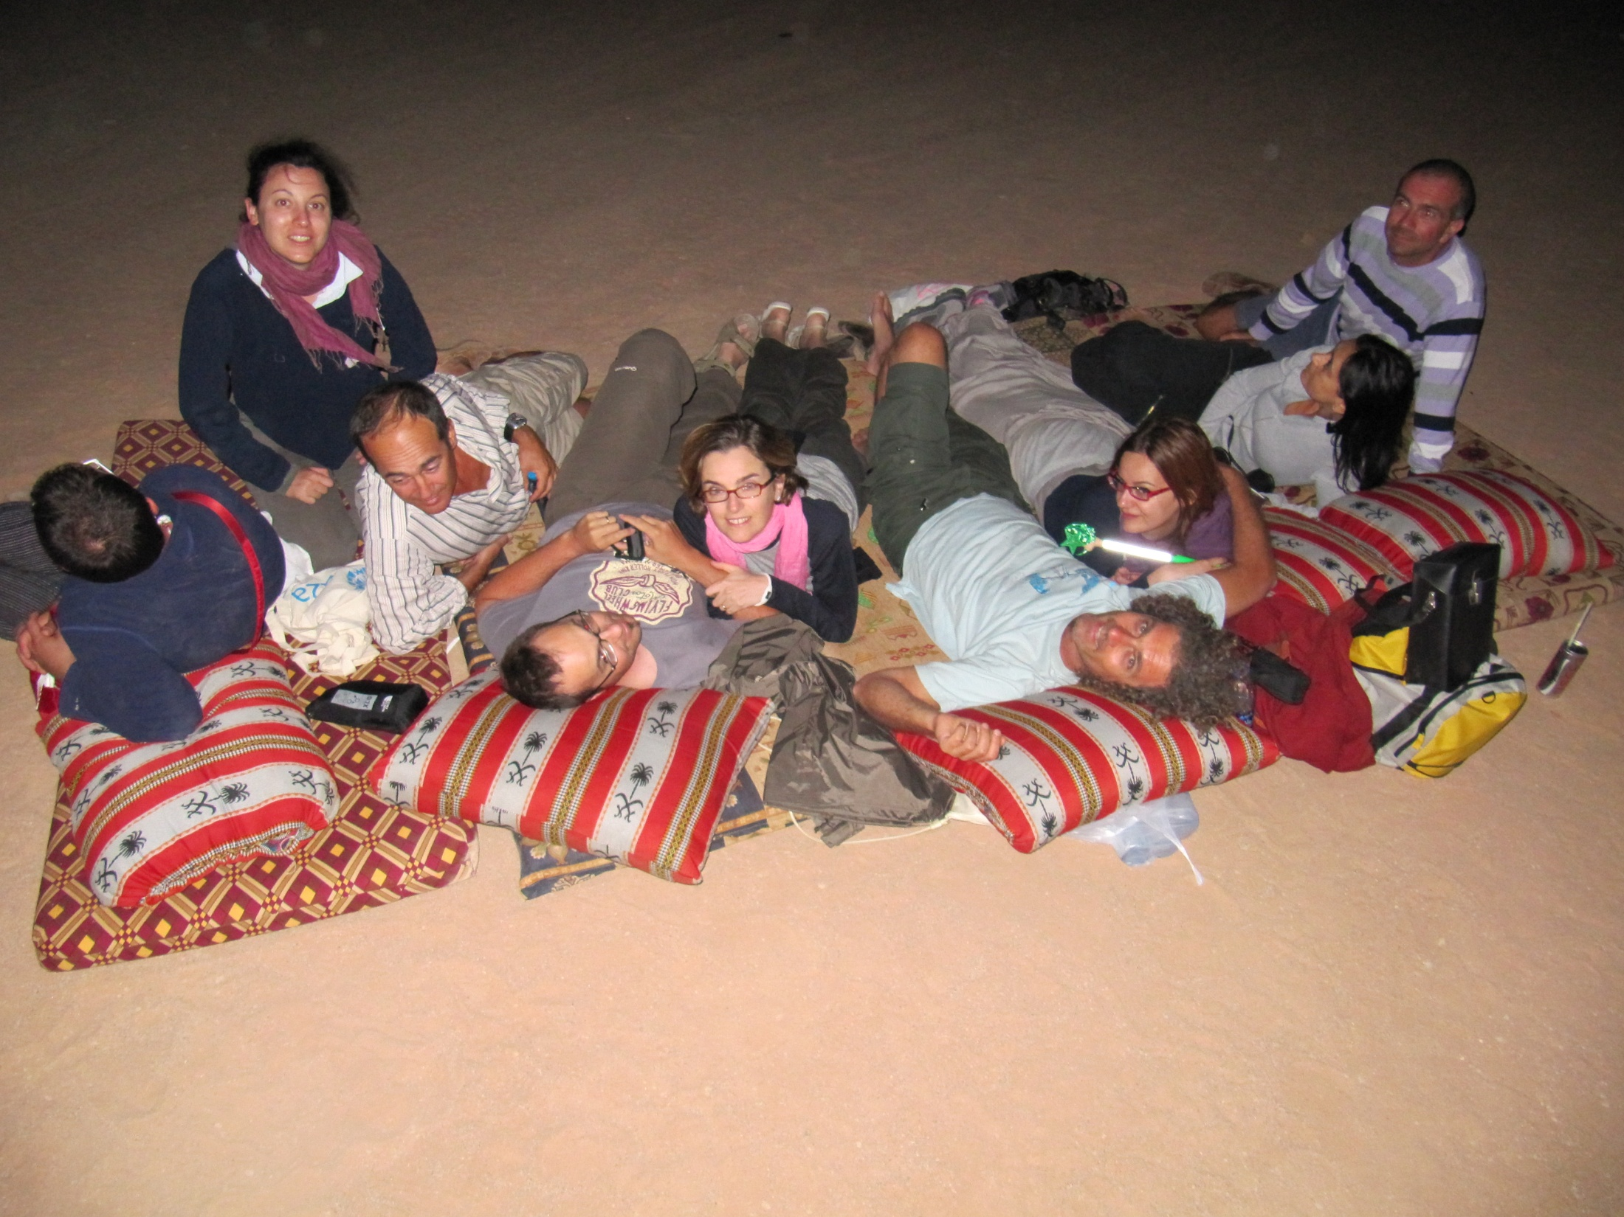
PERSEIDS IN JORDAN
Watching the Perseid meteor shower from the Wadi Rum desert (2010) with a group of 10 on a tour of Jordan with Vagabondo.
My role: tourleader and astronomer

Slide 31
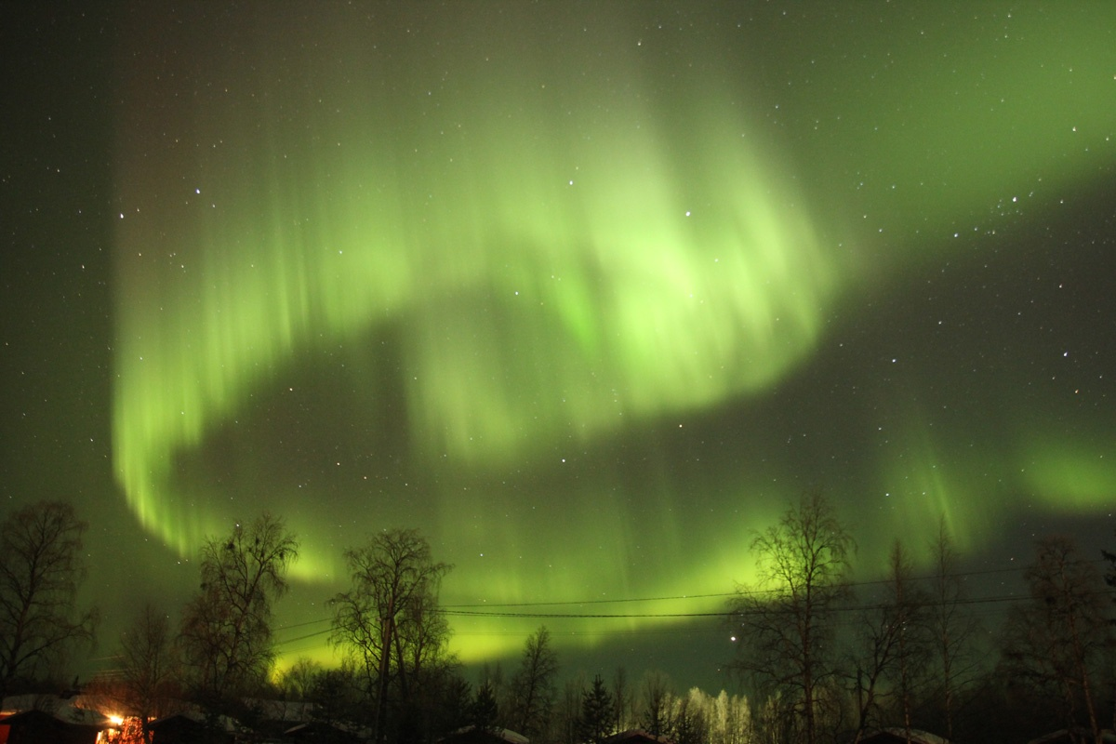
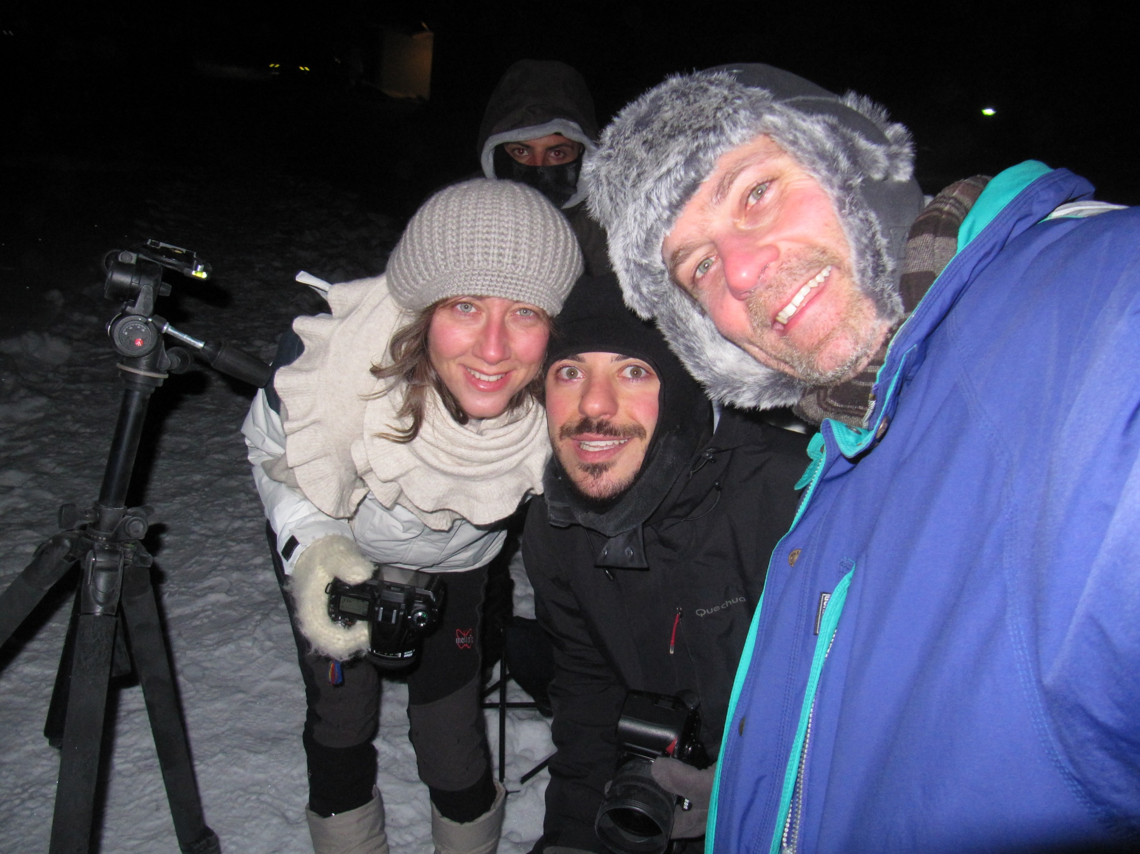
NORTHERH LIGHTS IN LAPLAND
Watch and photograph the northern lights on a dedicated trip to Ivalo (Finnish Lapland), with a group of 14 for Vagabondo, in 2013.
My role: tourleader, astronomer, astrophotographer

Slide 32
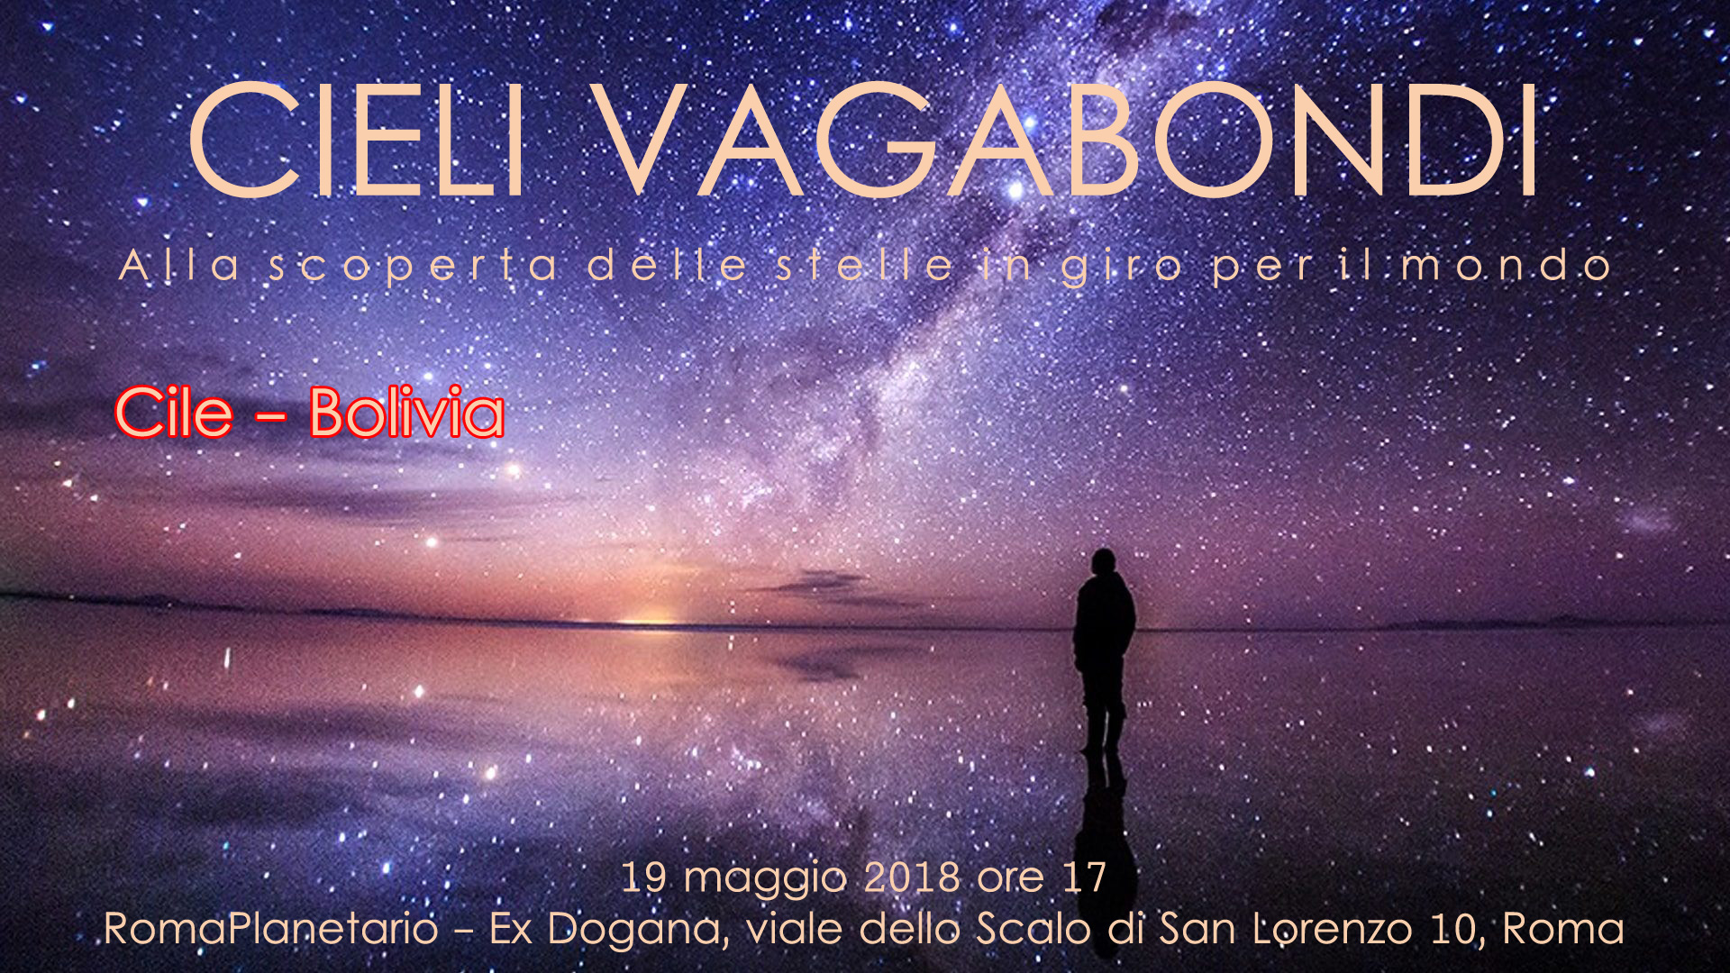
Back to the planetarium: touring the sky of your next holiday destination.

Slide 33
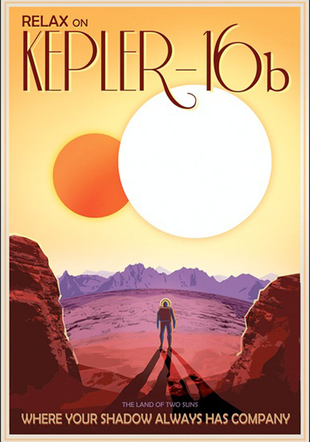
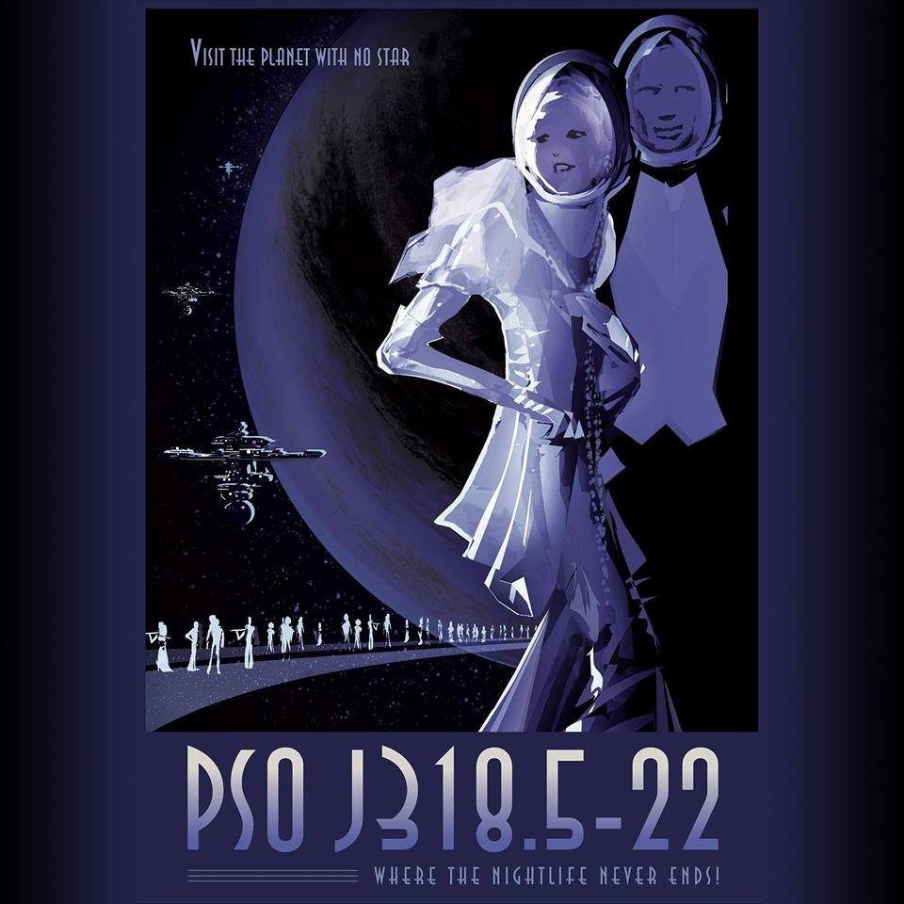
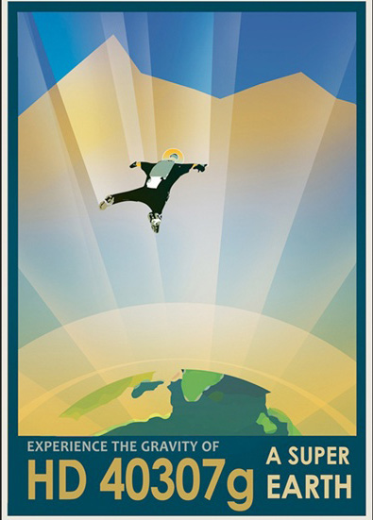
INFORMATION FRAMING OR SCIENTIFIC MARKETING
The touristic approach is so effective that NASA uses it to promote its discoveries (i.e. exoplanets).

Slide 34
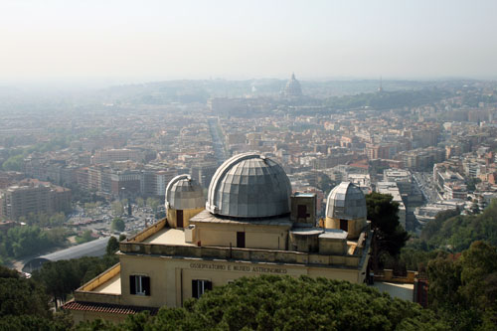
A PERFECT SHOWCASE OVER ROME
Astrotourism may help research institutions framing their mission within people’s lives, perhaps better than press releases.

Slide 35
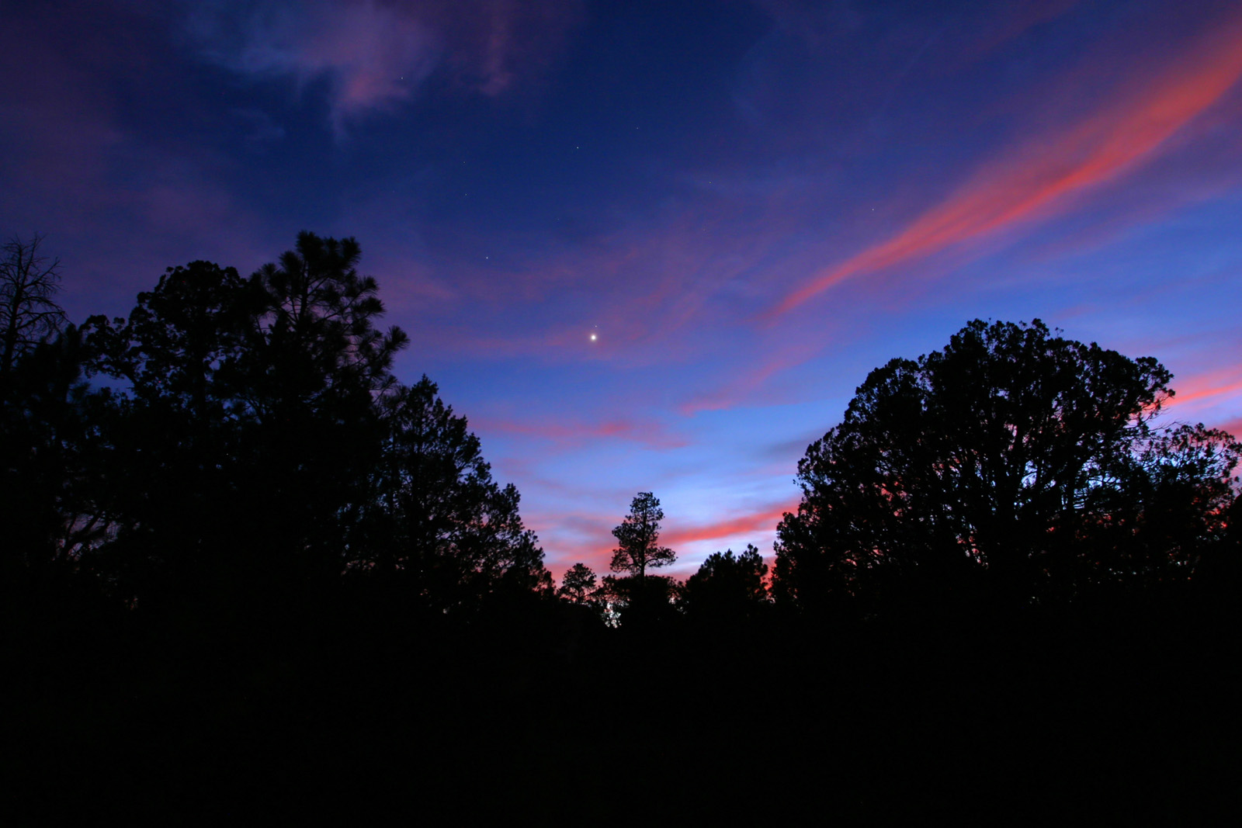
THE SKY AS A GATEWAY TO THE UNIVERSE

Slide 36
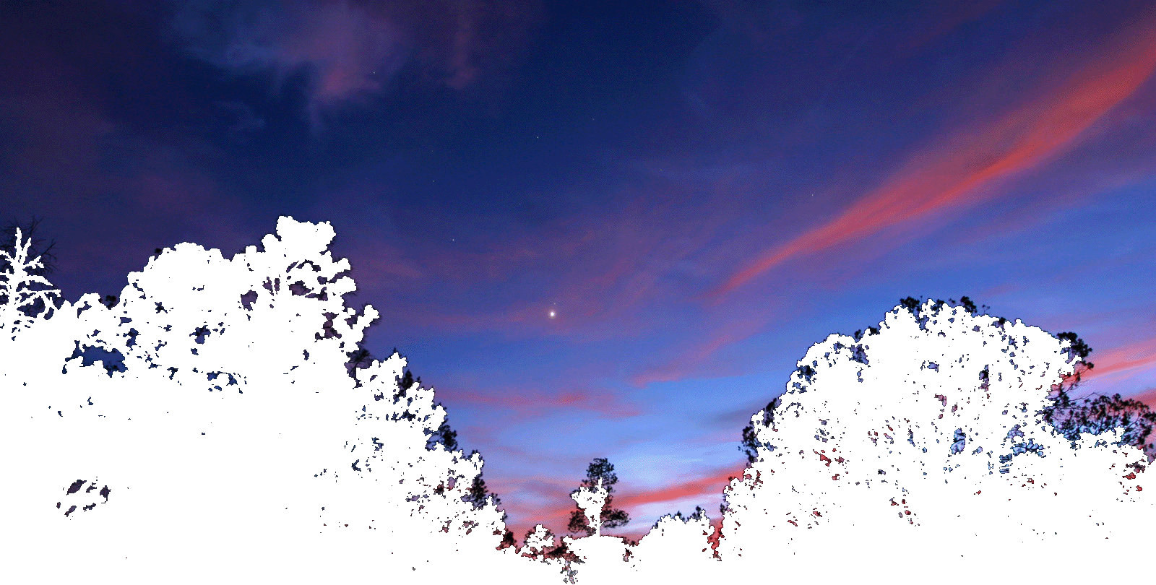
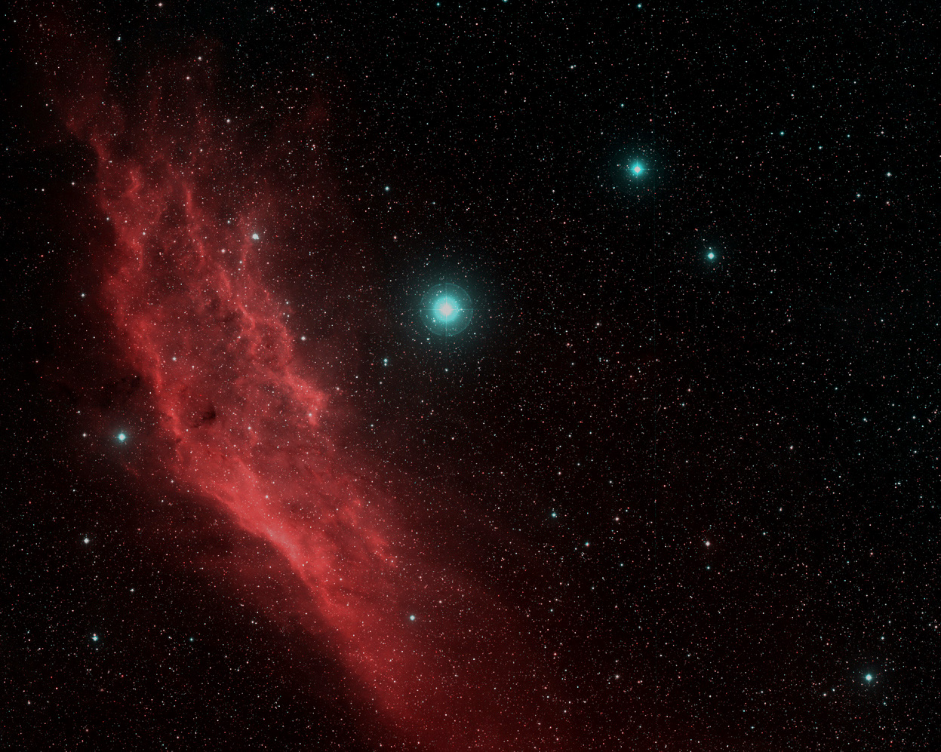
THE SKY AS A GATEWAY TO THE UNIVERSE

Slide 37
2020:
First European Touristic Spaceport, Grottaglie

Slide 39
CONTACTS
stefano_giovanardi@yahoo.it
Facebook: Stefano Giovanardi
Twitter: @SGiovanardi
Skype: stefano.giovanardi
+393401647871

Slide 43
Coordinamento fra Inaf, Asi, Università e Planetario per integrare l’offerta culturale astronomica su Roma (e nel Lazio).
Il Planetario è un perno naturale di contatto col pubblico e di raccordo con gli enti di ricerca.
Molti turisti cercano il planetario.

Slide 44
Experience the enchantment (Max Weber)
Play with the expectations of the public (satisfy or disappoint them in a constructive dialogue)

Slide 64
Il Triangolo della Comunicazione
Planetari
Accademia Astrofili
Livello narrativo
Livello di approfondimento Livello emotivo

