Slide 1
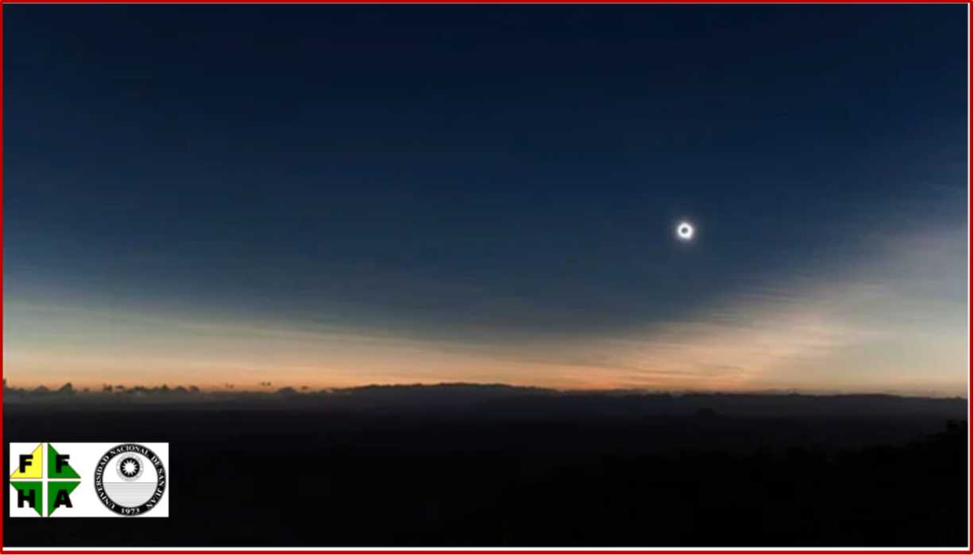
July 2, 2019: Helios' corona shines in the skies of Chile and Argentina
Claudio Carlos Mallamaci
Facultad de Filosofía, Humanidades y Artes
Universidad Nacional de San Juan
Chianti Topics / 11-13 July 2018 / 3rd International Focus Workshop

Slide 2
My travel from San Juan (Argentina) to Chianti (Italy)
OPC : 43°31’23”N ; 11°14’41”E
San Juan : 31°32’14”S ; 68°31’30”W
Dist. : ≅ 11650 km (104.5°)

Slide 3
Hawaii Islands
(1900 km to Northern limit)
Panama Canal
(90 km to NL)
Northern limit
Atlantic Ocean
Galapagos Islands
(2700 km to Mx)
Pacific Ocean
Tahiti (730 km to P1)
Mx (19:23 UT)
P4 (21:50 UT)
Path of
totality
San Juan
P1 (16:55 UT)
Oeno Island
50 km from Central line
Eastern Island
(1100 km to Mx)
U1 (18:02 UT)
Argentina
U4 (20:43 UT)
Maximum
at sunrise
Begin at
sunrise
End at
sunset
Maximum
at sunset
Begin at
sunset
Chatham
Island
(360 km to EoS)
Visibility región of the eclipse. The totality path will touch land only in Chile and Argentina
End at
sunrise

Slide 4
P4 (21:50 UT)
Bolivia
Paraguay
Chile
1000 km
Brasil
Córdoba
San Juan
(just in the border)
Uruguay
Buenos Aires and La Plata (10 km out of the path)
End at
sunset
Maximum
at sunset
Begin at
sunset
Totality path over Chile and Argentina

Slide 5
Detail over
Chile and Argentina
The westernmost part of Argentina is the least cloudy región within the path of totality, and San Juan is located in the most favorable región to observe totality.
Furthermore, Bella Vista, in particular, is almost on the central line and with the best weather forecast.
Adapted from http://eclipsophile.com/total-solar-eclipse-july-2-2019/

Slide 6
The Moon’s shadow at the time of máximum in Bella Vista (Adapted from http://xjubier.free.fr/en/site_pages/solar_eclipses/TSE_2019_GoogleMapFull.html)
Total eclipse path over San Juan and Chile
Las Campanas and GMT
La Silla
Bella Vista
(Tmx = 20:40.9 UT)
Tololo
T(mx) = 20:40.9 UT
Gemini South
At this location, the shadow of the Moon is an ellipse of approximately 143 km wide and 625 km long from Caleta Chanaral (Chile) to (almost) Lujan (Argentina). Three observatories (La Silla, Tololo and Gemini South) fall within the path of totality).
The shadow travels at a speed of 3.5 km/s (12660 km/h).
San Juan
El Leoncito
San Francisco del Monte de Oro

Slide 7
The Moon’s shadow at the time of máximum near Talita (San Luis) (Adapted from http://xjubier.free.fr/en/site_pages/solar_eclipses/TSE_2019_GoogleMapFull.html)
Total eclipse path over San Juan and Chile
San José de Jáchal
Talita
(Tmx = 20:42.4 UT)
Less than 2 minutes later, the shadow of the Moon has changed to an ellipse of approximately 120 km wide and 1200 km long, from San José de Jáchal (N. of San Juan) to Gral. Belgrano (Buenos Aires), and travels at a speed of 5.6 km/s (20000 km/h).
Gral. Belgrano

Slide 8
Simulated view of the eclipse from Bella Vista
Adapted from https://www.peakfinder.org

Slide 9
In science
  Einstein’s General Theory of Relativity can be tested (for example…)
  shape, structure and extent of the corona can be studied
  better measurements of the solar radius can be achieved in education
  science camps can be organized for students training (for example…)
  general knowledge can be presented, enriched or improved (f. example…)
In culture
  its use in artistic expressions (literature, painting, movies, &c.)
  can be studied (for example…)
In astro-tourism and dissemination of Astronomy
  eclipse tours expeditions and astro-tourism in general can be organized (for example…)
Taking advantage of
total solar eclipses
The end

Slide 10
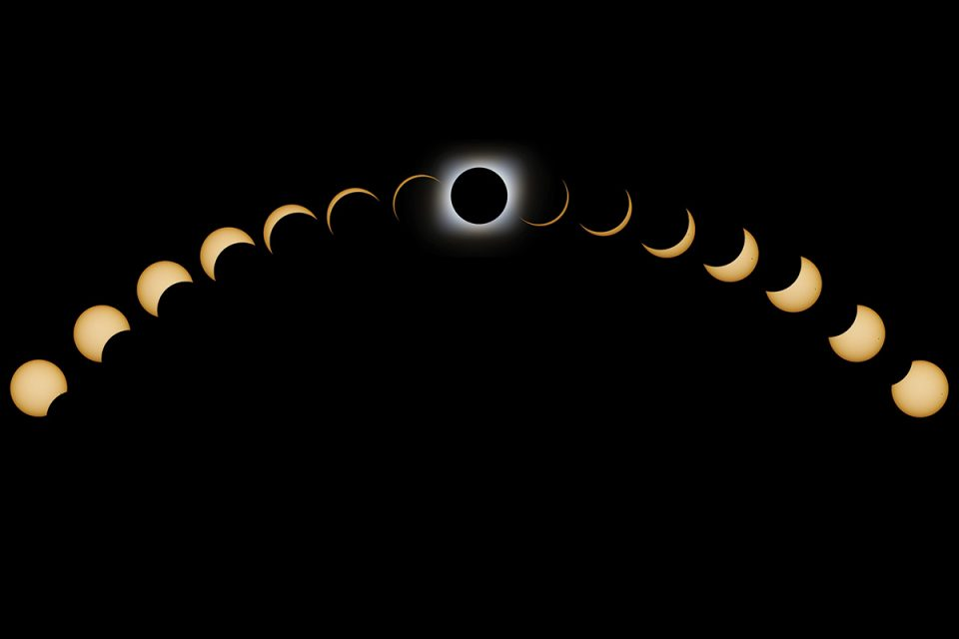
That’s all folks!
Restart

Slide 11
Images linked in
"Helios corona shines (…).pptx"

Slide 12
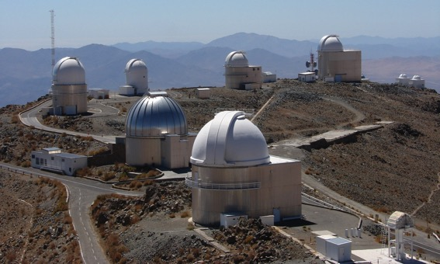
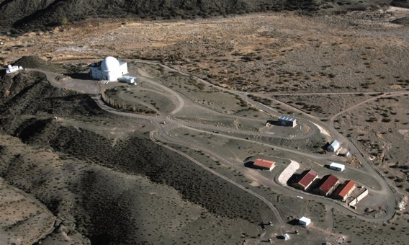
La Silla (2400 m): within the shadow
Cerro Tololo (2200 m): within the shadow
CASLEO - El Leoncito (2483 m): out of the shadow
CUC - El Leoncito (2348 m): out of the shadow

Slide 13
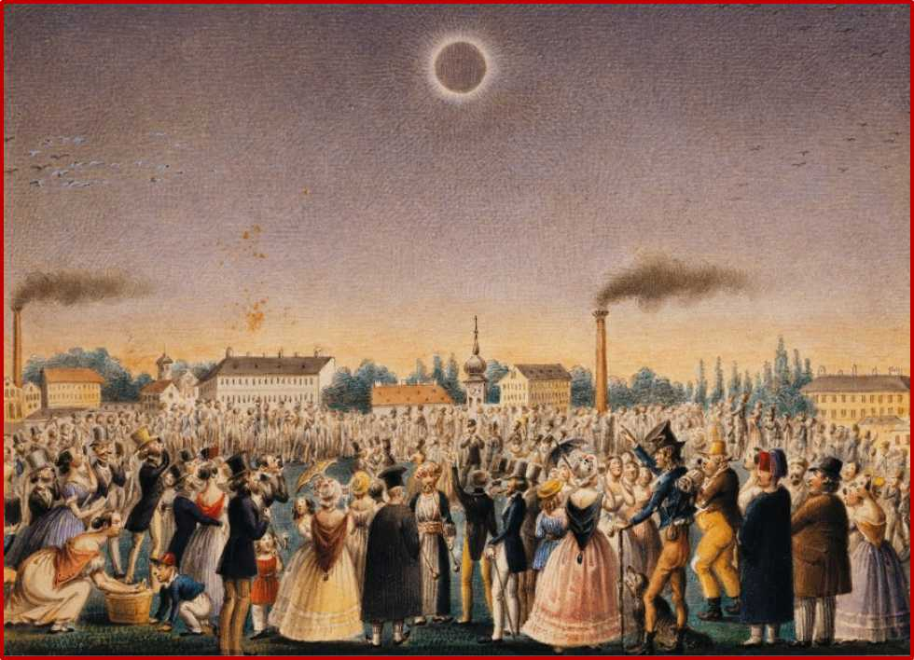
Eclipses in painting...
Total Solar Eclipse of 8 July 1842 as viewed from Vienna
(depicted in 1842 by Johann Christian Schoeller)

Slide 14
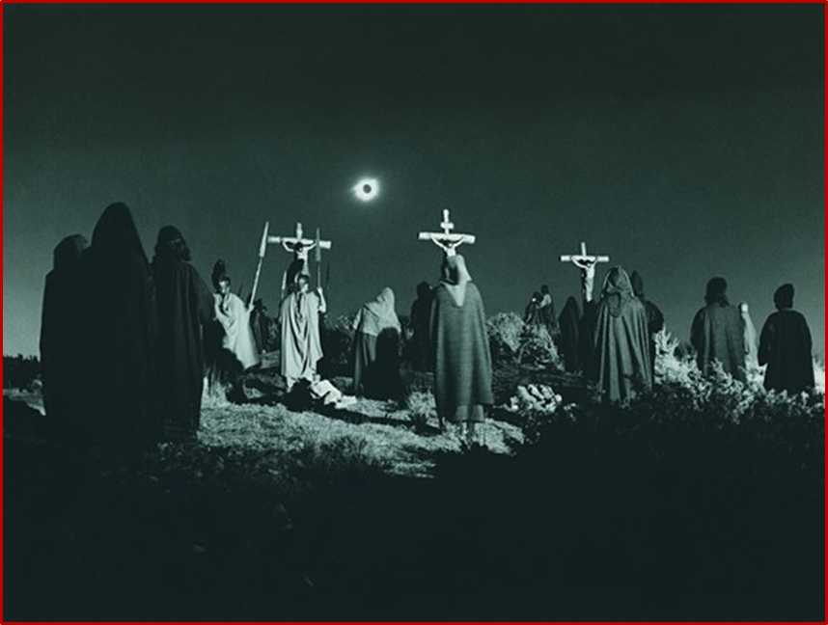

or in movies...
Miraculous eclipse of the Sun in the film Barabbas

Slide 15
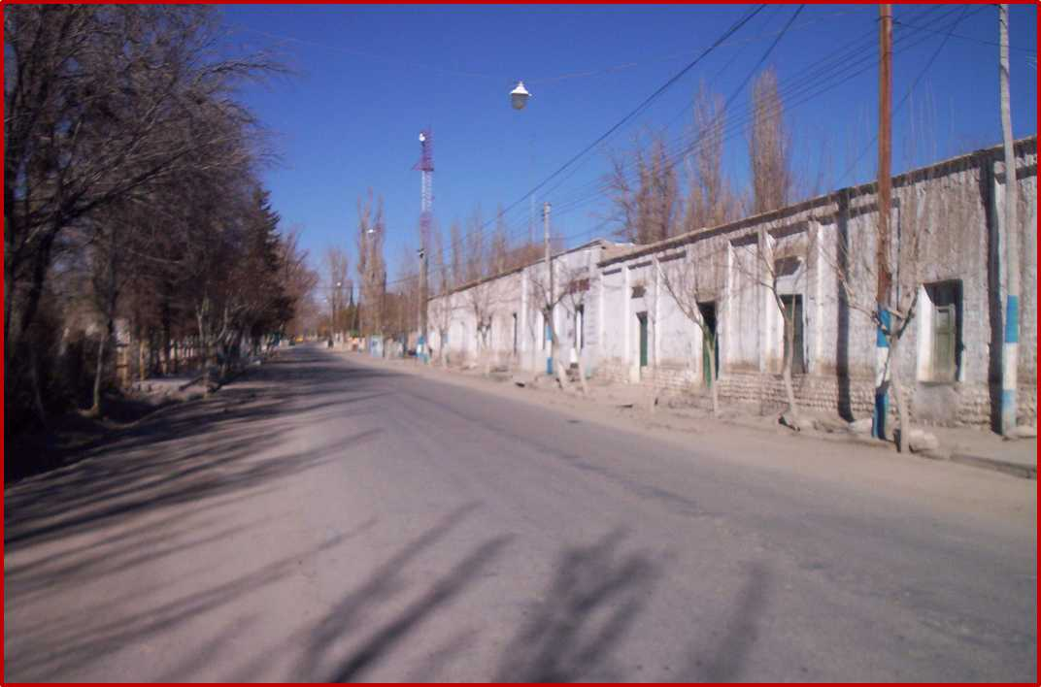
Main Street of Bella Vista
(500 inhabitants)
Volver

Slide 16
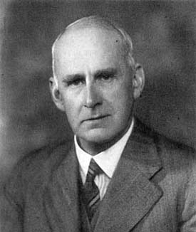
Einstein’s General Theory of Relativity can be tested, as it was made one century ago, in 1919, by Sir. A. Eddington
Total solar eclipse of May 29, 1919
https://www.space.com/37018-solar-eclipse-proved-einstein-relativity-right.html
Sir Arthur Eddington

Slide 17
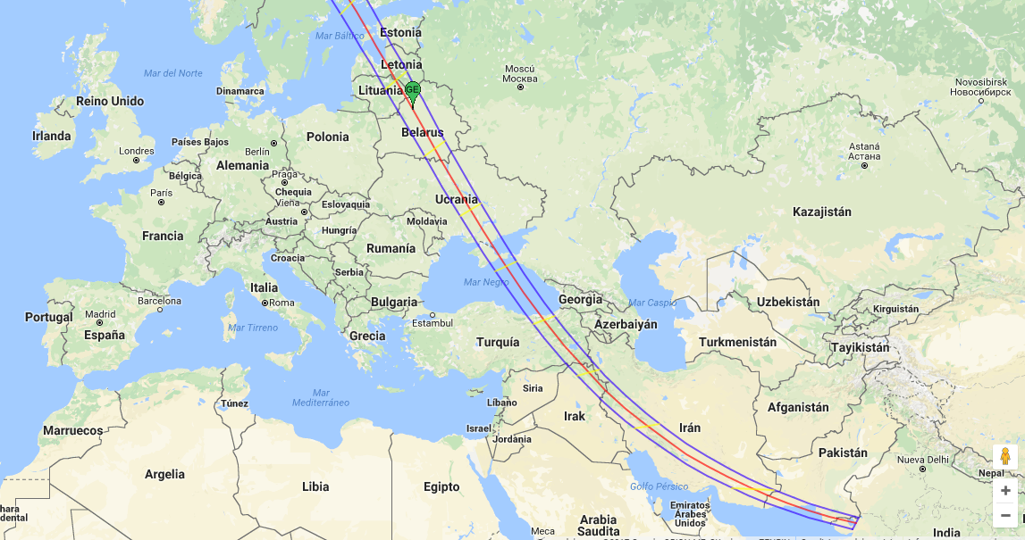
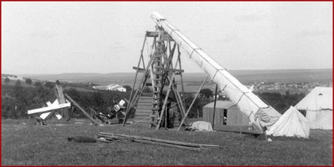
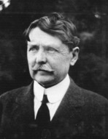
… or as attempted in 1914 by Dr. Perrine, Director of the Observatorio Nacional Argentino, in Feodosia
(the expedition had to be aborted due to the start of the Great War in July 1914)
Total solar eclipse of 21 August 1914
Feodosia
Odessa

Slide 18
Possible activities to carry out at the science camp through different kind of observatories
Astronomical observatory
(Learning basic concepts and observational training)
Shadows observatory
(Observing the moon shadow and flying shadows)
Meteorological observatory
(Recording of meteorological data, before, during and after the eclipse)
Radio astronomy observatory
(Building a simple antenna for monitoring general EM radiation)
Images observatory
(Photographic and video record of the eclipse)
Planets and stars O.
(Recording of visible planets and stars during the total eclipse phase)
Lights, colors and flying shadows observatory
(Observing light and colors variations)
Ecological observatory
(Recording changes in behaviour of the ecological environment of the site)
Social observatory
(Recording of people's behaviour during the eclipse)

Slide 19
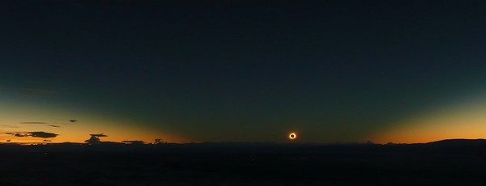
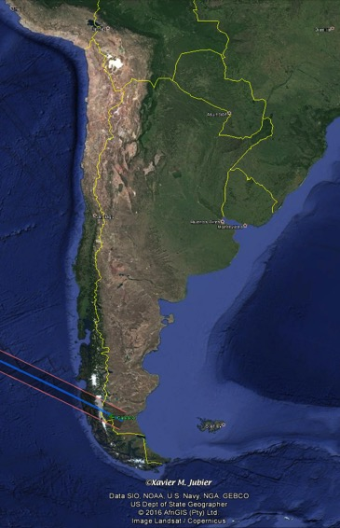
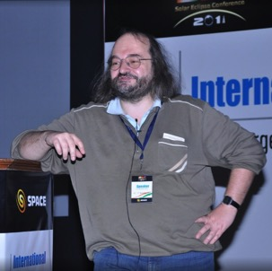
The shadow of the Moon and the solar corona
11-jul-2010 – El Calafate (2m47s)
Solar eclipse of 11 July 2010 at El Calafate (Argentina).
Something similar to this view can be expected for the 2019 eclipse from Bella Vista
El Calafate
Photograph by Daniel Fischer

Slide 20
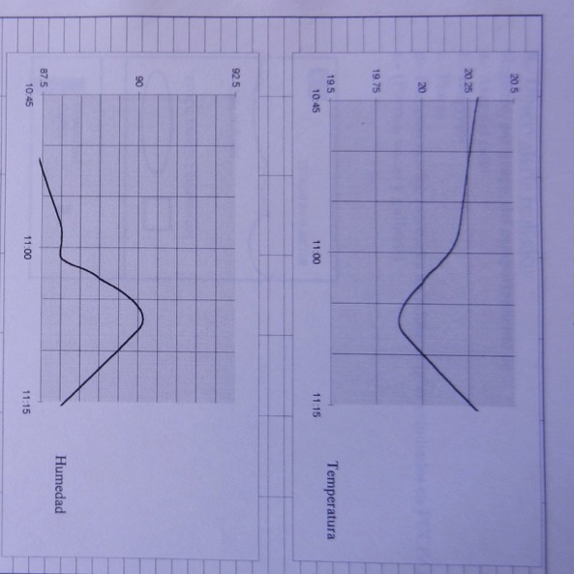
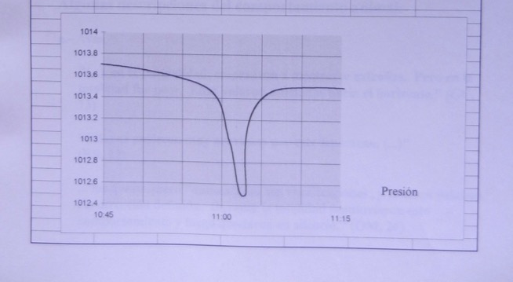
Some simple examples of results obtained by students in the Science Camp for the November 1994 eclipse
Meteorological changes during the eclipse (original field graphs)
Temperature and humidity show their extreme values shifted about 7 minutes with respect to the maximum of the eclipse, due to the effect of atmospheric inertia.
Pressure, however, is at a minimum just 2 minutes after the maximum, and with a steeper slope.

Slide 21
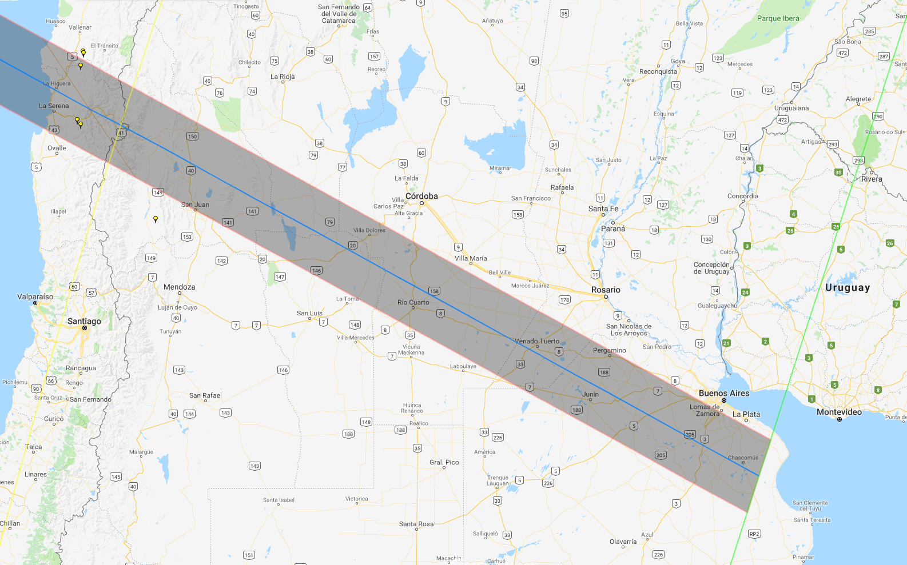
Esquina (400 km)
Isla Martín
García (70 km)

Slide 22
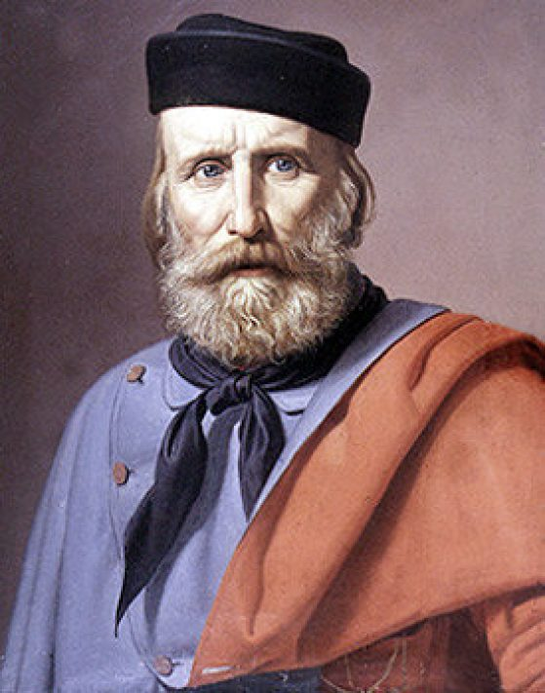
In August 1842, G. Garibaldi and G. Brown faced off in a naval battle, in Parana River, near the locality of Esquina (Corrientes)
Giuseppe Garibaldi
Guillermo Brown

Slide 23
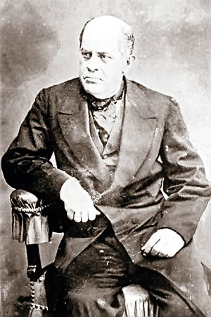
In 1850, before Argentina took the present configuration, Sarmiento (who would become President of the Nation) proposed Martín García Island as Capital of the Confederates States of Río de la Plata, a state formed by what is now part of Argentina, Uruguay and Paraguay .

Slide 24
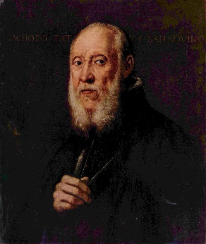
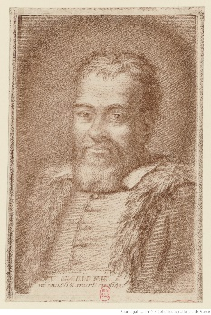
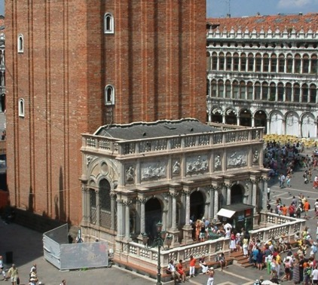
Some historical events on the date of the eclipse
Tuesday 2 July 1591:
Vincenzo Galilei, Italian lutetist and composer (born in 1520) and father of Galileo, dies.
Galileo Galilei Vincenzo Galilei
Sunday 2 July 1486:
Jacopo Tatti Sansovino, one of the most important artists in Venice, is born in Florence
Loggetta del Campanile
Piazza San Marco - Venezia

Slide 25
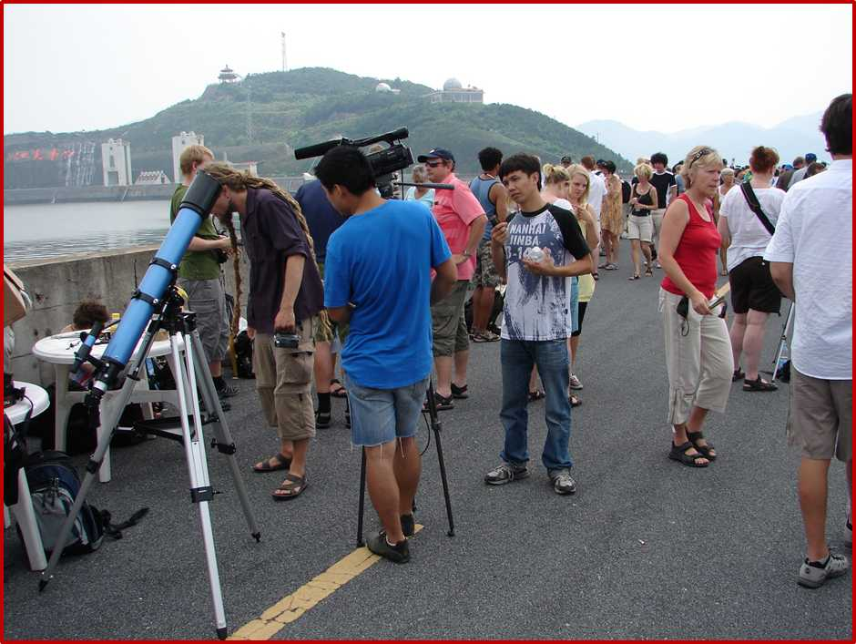
And, of course, the eclipse is a strong motivator for tourism

