Slide 1
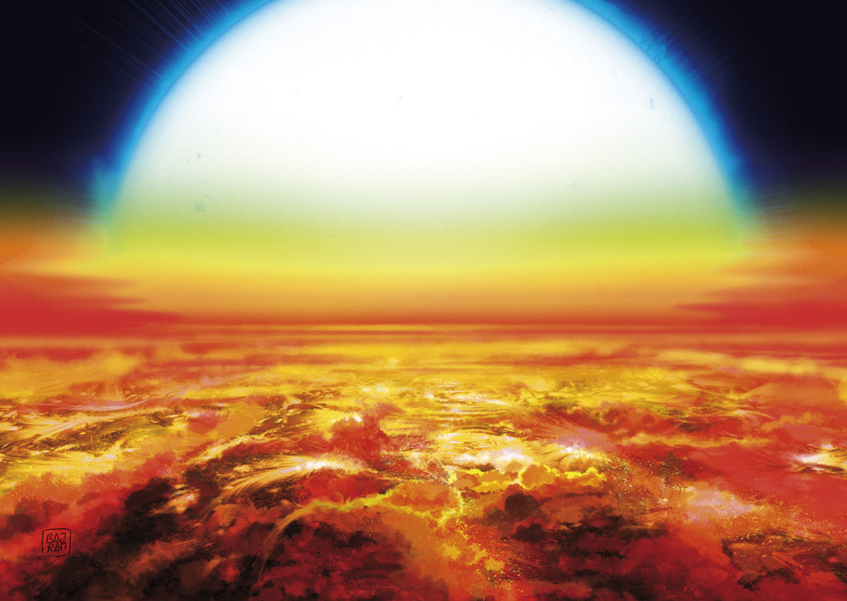


Ultra-hot Jupiters as laboratories
for theories of atmospheric structure and planet formation
Credits: Denis Bajram
Lorenzo Pino
INAF - Osservatorio Astrofisico di Arcetri
5th Chianti Topics
Main collaborators:
Matteo Brogi, Jean-Michel Désert,
Michael Line, GAPS collaboration
Notes:
HJ: dominant planet observed with JWST in the first two years
This is not over yet!!!
Statistics and transits: we may know more than about Saturn
My data: in a year from now.
HR and LR: upfront define
Coninuum: RML important for that?

Slide 2
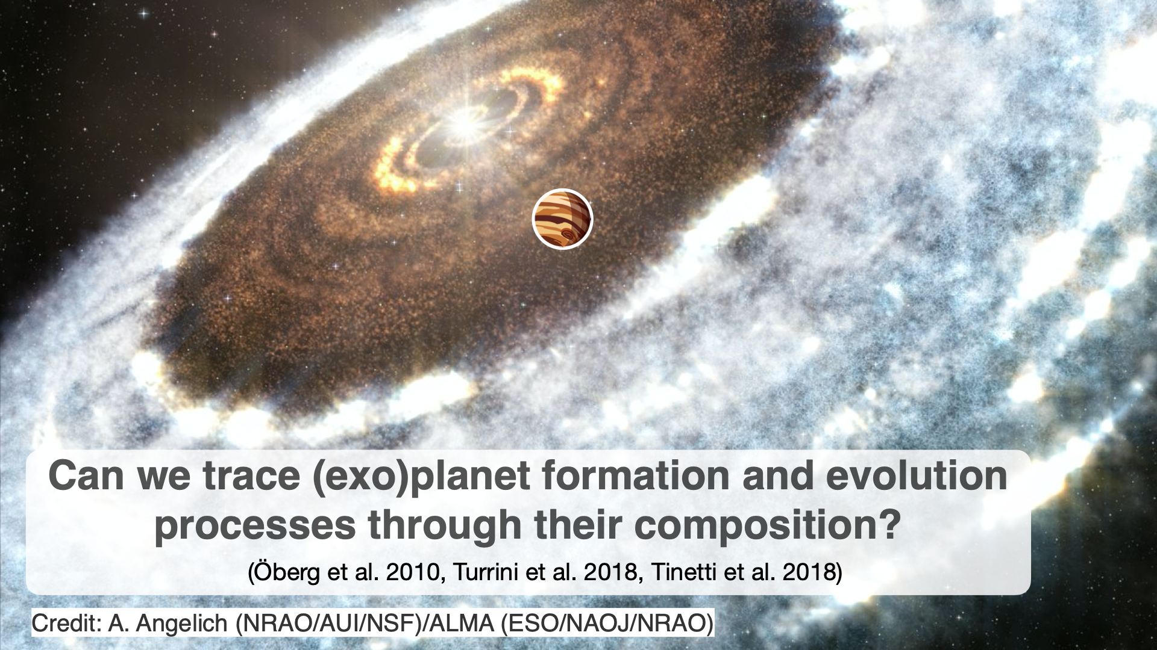

Slide 3
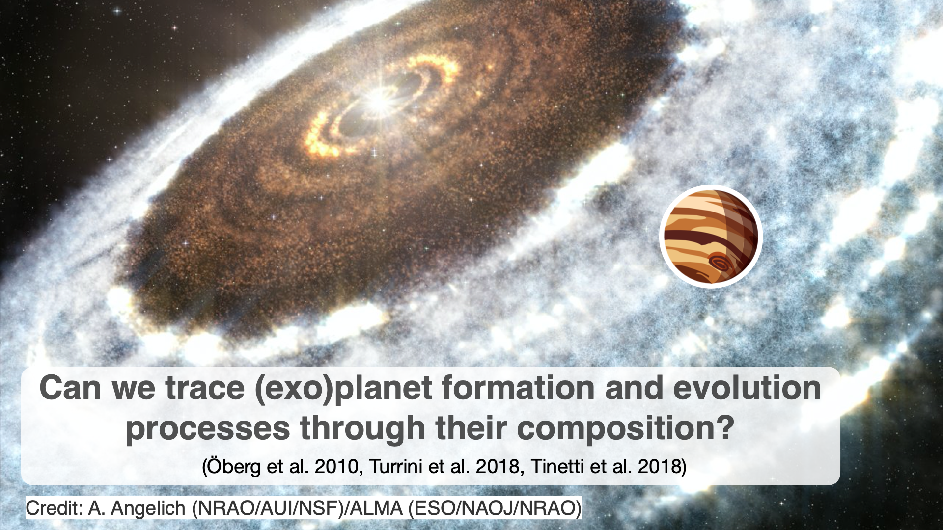

Slide 4
Every element tells a different story!

Slide 6
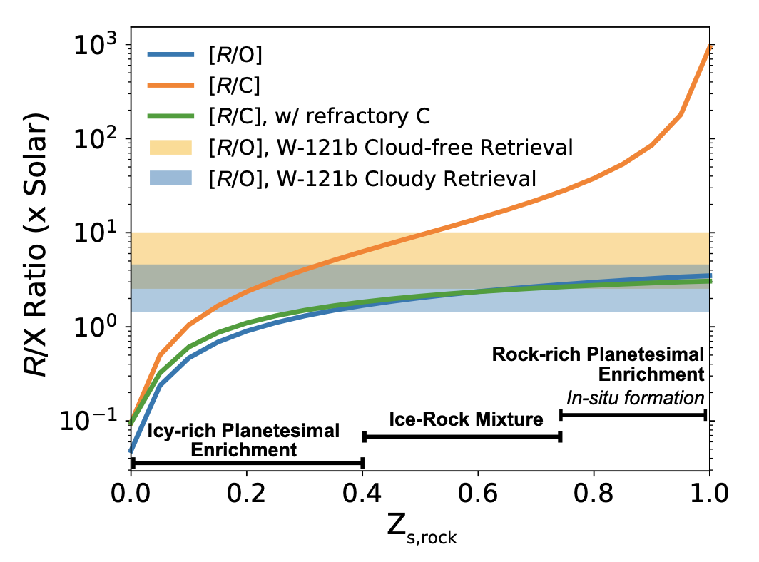
Refractory-to-volatile ratio to trace planet formation
Atmospheric abundances
are connected to the
“rockiness” of accreted planetesimals
Lothringer et al (2021)

Slide 11
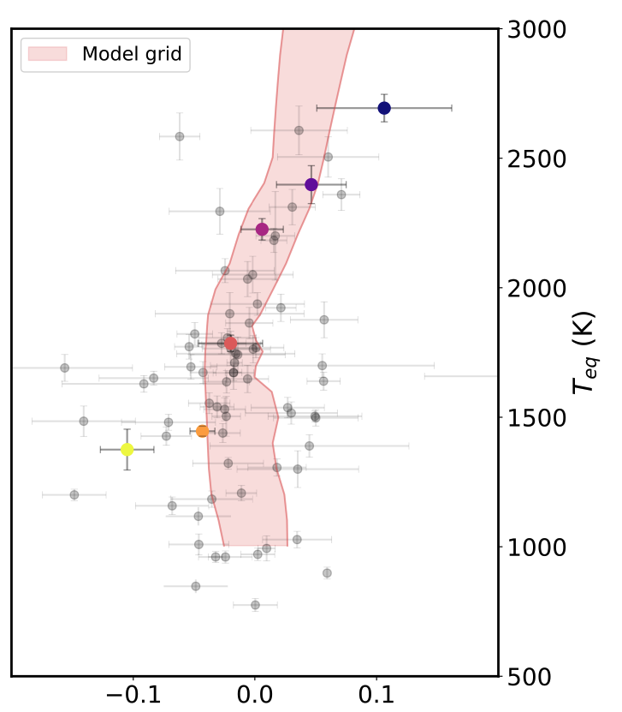
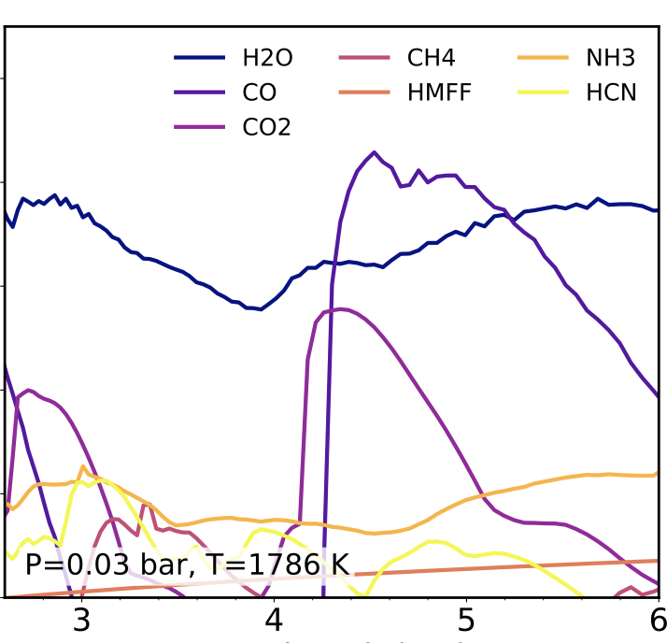

Ultra-hot Jupiters: the hot end of hot Jupiters
See also:
Mansfield et al.
(2022)
Cross-section
Wavelength (μm)
Likely, ultra-hot Jupiters share formation and evolution processes with “regular” hot Jupiters.
Baxter et al. (2021)

Slide 12
Credits: Denis Bajram
KELT-9b (4,000 K), archetype of UHJs
UHJs as a population: Arcangeli et al. (2018),
Baxter et al. (2021), Mansfield et al. (2022)
Iron gas is expected in
their atmosphere!

Slide 13
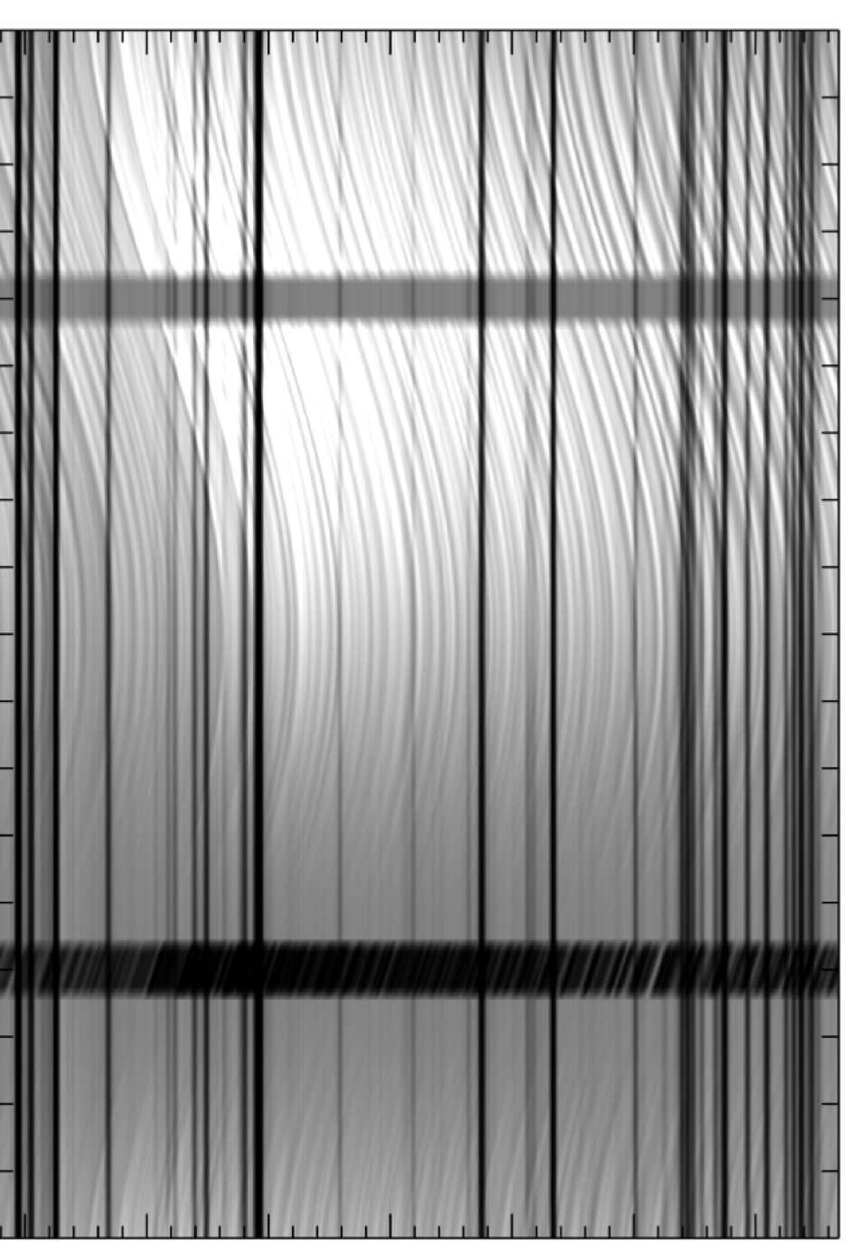
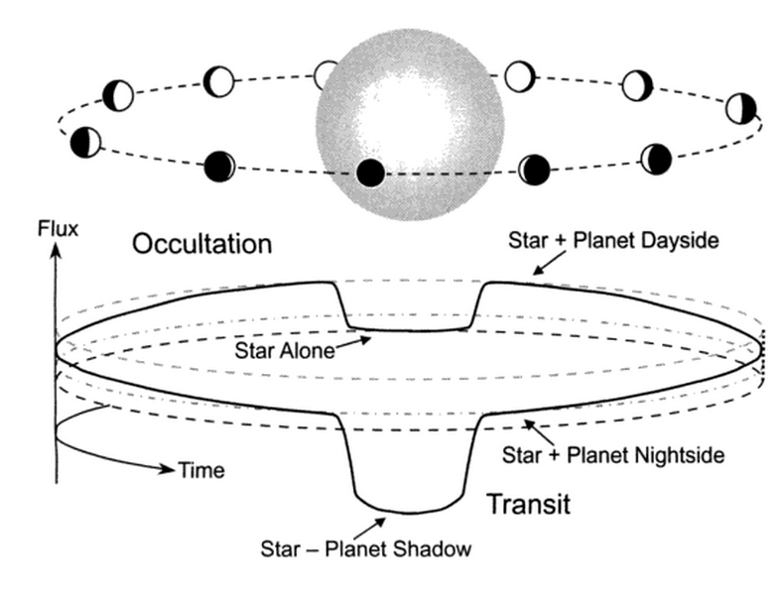
A new tool to study (U)HJs, optical HR phase curves
0.5
Planet phase
0.25
Credits: Joshua Winn
0
SNR on individual iron line:
Fp/F★ · SNR★ = 1.e-6 · 1,000 = 1.e-3
Wavelength
Not within reach of our
current best instruments
Hoeijmakers et al. (2015)
Notes:
Recording the combined star + planet flux of a transiting planet will provide a curve similar to this. Outside the primary transit, we are already recording some information about the planet atmosphere through its phase curve and secondary eclipse, which provide information about the brightness temperature of the planet as a function of phase.
Brief explanation of the different techniques, signals expected. Field started by pushing instruments not designed for this to their limit, which required understanding systematics at unprecedented level. We have now collected and successfully analyzed observations of tens of exoplanet atmospheres. The techniques are diverse in terms of spectral range, spectral resolution, ground based or space borne, planetary phase that they target. It is only from the combination of multiple of these techniques that we will be able to unravel the most compelling questions.

Slide 14
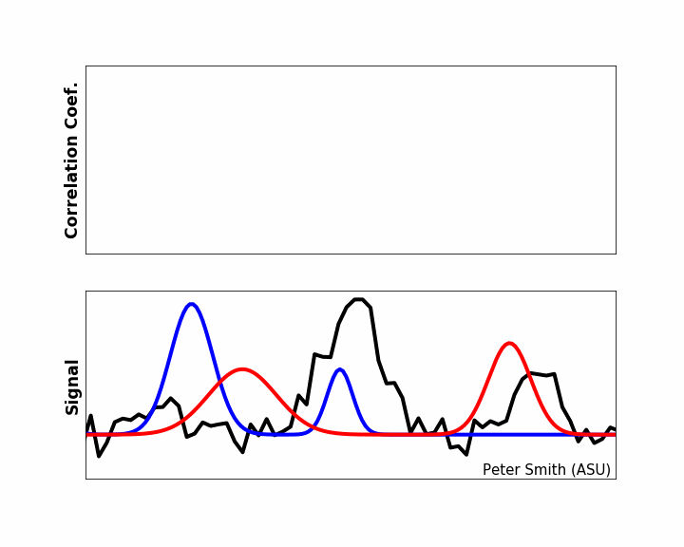
Cumulate signal from thousands of individual lines
0.5
Planet phase
0.25
0
Wavelength
Hoeijmakers et al. (2015)

Slide 15
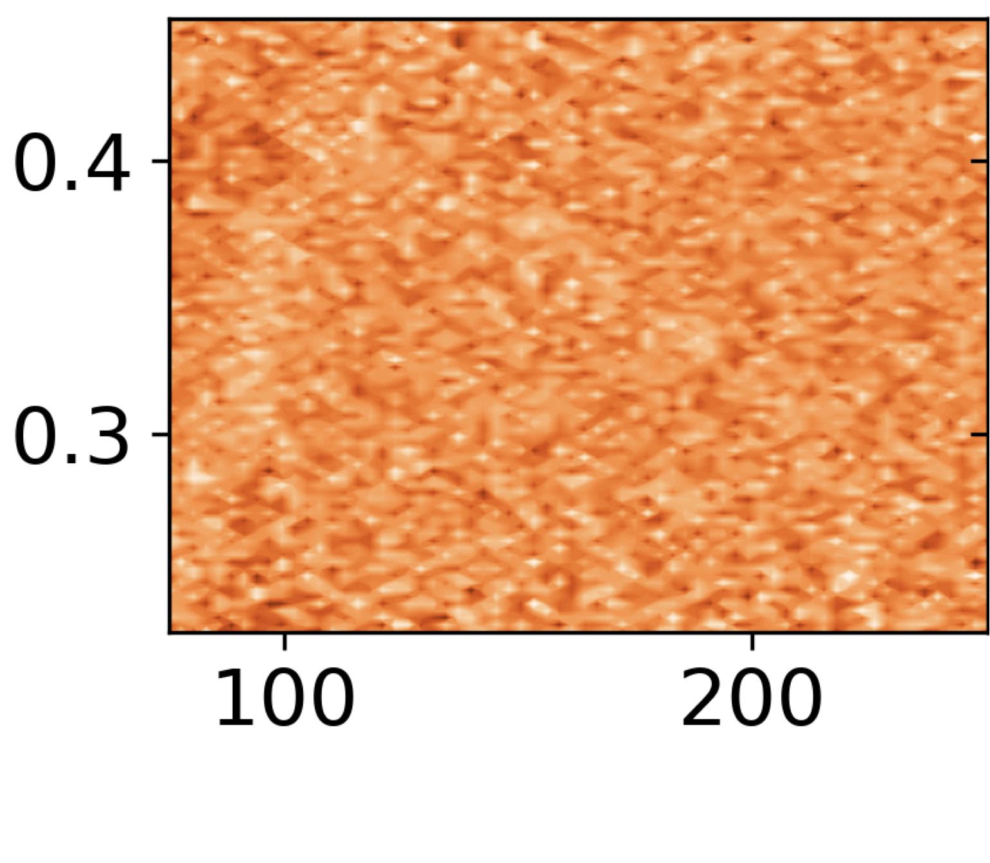
A new tool to study (U)HJs, optical HR phase curves
0.5
Planet phase
0.25
Credits: Joshua Winn
Radial velocity
[km/s]
0
HARPS-N
6 hours on UHJ KELT-9b
Fe I emission lines
Wavelength
Hoeijmakers et al. (2015)
Pino et al. (2020)
Notes:
Recording the combined star + planet flux of a transiting planet will provide a curve similar to this. Outside the primary transit, we are already recording some information about the planet atmosphere through its phase curve and secondary eclipse, which provide information about the brightness temperature of the planet as a function of phase.
Brief explanation of the different techniques, signals expected. Field started by pushing instruments not designed for this to their limit, which required understanding systematics at unprecedented level. We have now collected and successfully analyzed observations of tens of exoplanet atmospheres. The techniques are diverse in terms of spectral range, spectral resolution, ground based or space borne, planetary phase that they target. It is only from the combination of multiple of these techniques that we will be able to unravel the most compelling questions.

Slide 16
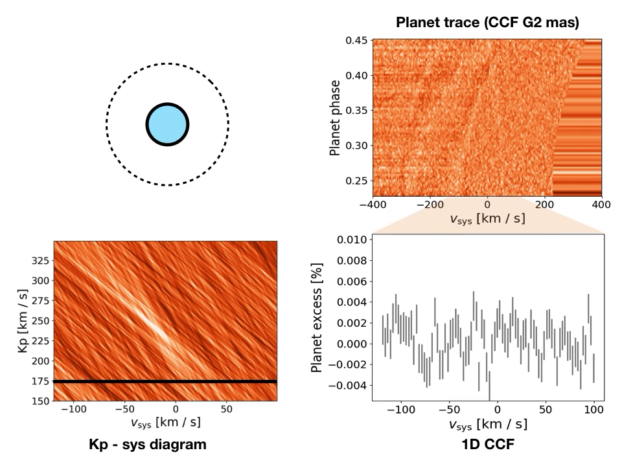
A new tool to study (U)HJs, optical HR phase curves
When correctly aligned in planet rest frame: average line interstected by G2 mask (iron)
Pino et al. (2020)

Slide 17
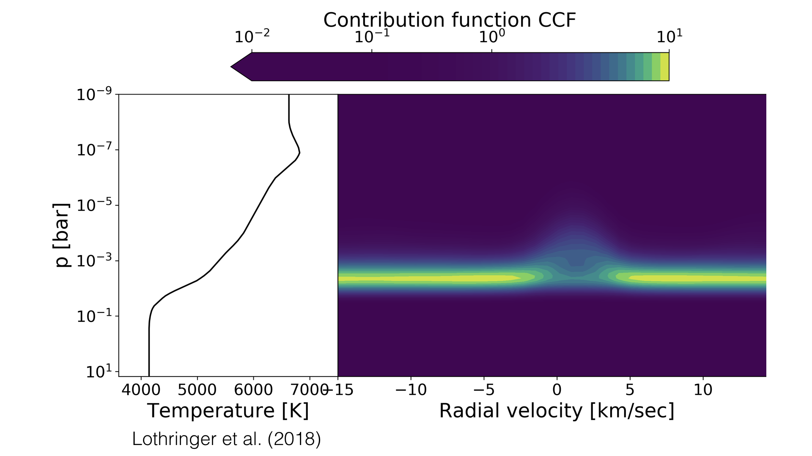
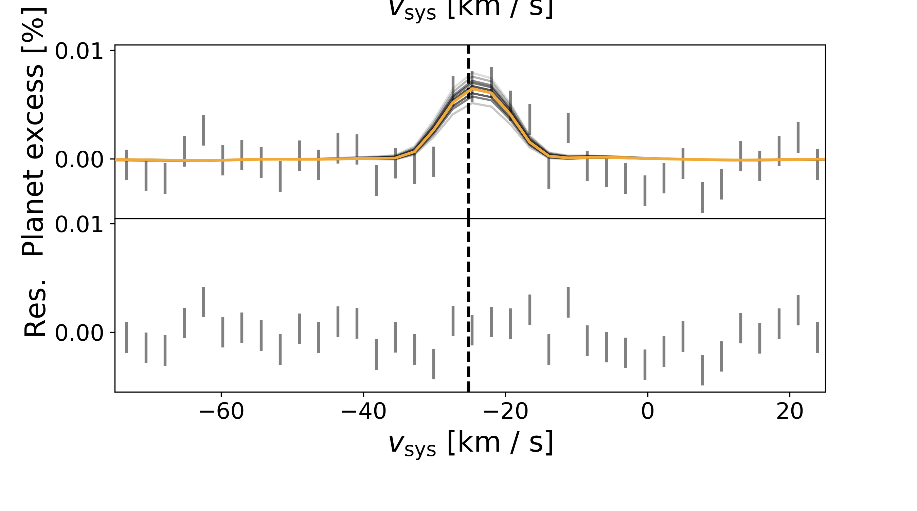
A thermal inversion in KELT-9b through iron lines
Pino et al. (2020)
Sensitive to
Fe I abundance
Thermal inversion
unambiguously detected

Slide 19
15 - 20 UHJs characterized in the next 2 - 3 years
KELT-9b
KELT-9b
Pino et al (2020)
WASP-33b
Pino et al (2020)
Nugroho et al. (2020)
WASP-189b
Yan et al. (2020)
KELT-20b
Yan et al. (2022)
Borsa et al. (2022)
Notes:
But also need abundances! -> LR + HR

Slide 20
15 - 20 UHJs characterized in the next 2 - 3 years
PI: PINO
KELT-9b
WASP-33b
Pino et al (2020)
MAROON-X
(500 – 900 nm):
∼50 hours acquired
ESPRESSO
(380 -800 nm):
∼60 hours acquired
Nugroho et al. (2020)
WASP-189b
Yan et al. (2020)
KELT-20b
Yan et al. (2022)
Borsa et al. (2022)
Symbol size proportional to expected SNR
Notes:
But also need abundances! -> LR + HR

Slide 21
15 - 20 UHJs characterized in the next 2 - 3 years
PI: PINO
KELT-9b
WASP-33b
Pino et al (2020)
Stronger?
MAROON-X
(500 – 900 nm):
∼50 hours acquired
ESPRESSO
(380 -800 nm):
∼60 hours acquired
Nugroho et al. (2020)
WASP-189b
Yan et al. (2020)
Thermal
inversions
KELT-20b
Yan et al. (2022)
Borsa et al. (2022)
Weaker?
No Fe, TiO…?
Main objectives:
Thermal structure
Chemical abundances
Symbol size proportional to expected SNR
Notes:
But also need abundances! -> LR + HR

Slide 22
Do we need to include more physics in our models?
Main open questions on which I am working:
Notes:
The key take-home messages from this presentation are: (1) We need to fully explore the potential of our data already now; (2) we need to combine data from different facilities to obtain the best. I’ll show the first steps in this direction using UHJs as an example

Slide 23
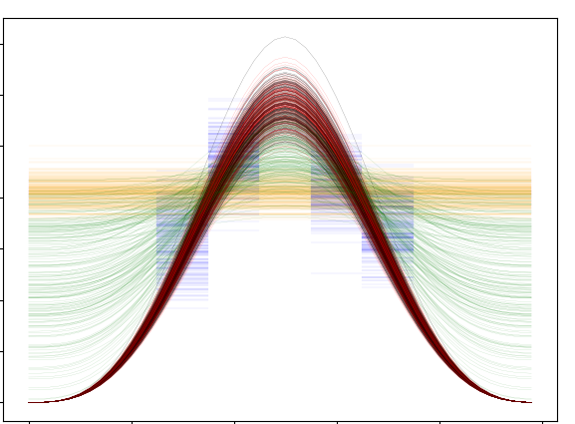
Re-assessing KELT-9b iron emission (Pino + in prep.)
Pino et al. (2020)
Pre-eclipse
Post-eclipse
PRELIMINARY.
Combination of 5 nights with 4-m class telescopes.
Potential to observe three-dimensional effects in the planet atmosphere.
Here, tentative symmetry around the sub-stellar point.
Planet moving
Iron emission strengths
See also Zhang et al. (2017), Beltz et al. (2021), Herman et al. (2022), Van Sluijs (2022)
Planet phase

Slide 24
Do we need to include more physics in our models?
Are there unique tracers of individual planet formation/evolution processes?
E.g.: migration within the disk; instauration of semi-convective interior; presence of condensates (clouds, aerosols)
→ Multiple species resolved in longitude (time)…
→ For many planets.
Main open questions on which I am working:
Notes:
The key take-home messages from this presentation are: (1) We need to fully explore the potential of our data already now; (2) we need to combine data from different facilities to obtain the best. I’ll show the first steps in this direction using UHJs as an example

Slide 25






Star
Later accretion determines composition?
Earlier accretion determines composition?
Condensates and rainout
Atmosphere
Envelope ⟷ atmosphere
Core?
Diluted
core?
Climate
winds
Two keys:
Multiple species resolved in longitude (time)…
For many planets.
Envelope

Slide 26
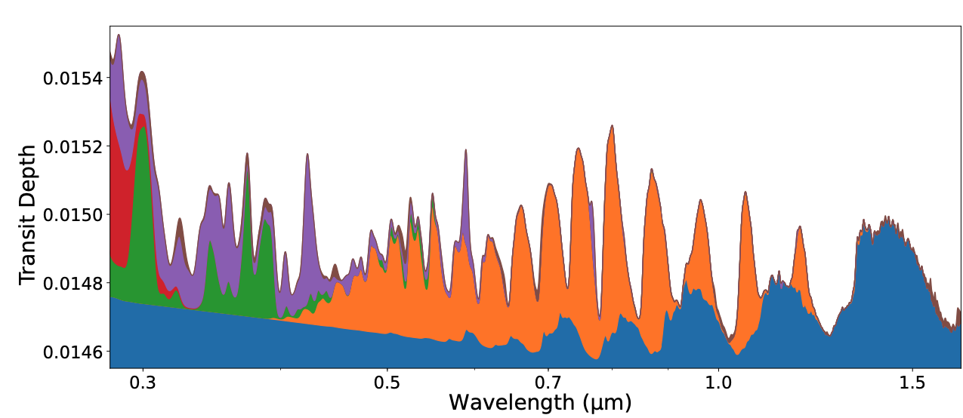
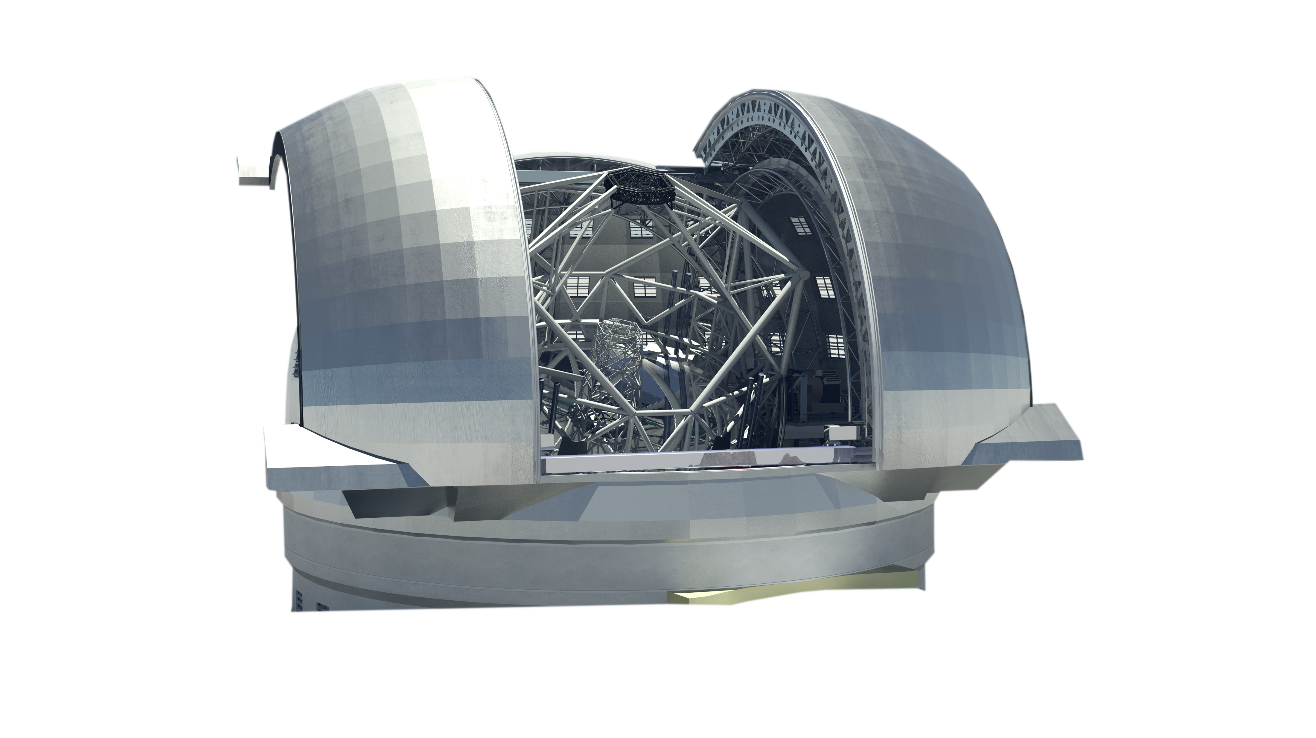
End of 2020s: prospects for (U)HJs characterization
Fe
Other
atoms
H₂O + Rayleigh
VO
2030
Fe I in KELT-9b:
> 50σ in 6 hours
Lothringer et al. (2021)
VLT ESPRESSO
ELT HIRES
1) Deep characterization of tens of (U)HJs
(chemistry, weather, TP)
2) Pushing towards smaller planets.

Slide 27
Conclusions
Comparative studies of hot and ultra-hot gas giants provide some of the best prospects to understand planet formation and evolution processes, and atmospheric structure;
The new, powerful technique of high spectral resolution (R = 100,000) phase curves is quickly emerging, and will culminate in the ELTs era.
Questions? Ideas for collaborations?
Contact me at: lorenzo.pino@inaf.it
(or find me around the room)

Slide 28
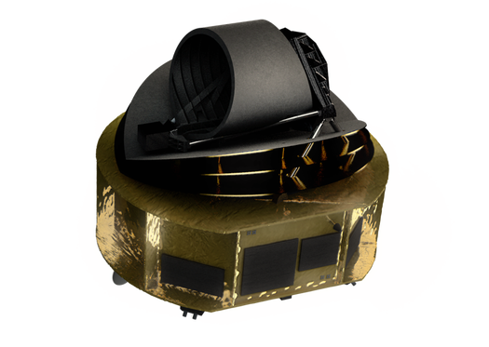
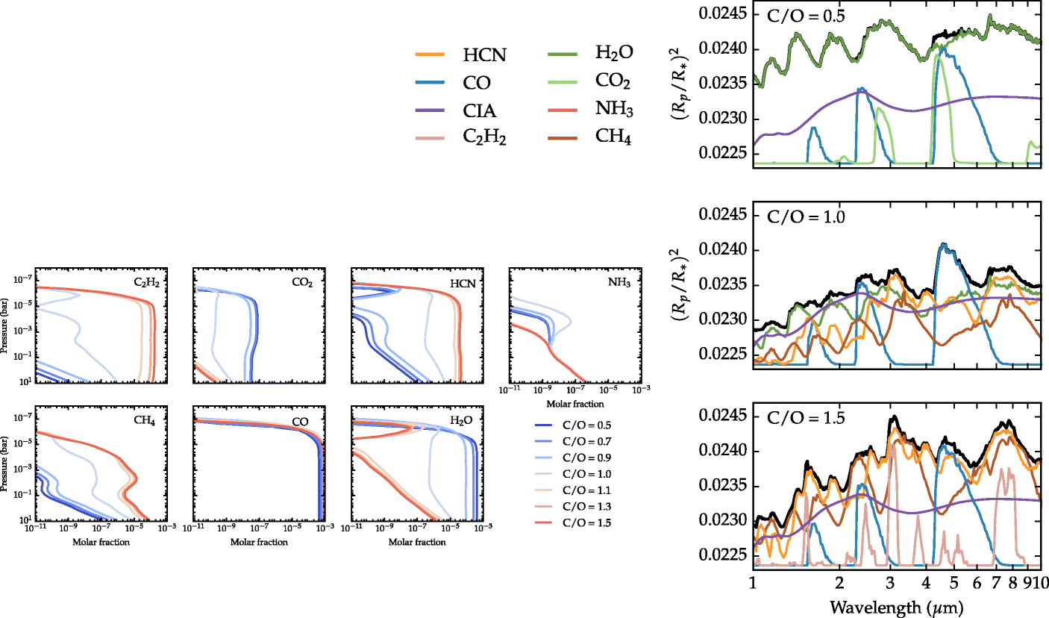
End of 2020s: prospects for (U)HJs characterization
2029
Tier 1: continua and LR chemical characterization of ∼ 1,000 exoplanets
In combination with ELTs:
abundances of tens of chemical species in (U)HJs.
Connection to planet formation theories?
Rocchetto et al. (2016)

