Slide 1
Preliminary results of atmospheric parameters varying with LT around volcanoes from PFS-MEx observations
Paulina Wolkenberg (1), Marco Giuranna (1), Davide Grassi (1), Aymeric Spiga (2), Alejandro Cardesin-Moinelo (3), Donald Merritt (3), Julia Marin-Yaseli de la Parra (3)
(1)Istituto Nazionale di Astrofisica (INAF), Istituto di Astrofisica e Planetologia Spaziali (IAPS), Rome, Italy (paulina.wolkenberg@inaf.it) (2) LMD, Paris, France (3) ESAC, Madrid, Spain

Slide 2
Outline
Planetary Fourier Spectrometer (PFS) measurements
Tharsis – map with volcanoes
Results - atmospheric parameters varying with LT
Concept of static stability, potential temperatures and their gradient
Conclusions

Slide 3
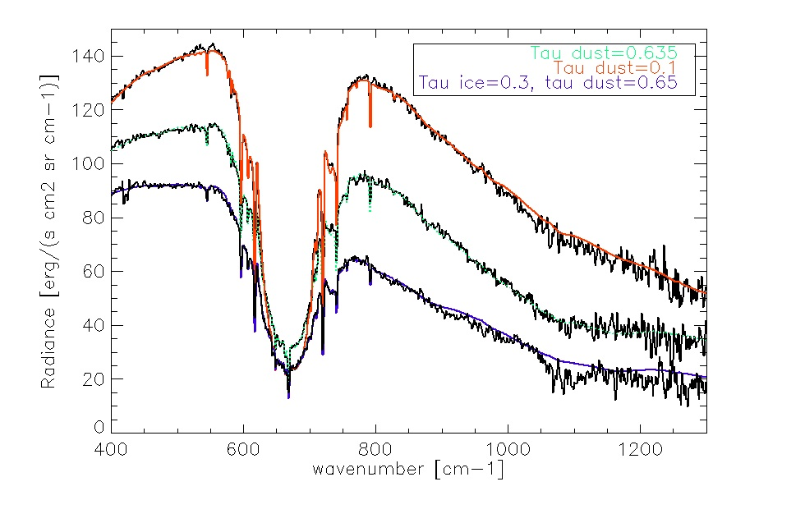
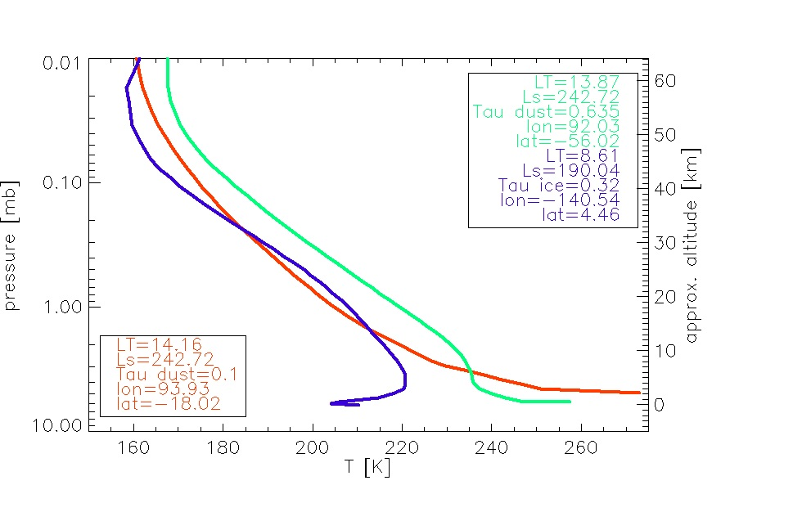
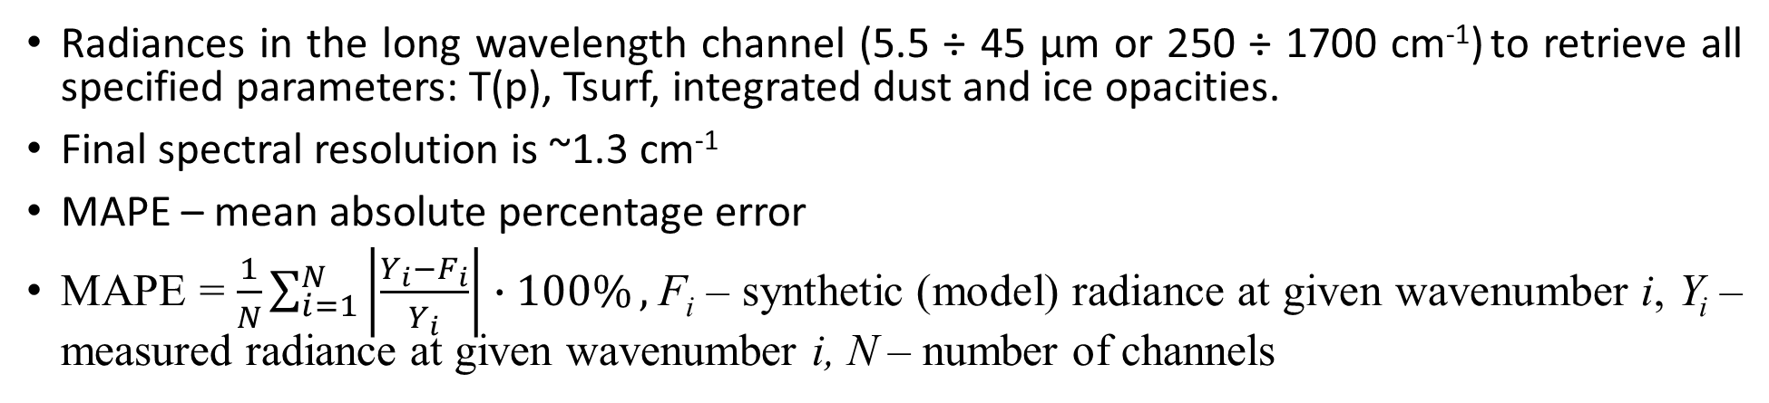
PFS measurements
Radiances in the long wavelength channel (5.5 ÷ 45 µm or 250 ÷ 1700 cm⁻¹) to retrieve all specified parameters: T(p), Tsurf, integrated dust and ice opacities.
Final spectral resolution is ~1.3 cm⁻¹
MAPE – mean absolute percentage error
MAPE = $\frac{1}{N}\sum_{i=1}^{N}{\left|\frac{Y_{i}−F_{i}}{Y_{i}}\right|∙100\%},$F_{i} – synthetic (model) radiance at given wavenumber i, Y_{i} – measured radiance at given wavenumber i, N – number of channels
CO2
dust
water ice

Slide 4
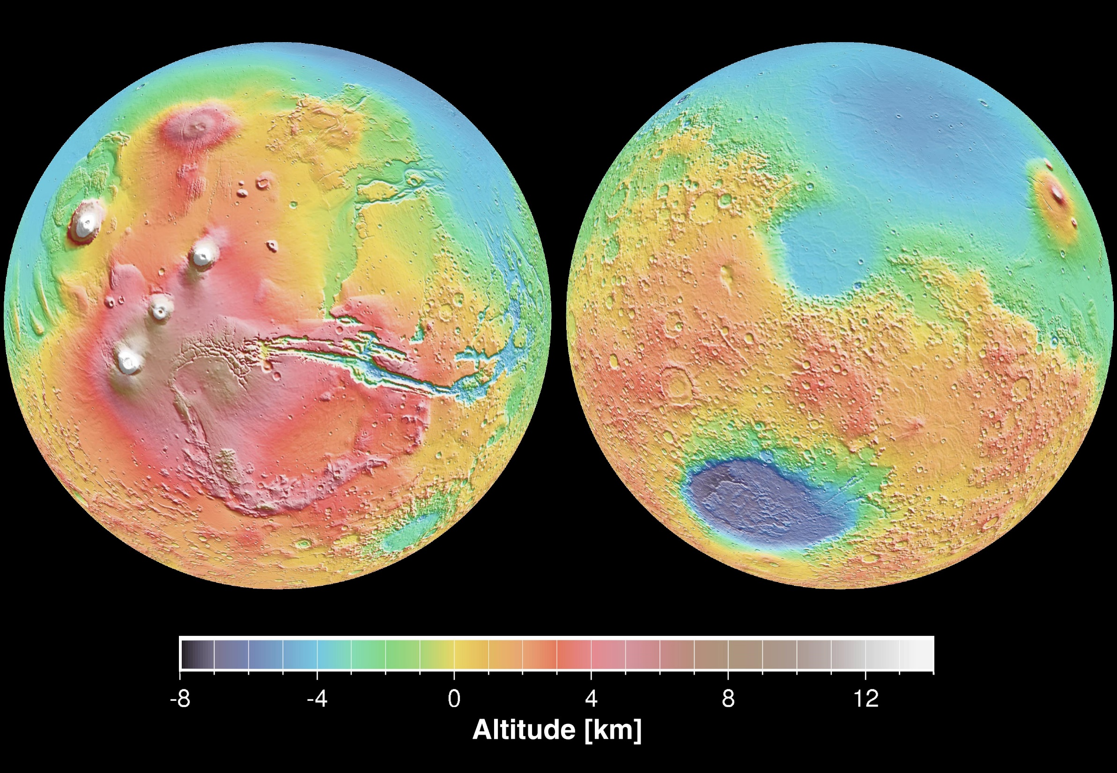
Tharsis
Olympus Mons
Ascreus Mons
Pavonis Mons
Arsia Mons
Valles Marineris
By NASA / JPL-Caltech / Arizona State University

Slide 5
Methodology – a surface pressure correction
We found that around volcanoes MAPEs were as large as 7% during the daytime and 30% during the night. This means that the model does not match well to observations. We notice an inappropriate fit mainly in the wings of the CO2 absorption band due to over- or underestimated pressures. Thus, a correction of our retrieval code on surface pressures helped a lot in obtaining better fits. Surface pressures are necessary to determine a vertical pressure grid for a retrieval from each spectrum.
Orbits in scan mode are performed where the spacecraft is quite far away from the pericenter at altitudes above 2000 km. Regarding this, the PFS field of view (FOV) is larger than at the pericenter which is very important when the spacecraft flies over volcanoes. Pressure variations are very large along the slope of volcanoes. Thus, we calculated the average of surface pressures from the whole PFS FOV and introduced into the retrieval procedure. It turned out that the model fitted better to observed spectra for orbits performed at high spacecraft altitudes. MAPEs averagely reduced to 2 – 4% during the daytime around volcanoes.

Slide 6
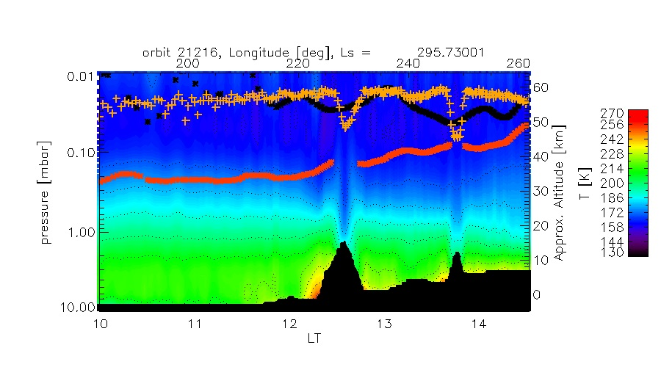
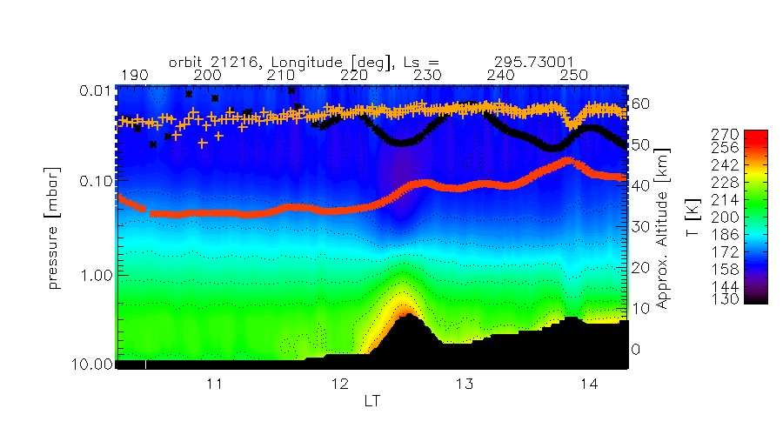
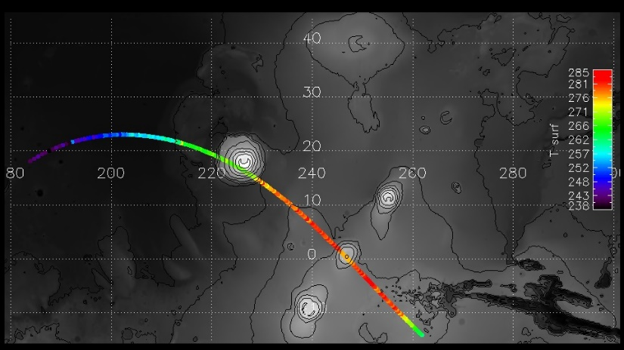
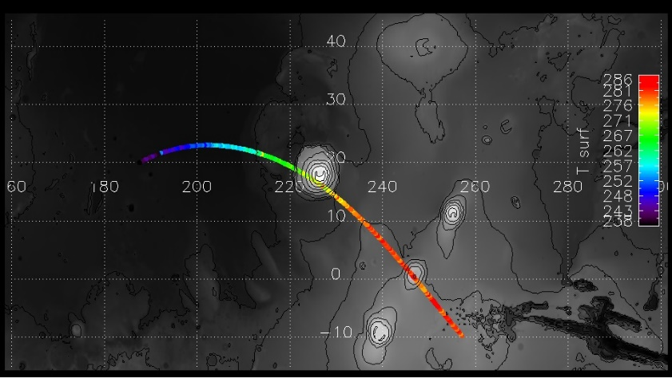
Results - atmospheric parameters varying with LT
Before correction
After correction
water ice
MAPE
dust
Olympus
Olympus
Pavonis
Pavonis
Surface temperatures
Surface temperatures
The scale of pressures also refers to dust, water ice opacities and MAPE in the upper panel. Large values of MAPE are found before correction on surface pressures.
Thermal structures around volcanes changed after correction. A cold pocket of air is observed at 40 km over volcano. A hot air is found close to the surface of the volcano slope.
A dust amount decreases with LT from 0.2 to 0.06. Small water ice opacities around 0.05 are found only over volcanoes.
Surface temperatures increase with LT along the track of orbit.

Slide 7
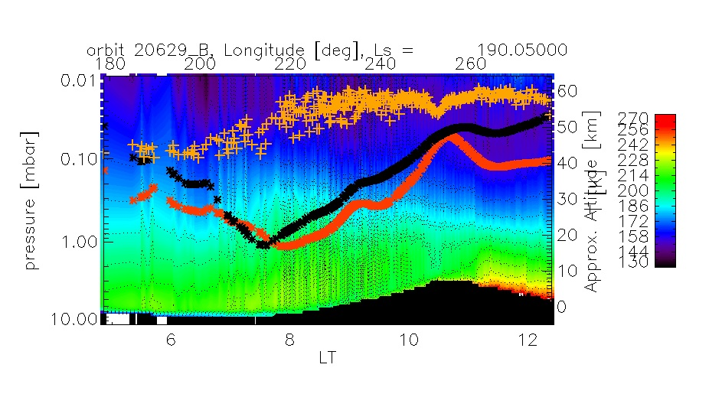
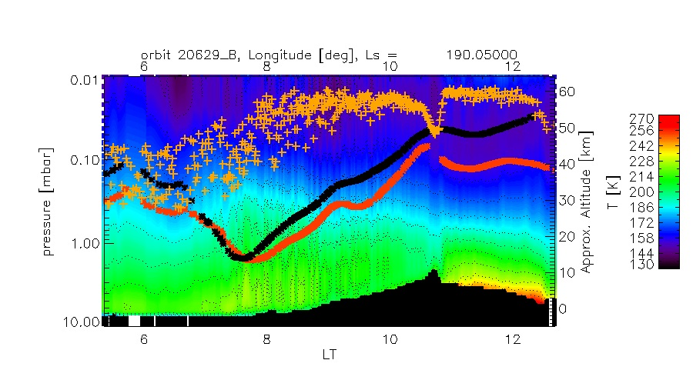
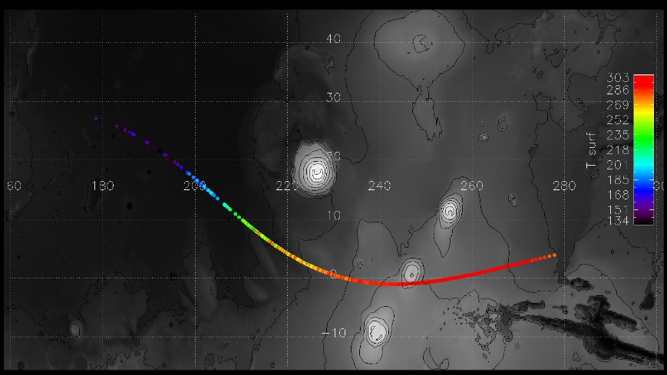
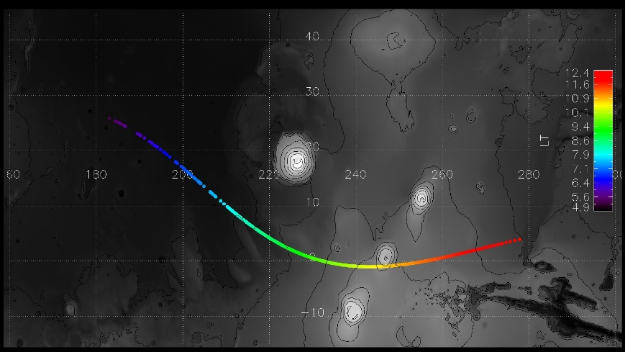
Results - atmospheric parameters varying with LT
After correction
Before correction
MAPE
water ice
dust
Olympus
MAPE (orange plus) is around 7% over volcano before correction and decreased to 3% after correction. The scale of pressures also refers to dust, water ice opacities and MAPE.
Large water ice and dust abundances (black and red lines) are observed southward of Olympus before 8 LT.
Aerosol abundances decrease with LT along the track of orbit.
Surface temperatures increase with LT accordingly.
Pavonis
Surface temperatures
LT

Slide 8
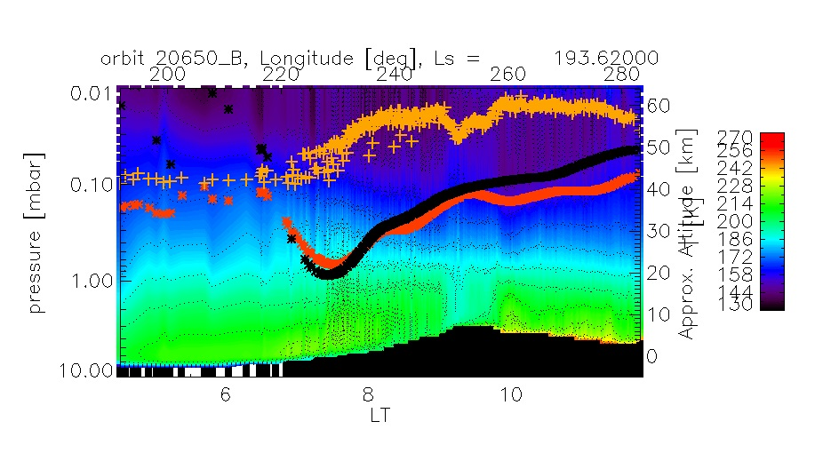
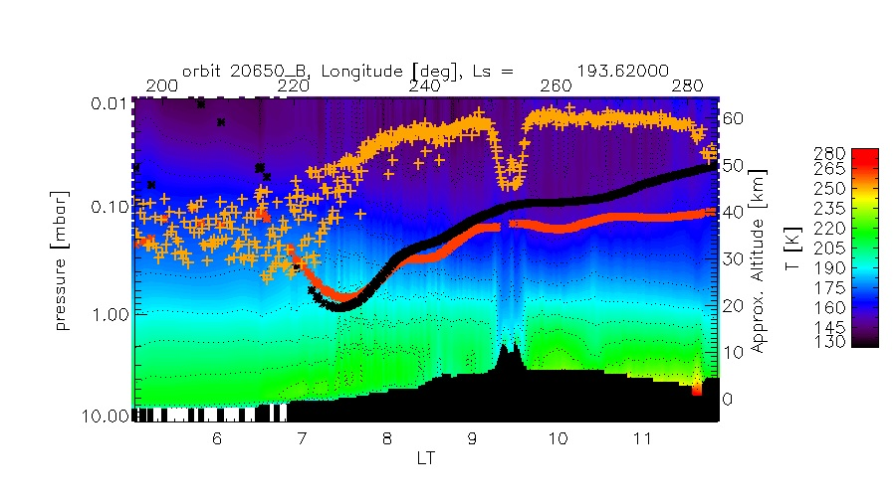
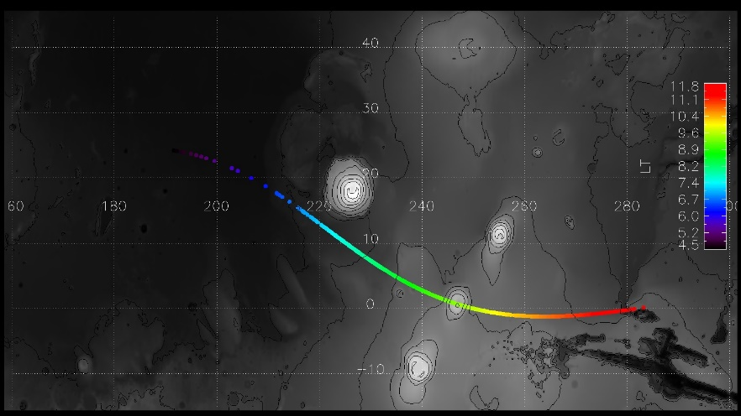
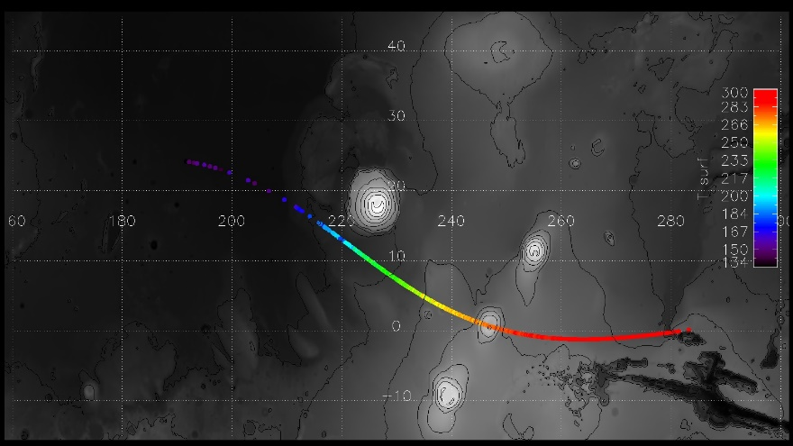
Results - atmospheric parameters varying with LT
After correction
Before correction
A large amount of water ice and dust is found southward of Olympus between 7 - 8 LT like for orbit 20629_B (previous orbit).
Similarly surface temperatures increase with LT like for orbit 20629_B.
Thermal structures over volcano differ from those before correction. A cold atmosphere is observed over volcano below 20 km of altitude. There is no cold pocket at 40 km as it was for orbit 21216.
LT
Surface temperatures

Slide 9
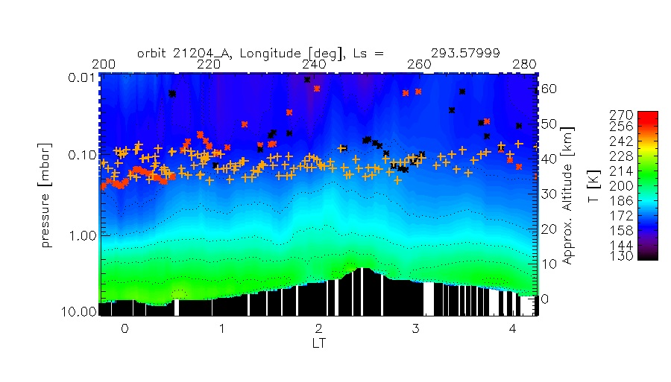
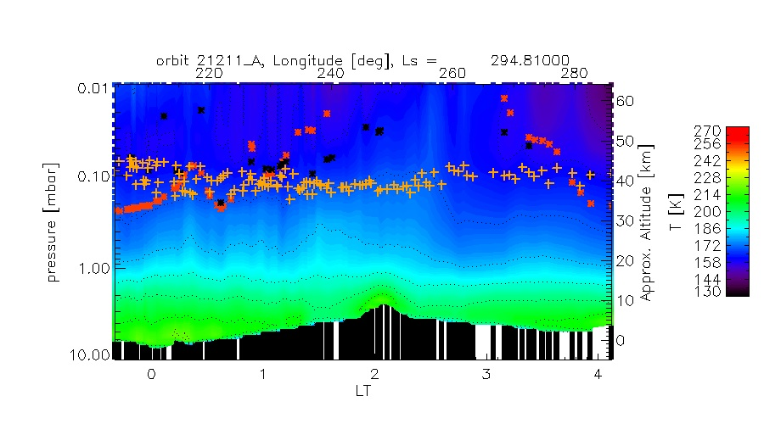
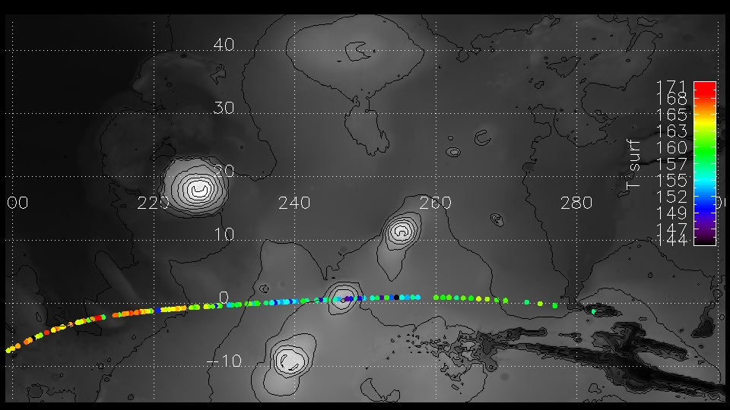
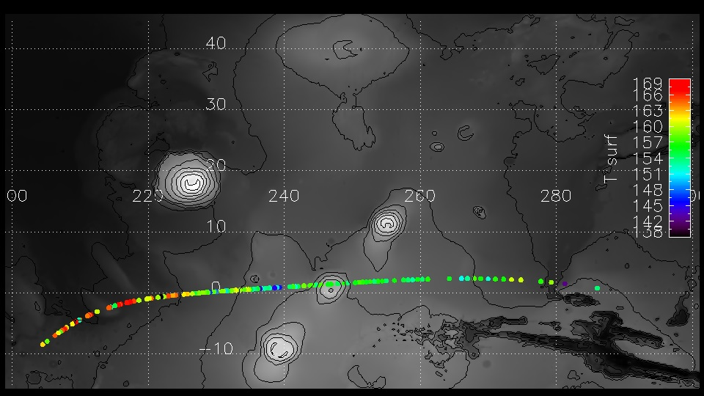
Surface temperatures
Surface temperatures
Surface temperatures decrease with LT during night. There is no dust over Pavonis Mons. Water ice opacity oscillates around 0.1 over the east slope between 2-3 LT. No water ice is observed one day after at the similar hour.

Slide 10
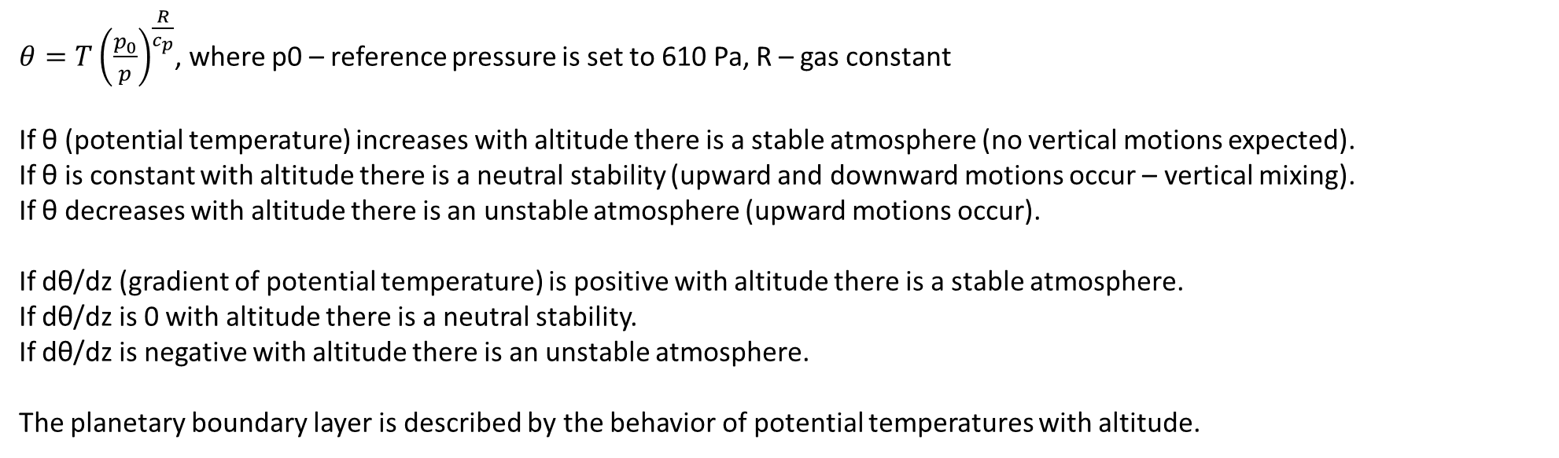
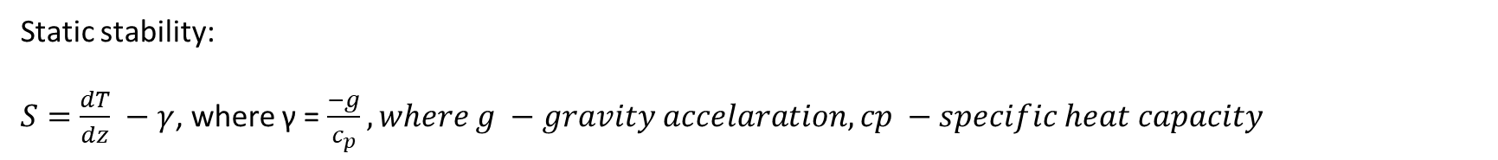
Static stability, potential temperatures and their gradients
Static stability:
$S=\frac{dT}{dz} −γ$, where γ = $\frac{−g}{c_{p}}, where g −gravity accelaration, cp −specific heat capacity$
S > 0 stable atmosphere
S = 0 neutral stability
S < 0 unstable atmosphere
$θ=T{\left(\frac{p_{0}}{p}\right)}^{\frac{R}{c_{p}}}$, where p0 – reference pressure is set to 610 Pa, R – gas constant
If θ (potential temperature) increases with altitude there is a stable atmosphere (no vertical motions expected).
If θ is constant with altitude there is a neutral stability (upward and downward motions occur – vertical mixing).
If θ decreases with altitude there is an unstable atmosphere (upward motions occur).
If dθ/dz (gradient of potential temperature) is positive with altitude there is a stable atmosphere.
If dθ/dz is 0 with altitude there is a neutral stability.
If dθ/dz is negative with altitude there is an unstable atmosphere.
The planetary boundary layer is described by the behavior of potential temperatures with altitude.

Slide 11
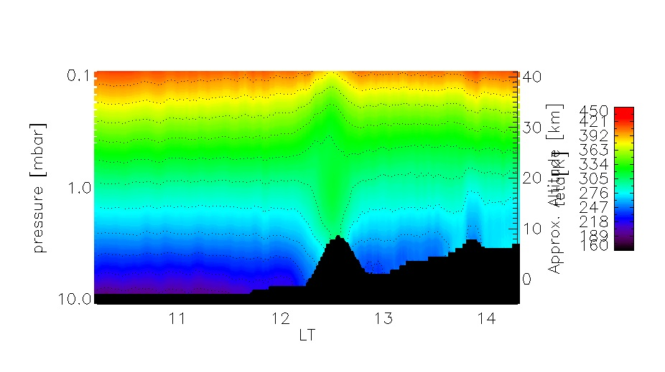
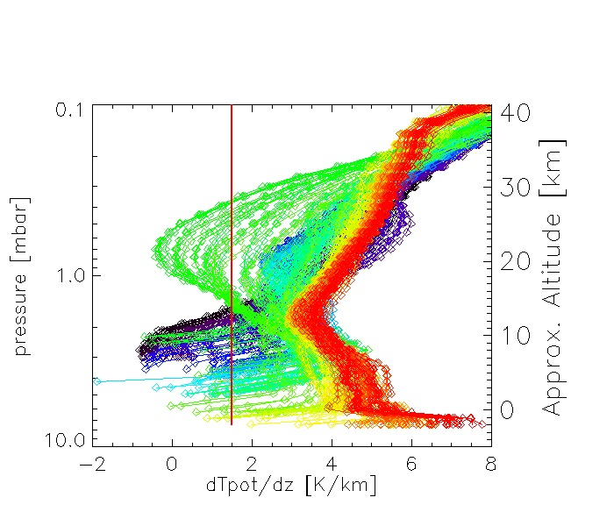
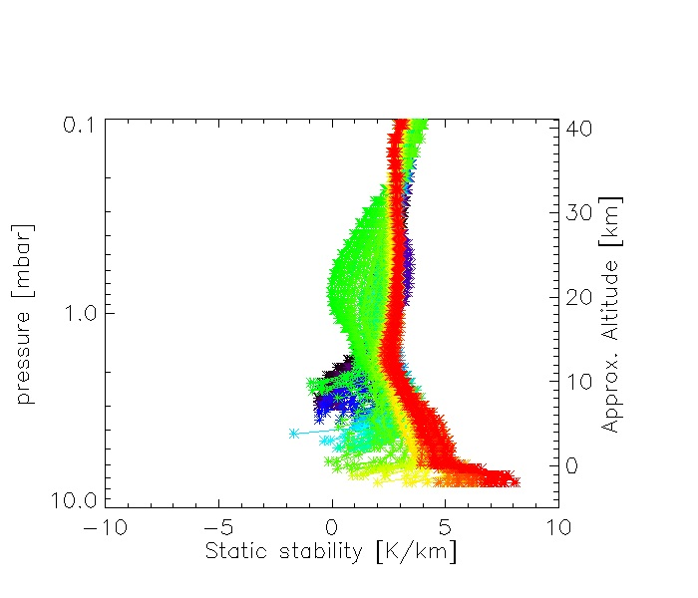
21216
Profiles of T with number 50 and 52 are taken at 273°E, 33N (dark blue) and at 339°E, 33N (light blue) from early spring (Ls = 16). Local time is 15.3 h. (Hinson et al., 2019)

Slide 12
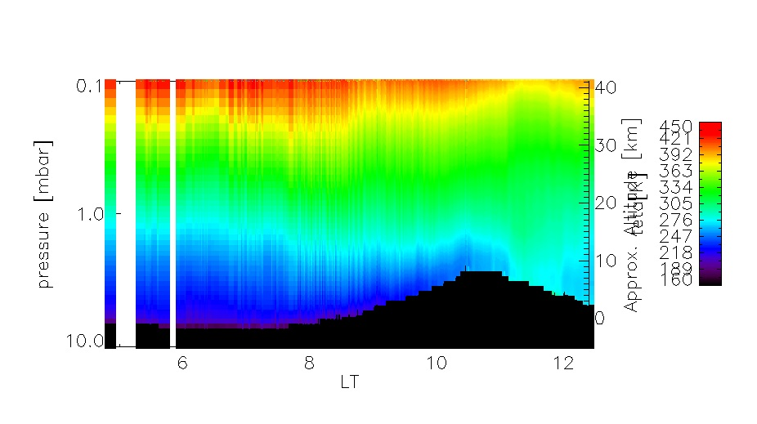
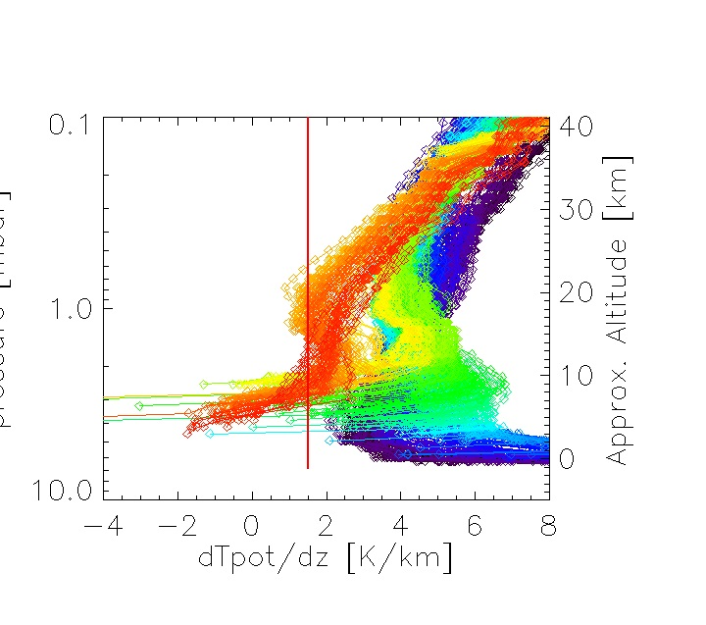
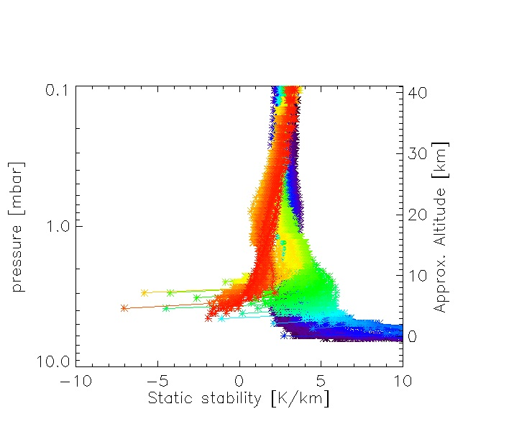
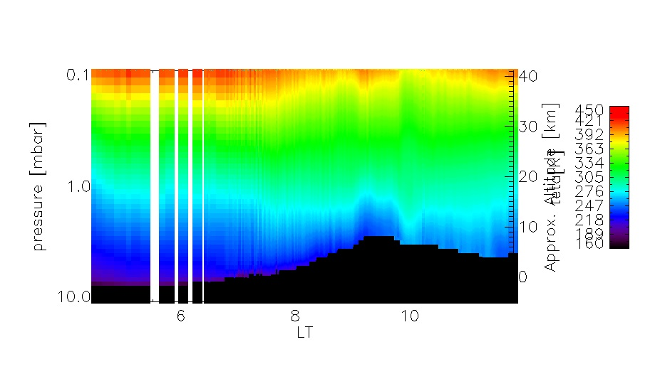
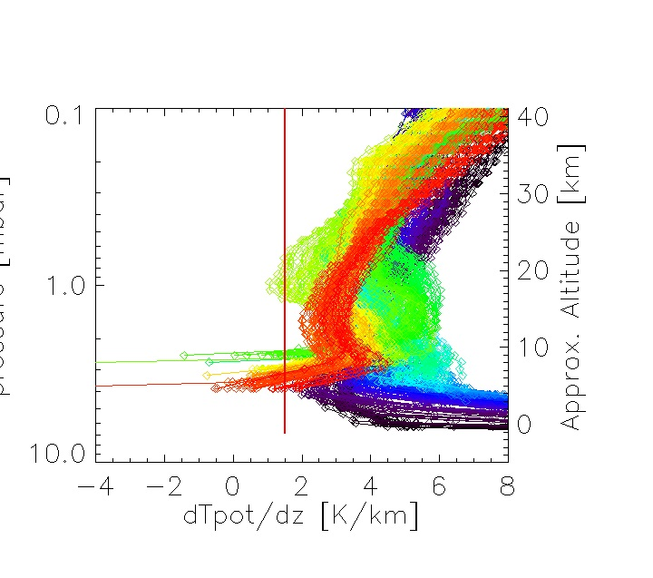
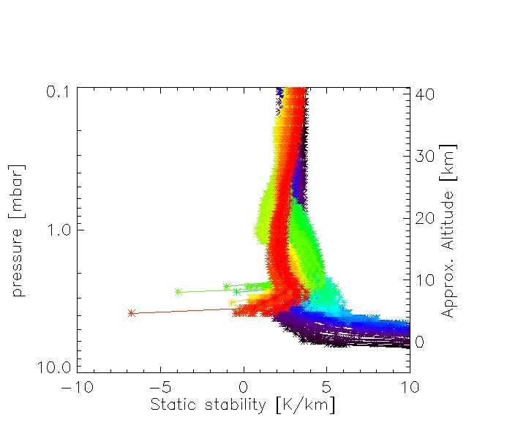
20629_B
20650_B
For both orbits we observe atmospheric layers in the neutral stability over the east slope of Pavonis Mons. However, the unstable atmosphere starts occurring over the east slope of Pavonis Mons one hour later (20629_B) than for orbit 20650_B close to the surface.

Slide 13
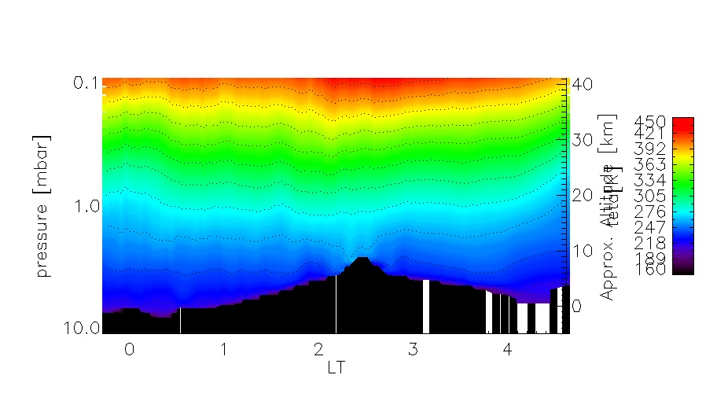
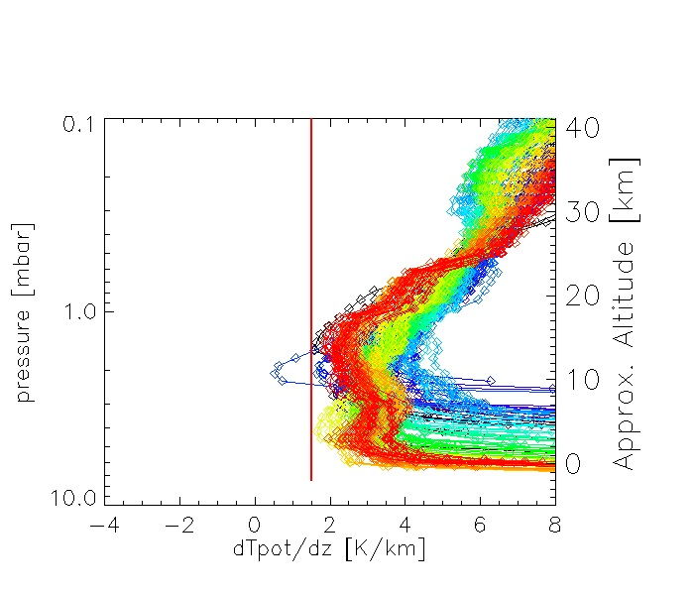
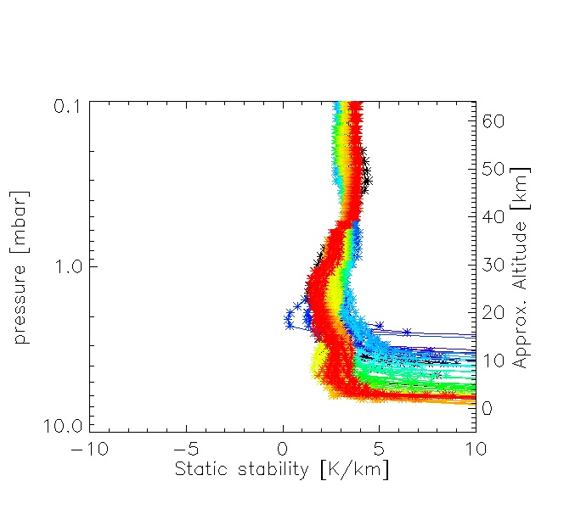
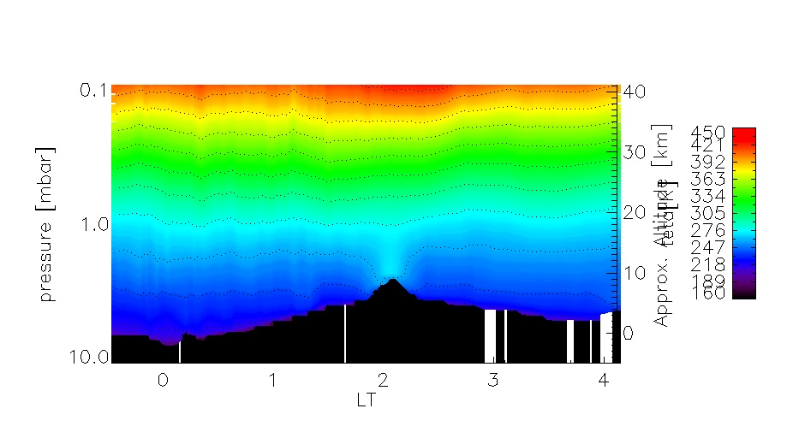
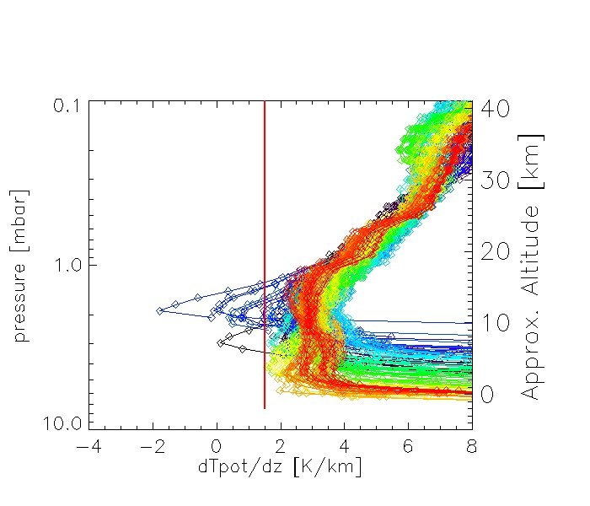
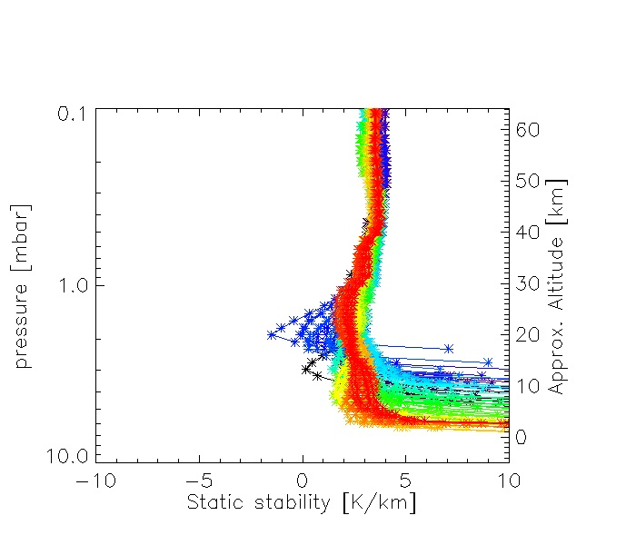
21204_A
21211_A
Night-time mixing layers over Tharsis region observed by radio-occultation measurements. (Spiga et al., 2017). The similar behavior of potential temperatures is also found over Pavonis Mons in orbit 21211_A.

Slide 14
Conclusions
After correction on surface pressures, MAPEs reduced to 2-4% during daytime over volcanoes.
The large aerosol opacities are found at 7 - 8 LT southward of Olympus at Ls = 190 and they decrease with LT.
The cold pocket of air can be observed over Olympus at 40 km between 12 – 13 LT.
Surface temperatures decrease with LT during night and increase with LT during day.
We observe vertically mixed layers over volcanoes along with thin unstable atmospheric layers.

